Slide 1
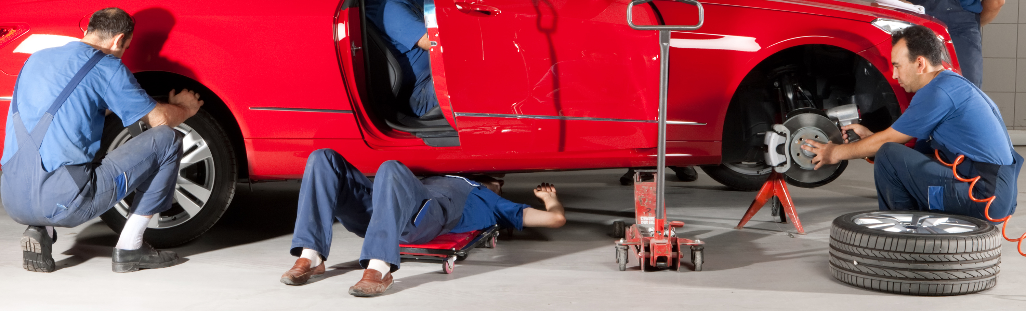

Conversations involve breakdown and repair.
Let’s fix this.

Slide 2








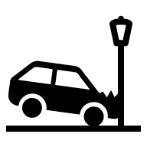
What tools can we use to fix a communication breakdown?
look carefully
say it again
take your time
stay calm
check:
do you know what I mean?
stop
put the brakes on
is your listener confused

