Slide 1

Universal Provision Training
Speech, Language and Communication

Slide 2
Aims
Promote awareness of the critical role speech and language development plays in every child’s learning journey across the school.
Provide staff with practical knowledge and strategies to enhance Universal Provision for speech and language support.
Foster strong partnerships with families to collaboratively support children’s communication development.

Slide 3
Objectives
Summarise the key findings and recommendations from the Bercow Review (2008/2018)-understand their implications for current school practice
Identify what constitutes effective universal provision for SLCN-reflect on current practice in own settings. Explore practical strategies to support SLCN in the classroom through quality first teaching.
Carry out an SLCN environment audit in their classroom or school-Using the Better Communication Research Programme (2012) observation tool.
Better understand the difference between Speech, Language and Communication Difficulties.
Working collaboratively with parents and families- working together on effective approaches.
Plan next steps-to improve Universal Provision for SLCN within the setting.

Slide 4

Group Activity
Participants need to put the sentence together and follow the instruction.
Notes:
Provide a sentence with an instruction on, it must have lots of the, and, on, in etc to work. Cut sentence up into words. They have only two minutes to do this.
However, here is the catch, throw the words up in the air and only the words they catch can be the ones the use to understand the question.
Example sentence: If you are standing near someone wearing red, give them a high five, but if not, wave both hands in the air twice

Slide 5

Why did we ask you to do this?
Feedback-what was difficult, how did you feel?
This activity can highlight key areas of Speech, Language and Communication development.
Notes:
Listening and attention- you had to focus, listen and try to work together.
Understanding sentence structure- you needed some awareness of grammar and how word order affects meaning.
Following instructions-You had to follow my verbal instructions and then the written instructions, not only understanding but then following them through.
Social interaction- making a connection with each other, listening, compromise, negotiation and responding to each other.
Why it was challenging: Difficulty remembering long instructions-holding lots of information. However you had some pieces of information missing for you to totally understand the whole meaning.
The use of if, then and but introduces conditional language that can make understanding more difficult.
Processing word order and how it may change the meaning was difficult.
Social and interaction skills, time restriction adding a pressure to the situation.
From: Communication and Mental Health — CAMHS
Many of us take our communication skills for granted. However, approximately 10% of children and young people will have a speech, language, or communication need (SLCN). Approximately 7.6% have developmental language disorder (DLD) and the remaining can have difficulties associated with another condition such as autism or a hearing impairment.
That’s about 3 children in every classroom. The young people most affected often need support from a speech and language therapist or someone with more specialist training.
This 10% also includes those children where English is a second language, but when they have struggled to acquire skills even in their home language.
Children who have English as a second language can have developmental language disorder. DLD affects all languages the child speaks.
Left unidentified, SLCN can have a range of negative consequences. They may affect:
Social, emotional, mental health, attainment, relationships, and employment
Behaviour: Many children with unmet or unidentified SLCN communicate through behaviour which can lead to exclusion from school, offending behaviour and involvement in the criminal justice system.
Children and young people with an SLCN are five times more likely to have a mental health need.
With the right support around them, young people with speech, language and communication needs can learn, build relationships and access employment.

Slide 6
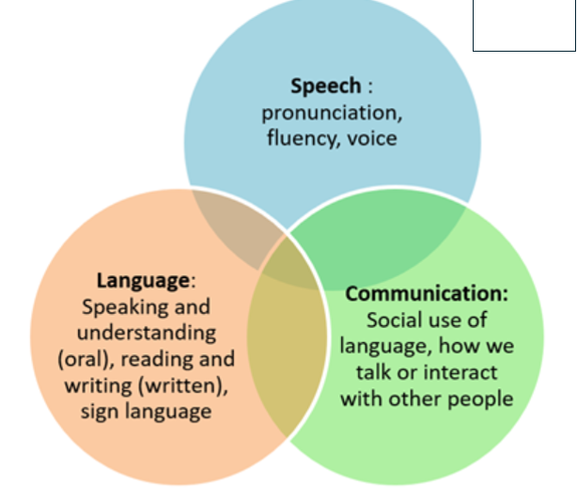
Speech, Language and Communication Needs
Notes:
From: Communication and Mental Health — CAMHS
A young person can have specific difficulties using clear and intelligible speech. Others may have specific difficulties understanding and processing the words and sentences they hear (language). Other young people may have more problems using language and non verbal skills to interact and communicate for social reasons. There is also considerable overlap. For example, someone with unclear speech may also find it difficult to interact with other people because of an awareness of their difficulties. Someone else may struggle to understand words and sentences and as a result may respond inappropriately in a conversation affecting their social skills. Someone else might have difficulties finding the words they want to say and also present with a stammer (be less fluent).
What do we mean by speech, language and communication?
Speech refers to:
Speaking with a clear voice, in a way that makes speech interesting and meaningful
Speaking without hesitating too much or without repeating words or sounds
Being able to make sounds like ‘k’ and ‘t’ clearly so people can understand what you say
Language refers to:
Knowing and choosing the right words to explain what you mean
Joining words together into sentences, stories and conversations
Making sense of what people say Needs diagram
(Communication refers to:
Using language or gestures in different ways, for example to have a conversation or to give someone directions
Being able to consider other people’s point of view
Using and understanding body language and facial expressions, such as:
Knowing when someone is bored
Being able to listen to and look at people when having a conversation
Knowing how to take turns and to listen as well as talk
Knowing how close to stand next to someone)

Slide 7
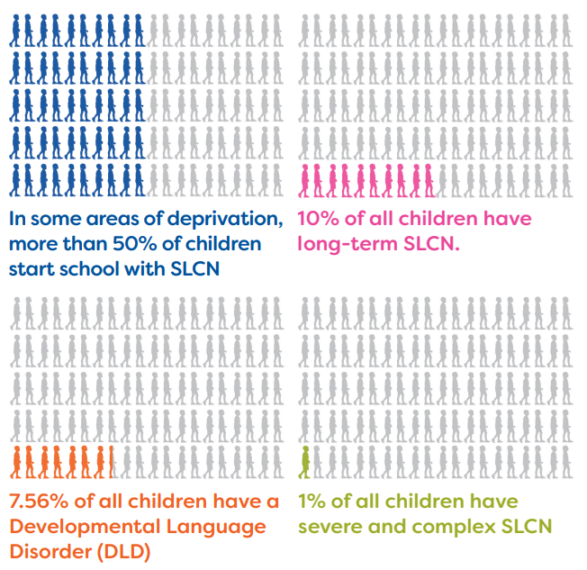
Prevalence of SLCN
Royal College of Speech and Language Therapists-2019
Notes:
Understanding prevalence (how many children are affected by SLCN ) can help schools plan support, staff training and early identification strategies.
On 4 July 2019 the Department for Education published the latest statistics on special educational needs in England.1 These revealed: • Speech, language and communication needs (SLCN) is now the most common primary type of need, at 22% of SEN pupils. • SLCN is the most common type of primary need for pupils on SEN support, at 23%. • But only 15% of pupils with SLCN have an education, health and care (EHC) plan
Royal College of Speech and Language Therapists-2019
There is a clear correlation between pupils who are more likely to have persistent and severe absence, and the prevalence of speech, language and communication needs (SLCN). This includes children living in areas of social disadvantage, pupils with SEND, those in alternative provision and those in touch with social care services.

Slide 8
Impact of SLCN
UK studies estimate that 60% of the youth offending population has SLCN (Gregory and Bryan, 2011), six times that of the general population (Norbury et al, 2016). While the exact prevalence of SLCN within the adult justice system is uncertain, there is evidence of an above average prevalence rate (Iredale et al, 2011).
Notes:
Long Term Impact of SLCN (links between speech, language, and communication needs (SLCN) and social disadvantage: Feb 2013-The All Party Parliamentary Group (APPG) on Speech and Language Difficulties was formed following the publication in 2008 of the report from the Bercow review
They stated:
School Readiness and Performance: SLCN affects literacy, school performance, and long-term outcomes in mental health and employment.
Early Identification: Teachers' assessments at age 5 can identify children at risk, but regular checks are necessary.
Support for Disadvantaged Children: Additional early years support is crucial for children from disadvantaged backgrounds.
Emotional and Social Needs: Provision should reflect the need for support in peer relationships and emotional wellbeing.
Evidence Base for Interventions
Universal Provision: Effective oral language environments and regular monitoring are essential.
Professional Development: Training for practitioners to deliver improved universal provision, especially in disadvantaged areas.
Evidence-Based Interventions: Interventions should be underpinned by evidence of effectiveness and fit into a coherent service delivery model.
Collaborative Working
Joint Commissioning: Collaboration between education, health, and social care services is crucial.
Equity of Access: Address variations in identification practices and support levels.
Health Visitor Training: Ensure health visitors are properly trained in relation to SLCN.
Integrated Reviews: Combine Healthy Child Programme reviews with Early Years Foundation Stage summaries for integrated assessments.
Conclusions
Promote Oral Language Development: Home and school environments are vital.
Regular Monitoring: Ensure children do not fall through the net.
Focus on Social Communication: Target social communication to reduce teenage behavioral problems.
Professional Development: Provide training and coaching for practitioners.
Collaborative Practice: Encourage joint commissioning and effective collaboration.

Slide 9
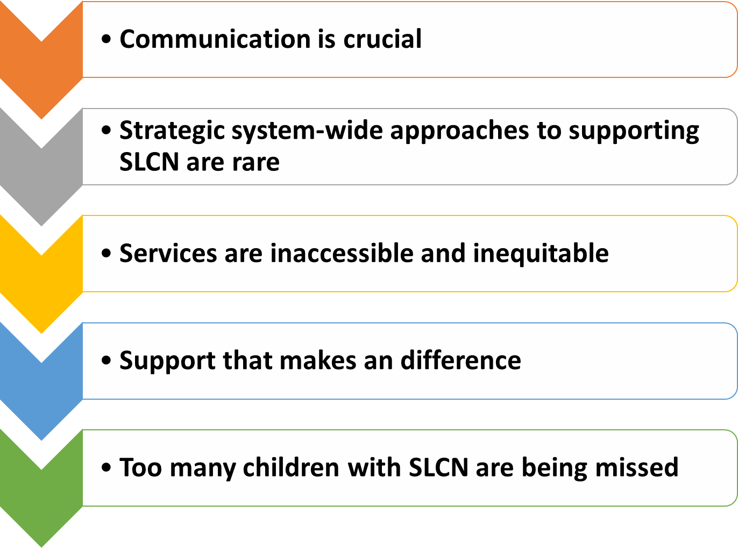
Bercow Review (2008) Findings:
Summary of the Bercow Review, led by John Bercow 2008
Notes:
The Bercow Review, led by John Bercow in 2008, was an independent review of services for children and young people with speech, language, and communication needs (SLCN) in England. The review highlighted the importance of communication skills for children's life chances and identified significant gaps in the support provided to those with SLCN.
Key Findings and Recommendations:
Communication is Crucial: Emphasized the fundamental role of communication in children's development.
Early Identification and Intervention: Stressed the need for early detection and support for children with SLCN.
Continuum of Services: Recommended a range of services designed around the needs of families.
Joint Working: Highlighted the importance of collaboration between different services and professionals.
Equity and Accessibility: Addressed the variability and lack of equity in the existing system1.
Impact:
The review led to several significant changes:
Creation of the Communication Council: To oversee the implementation of the review's recommendations.
Appointment of a Communication Champion: Jean Gross CBE was appointed to promote the importance of communication.
National Year of Speech, Language, and Communication (2011): Raised awareness and promoted best practices.
Better Communication Research Programme: Enhanced the evidence base for effective interventions1.
In 2018, the Bercow: Ten Years On report reviewed the progress made since the original review. It found that while there had been improvements, many challenges remained, including insufficient resources and variability in service provision.
1. Communication is Crucial
Communication is a core life skill, essential for learning, relationships, and well-being.
It needs to be recognized as a priority by everyone—parents, educators, and policymakers.
Early Identification and Intervention are Essential
Spotting speech, language, and communication needs (SLCN) early leads to better outcomes.
Delays in support can negatively affect education, social development, and mental health.
Family-Centered Services
Services should be designed around the needs of children and their families.
Support must be accessible, especially during key life transitions (like starting school).
Its about building a culture where everyone feels responsible for communication development.
Joint Working is Critical
Health, education, and social care professionals must work together.
Integrated services ensure children don’t fall through the gaps.
Equity in the System
Access to support varies widely depending on where a child lives (a “postcode lottery”).
National standards are needed to ensure fairness and consistency.

Slide 10
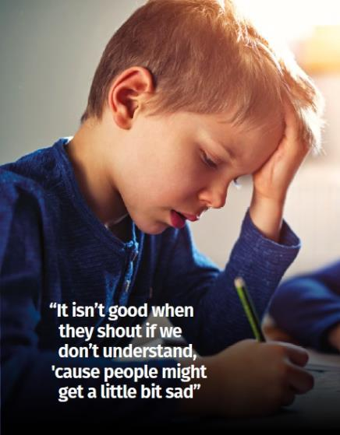
The voice of children and young people
Bercow Review: 10 years on
Notes:
In 2018, the Bercow: Ten Years On report reviewed the progress made since the original review. It found that while there had been improvements, many challenges remained, including insufficient resources and variability in service provision
Led by the children’s communication charity I CAN and the Royal College of Speech and Language Therapists (RCSLT), the review aimed to assess progress since 2008 and identify ongoing challenges in SLCN provision
Key Findings
Communication is Still Undervalued
Despite being essential for learning and life, communication remains a low priority in public policy and education.
77% of parents said information about SLCN was hard to find or unavailable 2
.
Support is Inconsistent and Often Inadequate
Many families described the process of getting help as “long, harrowing and tortuous.”
There is a “postcode lottery” in service availability and quality.
Lack of Strategic Leadership
SLCN is rarely included in national or local strategies.
95% of respondents felt the government’s role in improving outcomes was unclear or weak 2
.
Impact on Life Chances
Poor communication support affects education, employment, and mental health.
In some disadvantaged areas, up to 50% of children start school without the language skills needed to learn2
.
Need for Systemic Change
The report called for a national strategy, better training for professionals, and more consistent funding and commissioning of services.
✅ Recommendations
Make communication a priority in education and health policy.
Improve access to information and services for families.
Ensure consistent, evidence-based support across all regions.
Invest in workforce development and training

Slide 11
Good practice...
Group Discussion
From your background and experience, can you identify good practice in the area of SLCN in your school?
What would a system wide approach to SLCN look like in your school?
Notes:
Share in small groups
Summary and Recommendations-(links between speech, language, and communication needs (SLCN) and social disadvantage: Feb 2013-The All Party Parliamentary Group (APPG) on Speech and Language Difficulties was formed following the publication in 2008 of the report from the Bercow review)
Importance of Home and School Environments: Effective promotion of oral language development is crucial for socially disadvantaged children.
Training and Monitoring: Comprehensive training for practitioners and improved systems for monitoring children's communication skills over time are recommended.
Service Delivery: Services should be driven by the nature and severity of children's needs rather than diagnostic categories or parental expectations.
Targeted Support: Additional support is needed to improve communication environments for children in socially deprived areas.
National Framework: A national framework for local authorities' offers should cover education, health, and social care services for all children with SLCN.
Prompt them to think about training, screening, policy, family partnerships and tracking outcomes. Data ect……

Slide 12

How will we know if a child has SLCN?
How will a child with SLCN present in the classroom?
Notes:
Take ideas in groups

Slide 13
Challenges for young people with SLCN
Difficulties listening to and understanding complex information, understanding idioms and words with ambiguous meaning.
Limited understanding of vocabulary
Difficulties with concepts of time, creating narratives and re-telling events in a logical sequence
Difficulties altering the register of language used
Difficulties with working memory and processing speed
Difficulties with inferring information
Notes:
Clear links with cognition and learning and potential SEMH

Slide 14
What is the impact of speech, language and communication needs?
The impact of speech, language and communication needs on children will vary according to the severity of the problems, and may affect some or all of the following areas:
● social and emotional development;
● making friends;
● learning appropriate behaviour skills;
● accessing play and learning opportunities;
● further development of language skills;
● development of skills in literacy, mathematics and other areas of the curriculum.
Notes:
Learning, emotional health, self-esteem etc

Slide 15

Flourishing Communicators
Social skills
Understanding
Needs met by adults
Play
Listening and attention
Notes:
What do you already do to help communication to flourish in your setting?

Slide 16
Word Cloud
Free online word cloud generator and tag cloud creator - WordClouds.co.uk
Notes:
What do you already do to help communication to flourish in your setting?

Slide 18
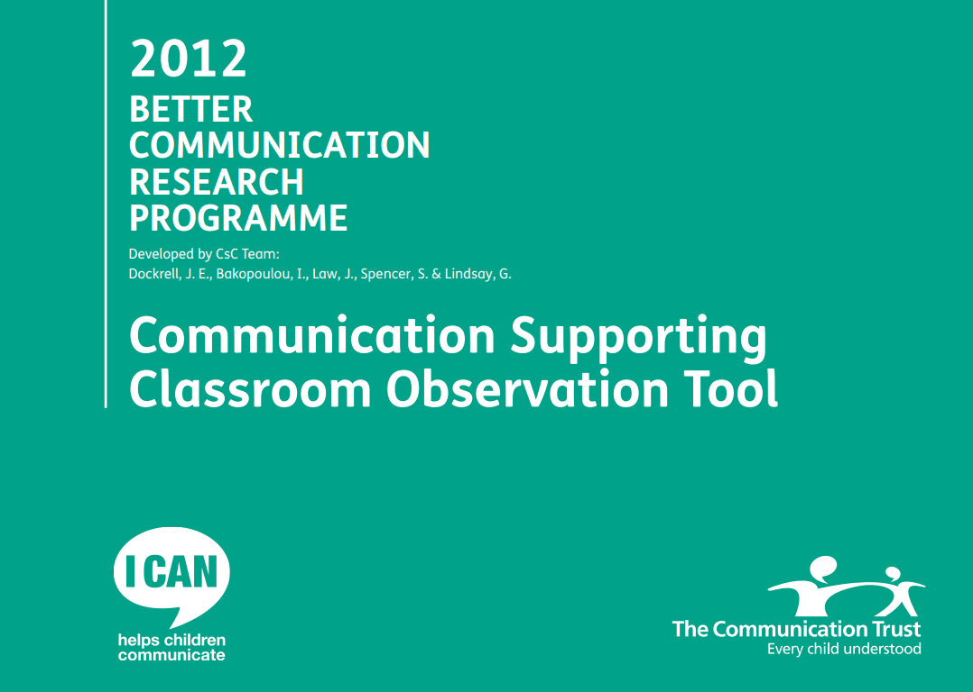
SLC Universal Provision
Environment
Opportunities
Interactions
Notes:
Audit came from Bercow review, broken down into 3 areas. Aimed initially at Nursery, foundation, years 1 and 2, but no reason not to use it across school!
Audit includes a section for each area about what to consider where there are gaps in provision noted once the audit is completed. These are the Quick Wins!

Slide 19
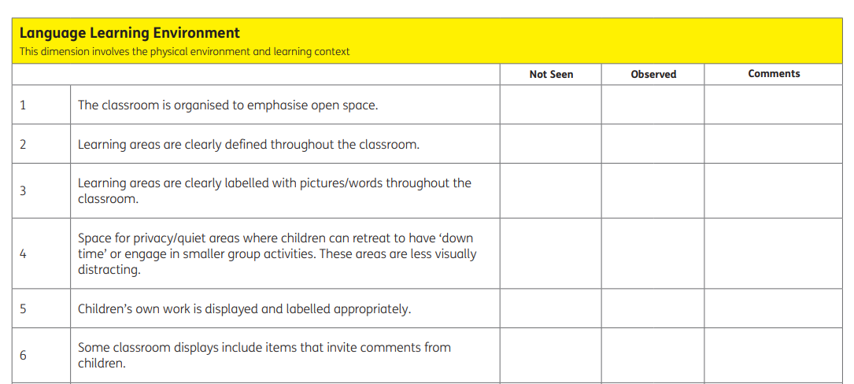
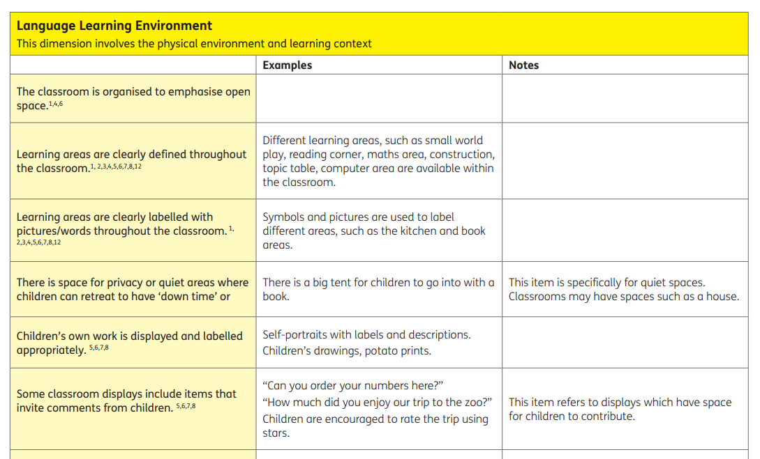
Language Learning Environment
Notes:
This dimension involves the physical environment and learning context

Slide 20
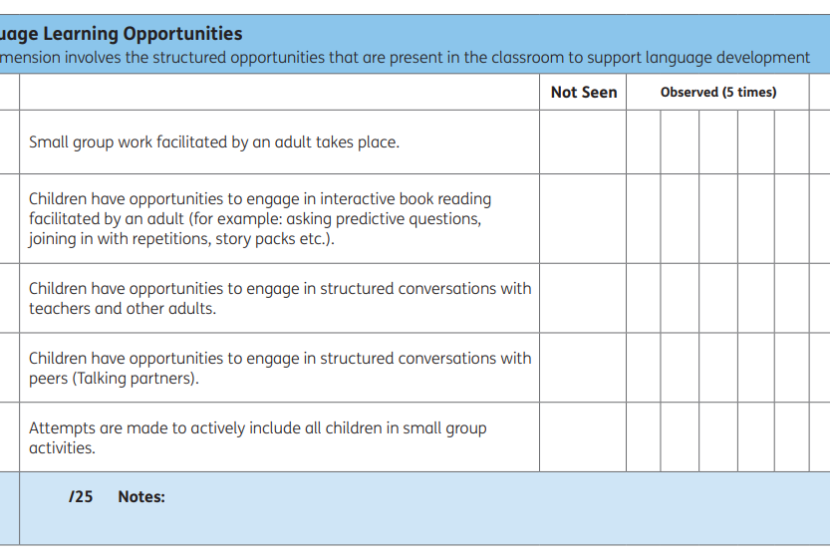
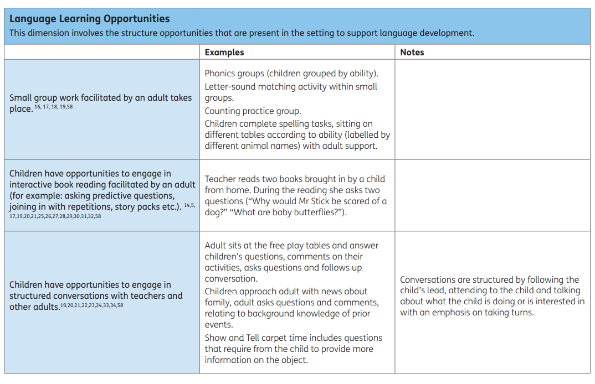
Language Learning Opportunities
Notes:
This dimension involves the structured opportunities that are present in the classroom to support language development

Slide 21
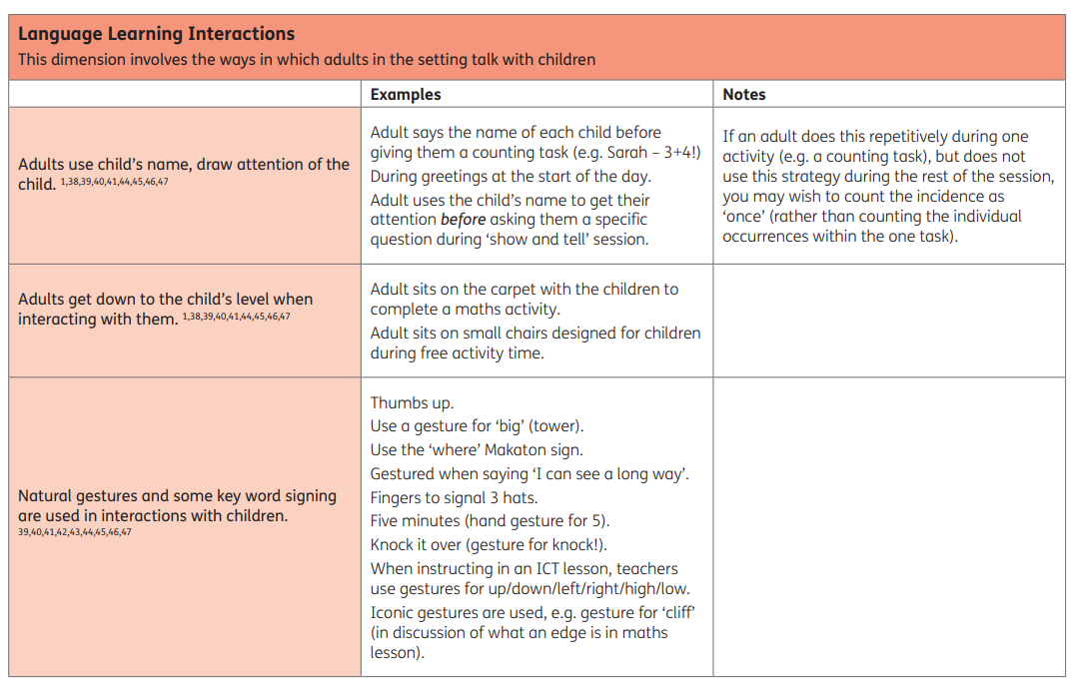
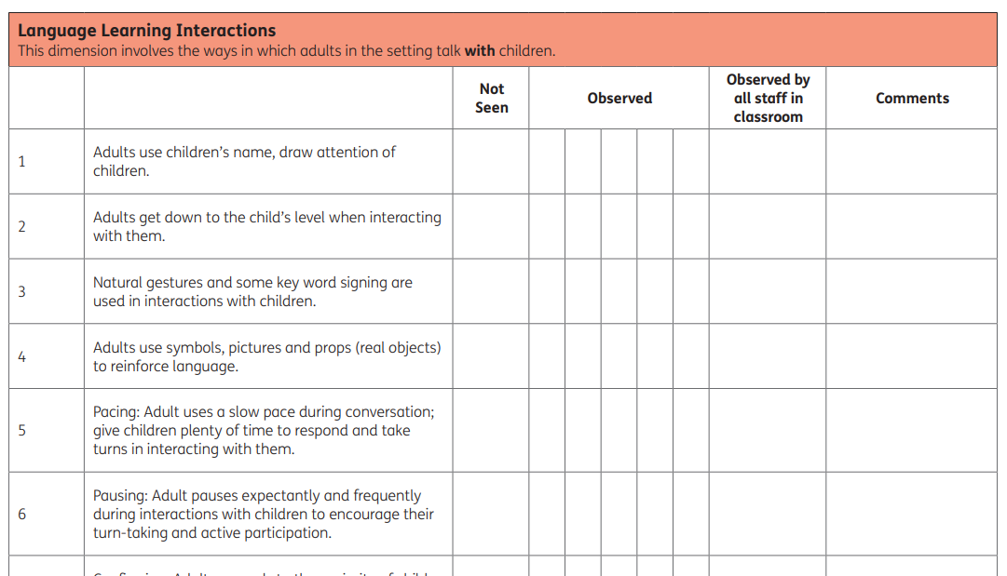
Language Learning Interactions
Notes:
This dimension involves the ways in which adults in the setting talk with children.
How might you use the data from these audits in school? Suggested the audit is completed by somebody other than class teacher.

Slide 22
School and Family Collaborative Practice
What would you wish ALL parents did at home for their children?
How do you remind parents of this?
Parents collaborating to support each other
How would you help all families to access information about this if their support networks are limited?
Coffee Mornings
Trainings
Posters/Display
Resources

Slide 23
Aims and Objectives (Expanded)
Understand the importance of SLC development.
Recognize signs of SLCN in the classroom.
Explore the impact of SLCN on learning and wellbeing.
Learn how to use the Better Communication 2012 audit tool.

Slide 24
Better Communication 2012 Audit Tool
Brief overview of the tool.
How to use it in practice.
Example audit questions.
How to interpret results and plan 'Quick Wins'.

Slide 25
Case Study or Scenario
Present a short case study of a child with SLCN.
Ask participants to identify needs and suggest universal strategies.

Slide 26
Universal Strategies
Visual timetables
Pre-teaching vocabulary
Adult modeling of language
Reducing background noise
Giving processing time

Slide 27
Reflection and Action Planning
What will you take back to your setting?
What one thing will you try/change?

Slide 28

Parent and Family collaboration.
Parent workshops-How to support speech and language at home.

Slide 29
Thank You & Next Steps
Contact info
Further reading/resources
Invite feedback

