Slide 1
































3. Naming
EY and KS1 Resources

Slide 2




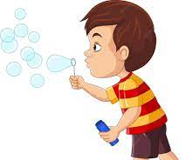
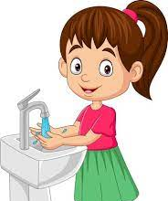


4. Verbs
EY and KS1 Resources

Slide 3









5. Guessing game
1
2
3
EY and KS1 Resources

Slide 4


6. Describing
EY and KS1 Resources

Slide 5
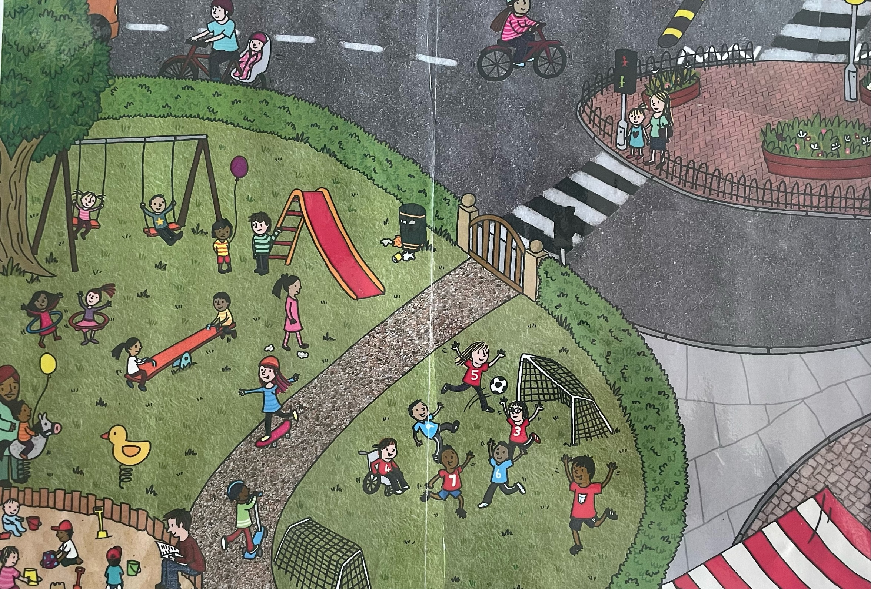
7. Park
EY and
KS1 Resources

Slide 6
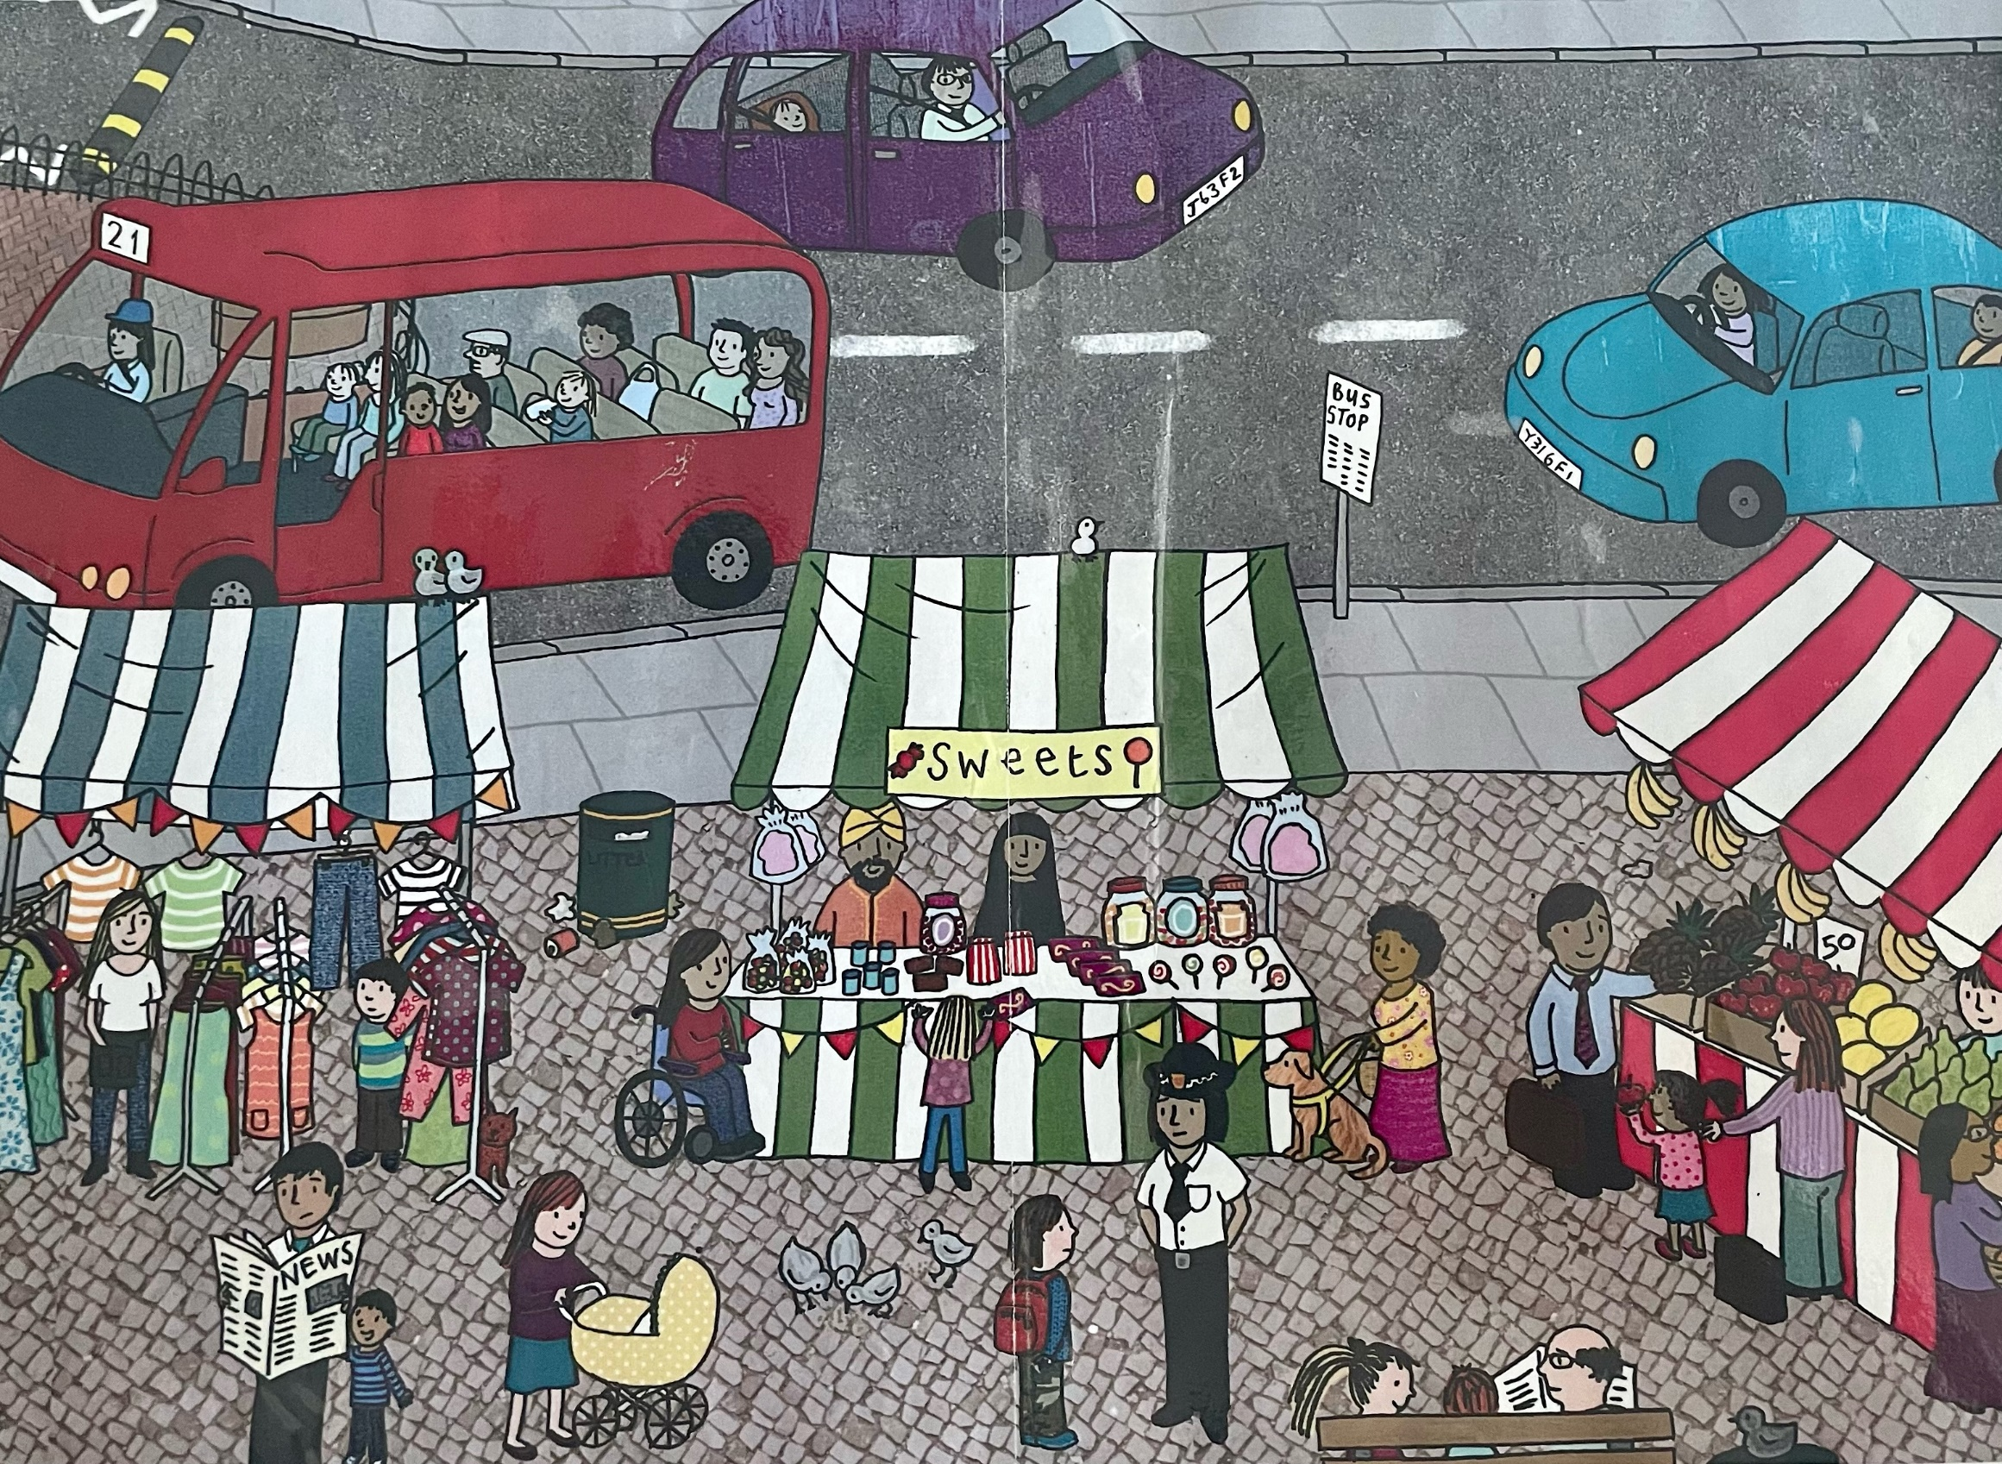
8. Market
EY and
KS1 Resources

Slide 7
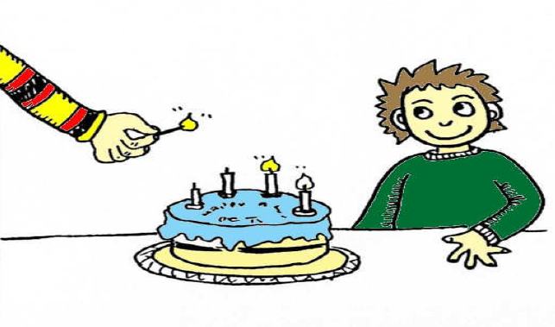
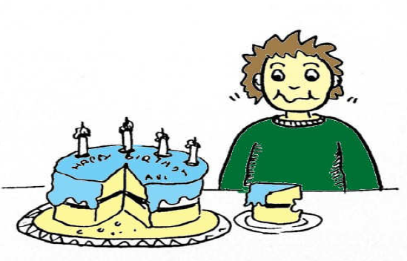
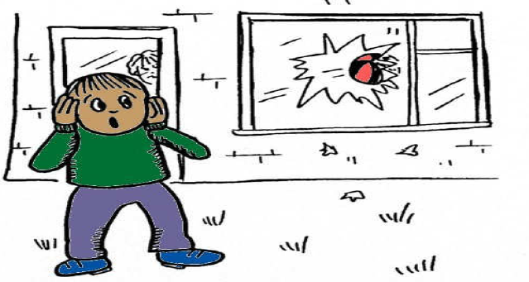
9. Sequencing
EY and
KS1 Resources

