Slide 1


KCSIE Update
Sept 2026

Slide 2


Slide 3
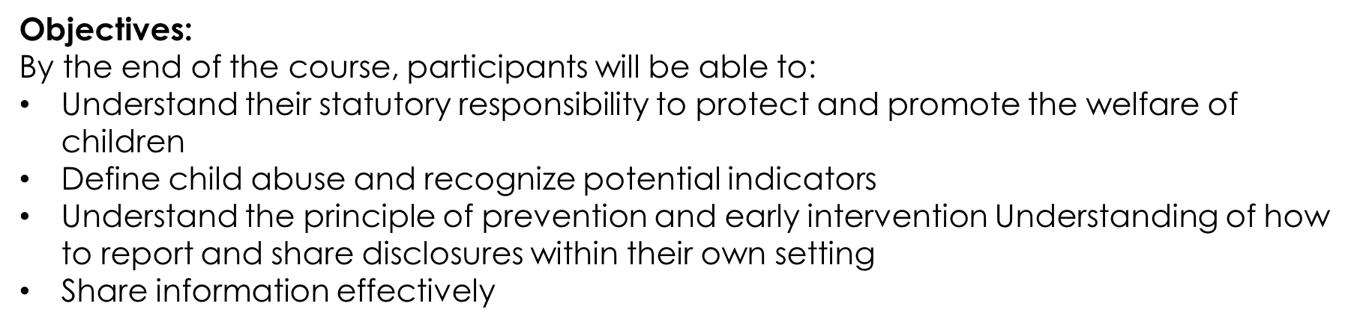
Aims
• To raise awareness and knowledge of the legal duties that govern schools and colleges in England when carrying out their duties to safeguard and promote the welfare of children under the age of 18 years alongside local contextual safeguarding matters.
• To enable participants to understand their roles and responsibilities in safeguarding and promoting the welfare of children.

Slide 4
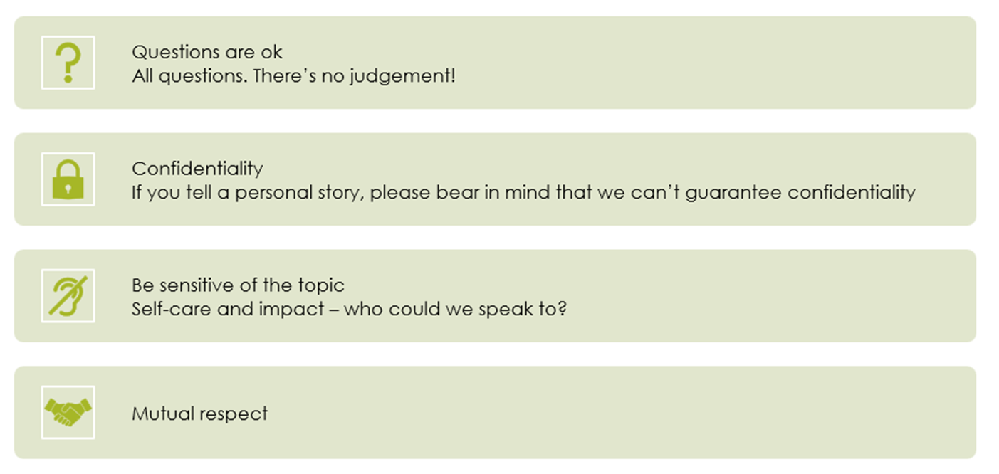
Group Agreement

Slide 5

Refresher of general Safeguarding information
Updates to KCSIE September 2026
Dealing with Disclosures
Local Context:
Nottingham City Council and beyond
Allegations against adults in positions of trust including Low level concerns
Contextual Safeguarding

Slide 6
Refreshing Key Skills

Slide 7
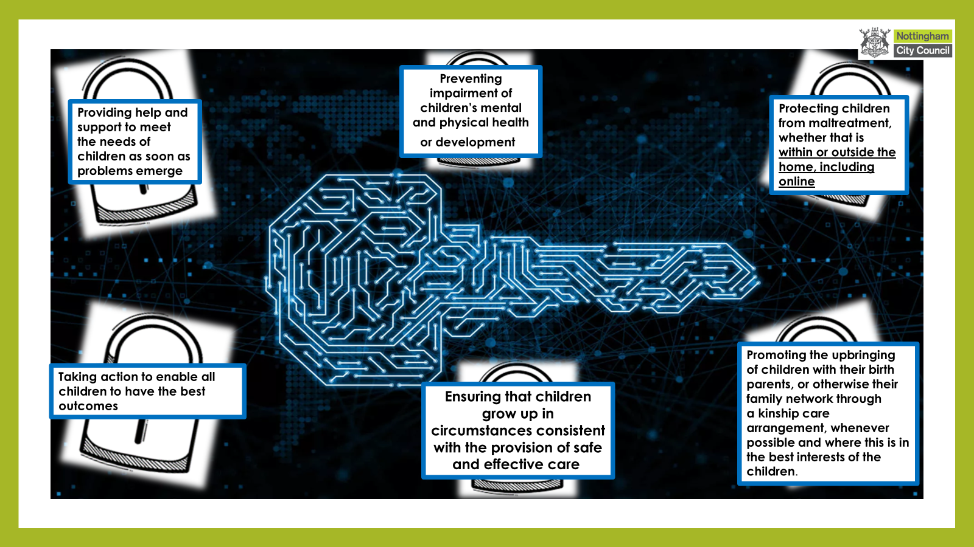
Notes:
Definition of Safeguarding – the KCSIE 2026 doesn’t not quote – promoting the upbringing of children with their birth parents … however this is explicitly included in the most recent update of Working Together to Safeguard Children (2023). The updated guidance continues to stress that children should be brought up within their families wherever it is safe and appropriate, and that kinship care should be promoted as a positive option when children cannot live with their birth parents.
The wording in your image mirrors the phrasing used in the “Principles for Practice” section of the 2023 update, which reinforces family networks and kinship arrangements as part of a child‑centred approach

Slide 8
Your role…
Safeguarding and promoting the welfare of children is everyone’s responsibility. Everyone who comes into contact with children and their families and carers has a role to play in safeguarding children. In order to fulfil this responsibility effectively, all professionals should make sure their approach is child-centred. This means that they should consider, at all times, what is in the best interests of the child.
All school and college staff have a responsibility to provide a safe environment in which children can learn.
All staff members should be aware of systems within their school or college which support safeguarding, and these should be explained to them as part of staff induction. This should include:
• the child protection policy;
• the staff behaviour policy (sometimes called a code of conduct); and
• the role of the designated safeguarding lead (including the identity of the designated safeguarding lead and any deputies).
All school and college staff members should be aware of the types of abuse and neglect so that they are able to identify cases of children who may be in need of help or protection.
All staff should be prepared to identify children who may benefit from Family Help.
Staff members working with children are advised to maintain an attitude of ‘it could happen here’ where safeguarding is concerned. When concerned about the welfare of a child, staff members should always act in the best interests of the child.
Notes:
The above is taken from KCSIE, 2026 page 8-10 within Part 1 safeguarding information for ALL STAFF explaining the role of the school and staff within it. It is imperative that all staff understand their responsibilities regardless of the individual role.

Slide 9


Slide 10
Significant Safeguarding Incidents
1984 The death of Jasmin Beckford
2000 The death of Victoria Climbie
2000 The death of Lauren Wright
2002 The deaths of Holly Wells and Jessica Chapman
2007 The death of Baby Peter Connelly
2010 Plymouth Serious Case Review/Little Teds Nursery
2012 North Somerset Serious Case Review/Nigel Leat
2012 The death of Daniel Pelka
2013 East Sussex Serious Case Review/Jeremy Forrest
2014 Scotland The Death of Liam Fee
2015 The Death of Shanay Walker
2018 The Death of Frankie Thomas
2019 Northampton Serious Case Review
2020- The death of Arthur Labinjo – Hughes
2020 – The Death of Star Hobson
2022 – City and Hackney – Child Q
2022- Archie Battersbee, Isaac Kenevan, Maia Walsh, Julian Sweeney
Safeguarding Legislation and Guidance
1989 The Children Act
1999 The Protection of Children Act
2000 The Assessment Framework of Children in Need
2002 The Education Act
2003 The Female Genital Mutilation Act
2003 Every Child Matters
2003 The Sex Offences Act
2004 The Children Act
2006 the Safeguarding Vulnerable Groups Act
2012 The Protection of Freedoms Act
2014 The Children and Families Act
2015 Keeping Children Safe in Education document first released.
2015 Counter Terrorism and Security Act – The Prevent Duty
2015 FGM Mandatory Reporting Duty
2023 Working Together to Safeguard Children
2025 Online Safety Act
2026 Keeping Children Safe in Education

Slide 11
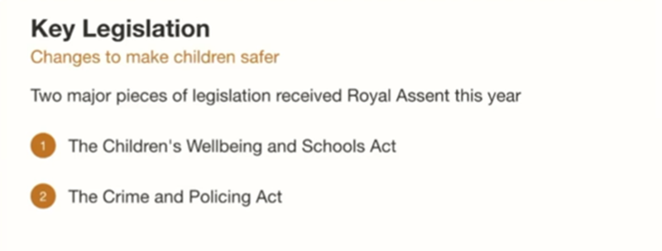
New Legislation contd..
Children’s Wellbeing and Schools Act
Five key contributions
Statutory multi‑agency child protection teams established — bringing together police, health, and children’s social care for the most serious cases.
Single unique child identifier introduced across services to prevent children from falling through gaps.
Duty on local housing authorities to notify schools when a child is placed in temporary accommodation.
Requirement for family group decision‑making meetings before applying for a care or supervision order.
Duty on local authorities to maintain a register of children not in school.
Crime and Policing Act
Five key contributions
New standalone offence of child criminal exploitation — no longer dependent on linked offences such as drugs or violence.
New offence of “cuckooing” — taking control of a person’s home, including a child’s, for criminal purposes.
Mandatory reporting duty for education and childcare staff to report child sexual abuse to the police and children’s social care.
Grooming recognised as a statutory aggravating factor in sentencing for sexual offences against children.
Removal of the supervised volunteer exemption — widening the scope of who requires an enhanced DBS and barred list check
Notes:
See slide for key points

Slide 12

What is Abuse?
Abuse is any form of maltreatment of a child.
It can involve inflicting harm or failing to act to prevent harm.
Harm includes non‑physical ill treatment, such as emotional or psychological harm.
Children can be harmed by witnessing the ill treatment of others, including all forms of domestic abuse.
Abuse may occur in a family, institutional, or community setting.
It can be carried out by people known to the child or, less commonly, by strangers.
Abuse can take place entirely online, or technology may be used to facilitate offline abuse.
Children may be abused by adults or by other children.
Children may also cause harm to family members, known as child‑to‑parent or caregiver abuse
Notes:
Keeping Children Safe in Education 2026 ( Pg 13, para 24)

Slide 13
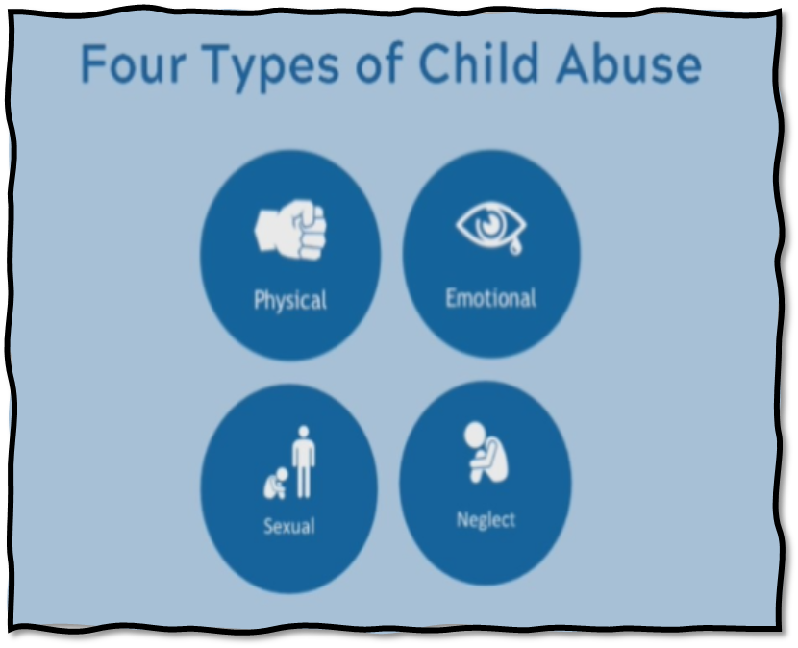
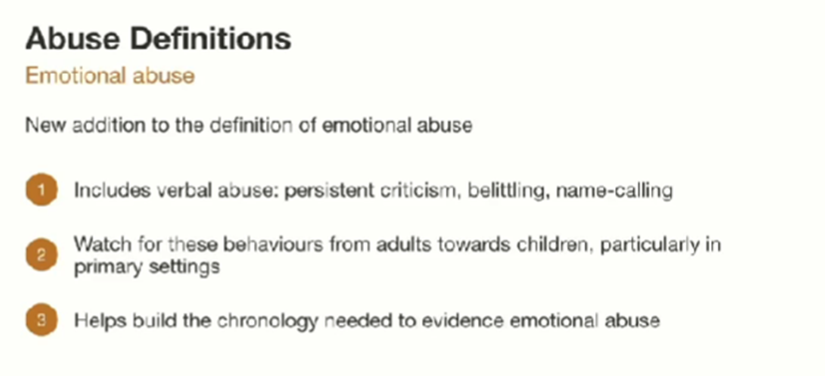
Notes:
Changes to definition of emotional abuse – extended to include verbal abuse. This will help to build a chronology of this type of abuse earlier as emotional abuse has always been difficult to identify/evidence.

Slide 14

New Risk Indicators
Additional signs that a child may require support before statutory intervention
Repeatedly removed from the classroom
Has experienced multiple suspensions
Placed on a part‑time timetable
Is pregnant and/or a parent themselves
Shows early signs of abusive, violent, or otherwise harmful behaviours
Persistent absence or unexplained reduced attendance
Frequent changes in living arrangements
Online risks
Notes:
New and Updated Risk Indicators (KCSIE 2026) – previously seen as behavioural issues and not necessarily safeguarding
Repeated classroom removals — persistent exclusion from learning environments.
Multiple suspensions or exclusions — patterns suggesting unmet needs or escalating behaviour.
Part‑time timetables — used as a management strategy but may indicate vulnerability or disengagement.
Pregnancy or parenthood — young people who are pregnant or parents themselves may need additional safeguarding support.
Early signs of abusive, violent, or harmful behaviours — including child‑on‑child abuse or emerging coercive patterns.
Persistent absence or unexplained reduced attendance — may signal neglect, exploitation, or emotional distress.
Frequent changes in living arrangements or care settings — potential instability or safeguarding concerns.
Online risks — exposure to harmful content, grooming, or exploitation facilitated by technology.
ALL these indicate distress in children, and it is important for schools to consider the data around suspensions/exclusions/alternative provisions (including internally)

Slide 15

https://www.youtube.com/watch?v=XEdNGbnvzRs
Notes:
Professional Curiosity SHORT version (youtube.com)
Discuss professional curiosity meaning 'being professional nosey' and play video- link to everyone's responsibility to safeguard and professionally challenge each other where we think something may have been missed or not seen as you see where risk of harm exists.

Slide 16
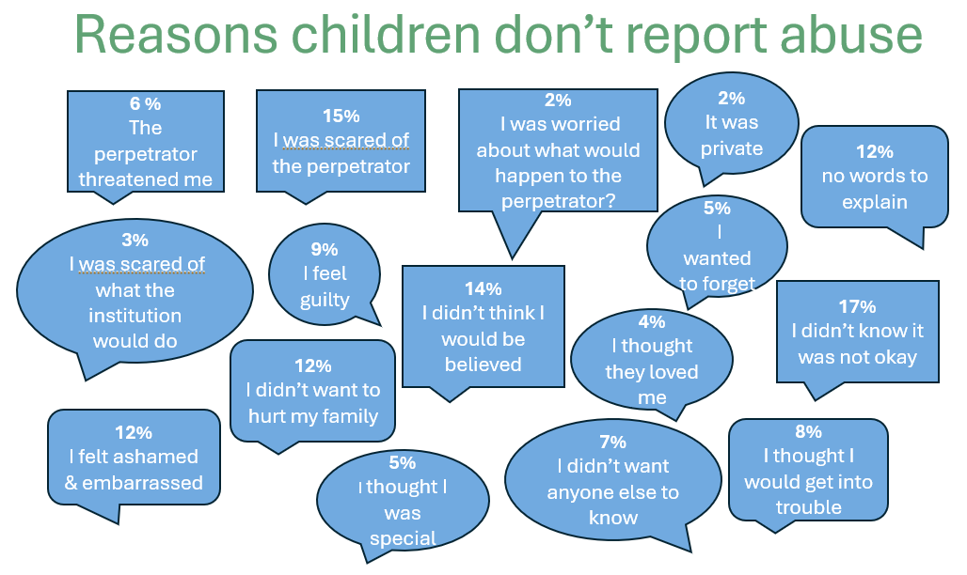
Notes:
Important to realise that not all victims disclose abuse
When our authority undertook a review of all of our Serious Case Reviews over the past 7 years alongside all of the other authorities within our region (Derby, Derbyshire, Nottinghamshire, Leicester and Leicestershire) the data told us that only a minority of the children who had died or been seriously harmed had ever disclosed that they were being abused.

Slide 17
Keeping Children Safe in Education Updates
September 2026

Slide 18

What’s New in 2026 (Updated)
Removal of Annex A – all staff must now read Part 1 in full.
Stronger expectations around online safety, AI risks, and digital harm.
New guidance for gender‑questioning pupils based on the Cass Review.
Updated processes for allegations against staff and low-level concerns.
Attendance recognised explicitly as a safeguarding vulnerability.
Reinforced expectation that schools are mobile‑phone‑free by default.
Expanded definitions of child‑on‑child abuse, including violence and weapon‑related behaviour

Slide 19
Family Help

Slide 20
Family Help
New terminology, same legal routes
The term “Early Help” is now replaced by “Family Help” throughout the guidance.
Staff should be familiar with the key legal routes underpinning Family Help:
  Sections 10 & 11, Children Act 2004 – Targeted Family Help
  Section 17, Children Act 1989 – Children in need
  Section 47, Children Act 1989 – Significant harm
  Section 31, Children Act 1989 – Care and supervision orders
  Section 20, Children Act 1989 – Duty to accommodate

Slide 21
Online Safety
Schools must ensure:
A whole-school approach to digital safeguarding.
Filtering and monitoring systems that are age-appropriate and risk-based. Annual review of filtering and monitoring systems. Reviews must consider emerging risks such as:
AI‑generated content
Deep fakes Image‑based abuse
Attempts to bypass filters (VPNs, proxies)
Staff must understand how AI can be used to manipulate images or impersonate pupils.
Children must be taught to recognise and report concerns.
Staff understand risks such as:
  Grooming
  Online bullying
  Exposure to harmful content
  Live-streaming risks
  AI-generated sexual imagery
Children are taught to recognise and report concerns

Slide 22
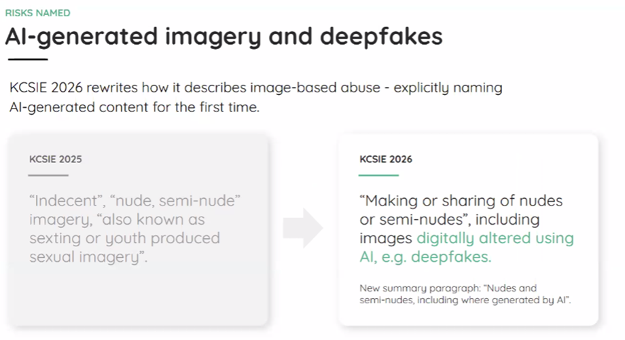
Nudes and Semi‑Nudes
Including those generated by AI
New definition added to the 2026 guidance:
“Images” now explicitly include photographs, videos, and livestreams.
Images may be:
- Self‑generated by the child
- Taken or created by another person
- Digitally altered or wholly generated using AI, including deepfakes or deep nudes
This definition underpins how child‑on‑child abuse and online safety are addressed throughout the guidance
Notes:
The Internet Watch Foundation (a research body) looked at the types of images created and how they were most commonly generated.
The Internet Watch Foundation (IWF) is a UK‑based non‑profit organisation and research body that works to make the internet safer, particularly for children.
Here’s a clear overview:
Purpose and Role
The IWF identifies and removes online child sexual abuse material from the internet.
It operates a confidential reporting system where the public and professionals can report harmful online content.
It collaborates with law enforcement, technology companies, and international partners to track and remove illegal imagery globally

Slide 23
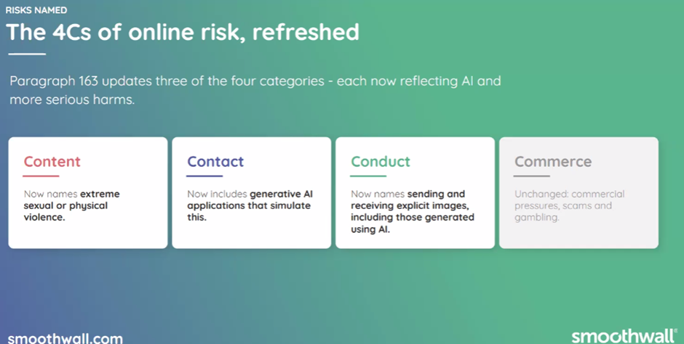
Notes:
3 out of the 4 C’s mention AI
Note: This framework appears in Part Two, but is referenced here because Part One now explicitly includes AI‑generated images.
Content: Exposure to harmful material — now includes misinformation, disinformation, and conspiracy theories.
Contact: Harmful interactions with other users or AI applications simulating user contact.
Conduct: Online behaviour causing harm — including creating, sending, or receiving explicit images, such as those generated using AI.
Commerce: Risks linked to online gambling, phishing, and financial scams

Slide 24
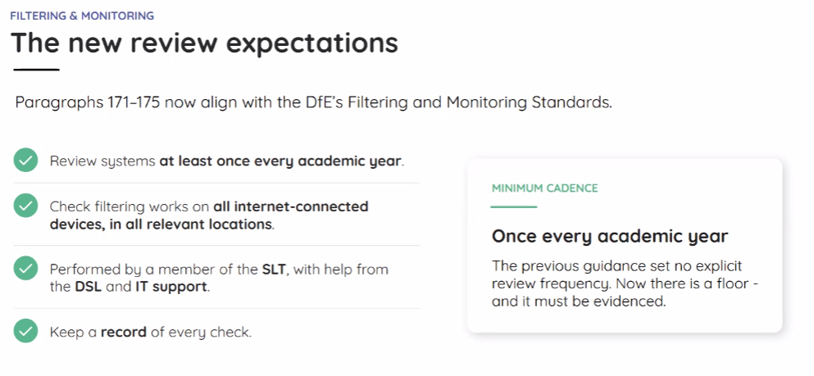
Changes to Digital Standards
Notes:
Review Filtering and Monitoring termly – use tools like test filtering .com
Keep records of these tests.

Slide 25
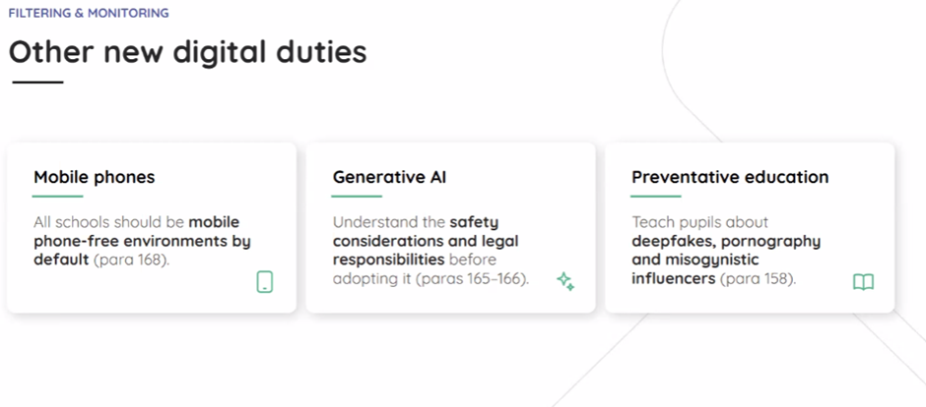

Slide 26
Mobile Phones
KCSIE reinforces DfE behaviour guidance:
Schools should be mobile‑phone‑free by default.
Policies must clearly outline:
Expectations
Storage
Consequences
Safeguarding rationale includes:
Online bullying
Exposure to harmful content
Sharing inappropriate images
Distraction from learning
Increased vulnerability to exploitation

Slide 27
Cybercrime
A rapidly evolving threat
Recognised as one of the most significant and fast‑developing threats in the UK crime landscape.
Offences under the Computer Misuse Act have increased substantially.
Young people may become involved in cyber‑dependent crime without realising the legal consequences.
Designated Safeguarding Leads (DSLs) can consider referral to the Cyber Choices programme for guidance and support.

Slide 28
'Cybercrime is criminal activity committed using computers and/or the internet.
It is broadly categorised as either ‘cyber-enabled’ (crimes that can happen off-line but are enabled at scale and at speed on-line) or ‘cyber dependent’ (crimes that can be committed only by using a computer).
Cyber-dependent crimes include:
unauthorised access to computers (illegal ‘hacking’), for example accessing a school’s computer network to look for test paper answers or change grades awarded
‘Denial of Service’ (Dos or DDoS) attacks or ‘booting’. These are attempts to make a computer, network or website unavailable by overwhelming it with internet traffic from multiple sources, and,
making, supplying or obtaining malware (malicious software) such as viruses, spyware, ransomware, botnets and Remote Access Trojans with the intent to commit further offence, including those above. '
Additional advice can be found at: National Education Network, Cyber Choices, ‘NPCC- When to call the Police’ and National Cyber Security Centre - NCSC.GOV.UK.

Slide 29
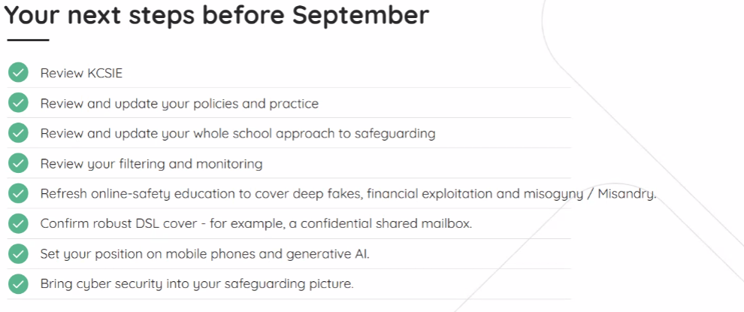

Slide 30
Children Who Are Questioning Their Gender
KCSIE 2026 – Key Points are:
Increasing numbers of children are questioning their gender or how they fit into social expectations.
Schools must not initiate any action relating to social transition — staff only respond when a child or parent makes a request.
Childhood exploration is normal: many children experiment with interests or behaviours not typically associated with their sex.
For most children, gender questioning does not continue into adulthood; for some, feelings may intensify during puberty.
Staff should be professionally curious, taking time to understand the child’s thoughts, feelings, and wider experiences.
Be alert to vulnerabilities, including mental health needs, family or peer difficulties, and discriminatory bullying.
Schools should adopt flexible, non‑stereotyped policies that avoid rigid expectations based on gender.

Slide 31
Attendance
KCSIE 2026 emphasises:
Persistent or unexplained absence can be a sign of safeguarding risk, including neglect, exploitation, or mental health concerns.
Schools must have robust systems to identify patterns of absence and act promptly.
Daily attendance monitoring is required for all pupils, including those in alternative provision or off‑site education.
First‑day contact remains essential — schools must follow up immediately when a child is absent without explanation.
Escalation routes should be clear: concerns about attendance must be shared with the Designated Safeguarding Lead (DSL) and, where appropriate, children’s social care.
Attendance data should be reviewed regularly to spot trends that may indicate wider welfare issues.
Notes:
Legal and Procedural Links
The guidance aligns with the Children’s Wellbeing and Schools Act 2026, which requires local authorities to maintain a register of children not in school.
Schools must cooperate with local authorities to ensure no child is missing education

Slide 32
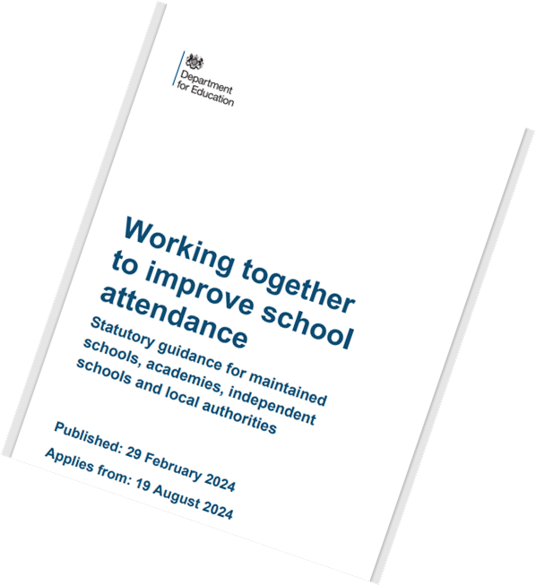
Chapter 3: Expectations of academy trust boards and governing bodies of maintained schools
70. Improving attendance requires constant focus, and effective whole school approaches require regular ongoing support, guidance, and challenge. Therefore, all trusts and governing bodies are expected to:
• Recognise the importance of school attendance and promote it across the school’s ethos and policies.
• Ensure school leaders fulfil expectations and statutory duties.
• Regularly review attendance data, discuss, and challenge trends, and help school leaders focus improvement efforts on the individual pupils or cohorts who need it most.
• Ensure school staff receive adequate training on attendance.
71. Multi-academy trust boards and governing bodies of federations are also expected to:
• Share effective practice on attendance management and improvement across schools.
72. Whilst it is expected that all trusts and governing bodies will provide support covering these areas, the approach to delivering it should be proportionate to the size of the group of schools and type of school(s) within it.

Slide 33
Child-on-Child Abuse
KCSIE 2026 emphasises:
Zero tolerance for harmful sexual behaviour.
Clear reporting and recording expectations.
Support for both victims and alleged perpetrators.
Preventative education through RSHE, online safety, and school culture.
Staff must recognise that abuse can be verbal, physical, sexual, or online.
Expanded definitions now include:
Harassment
Violence
Threats involving weapons
Violent behaviour must be treated as a potential indicator of risk for the perpetrator, not only the victim.
Notes:
Child‑on‑Child Abuse
Minimising or dismissing behaviours such as “just banter” or “boys being boys” can lead to:
A culture of unacceptable behaviour
Misogyny and discriminatory attitudes
An unsafe environment for children
Normalised abuse, where children no longer feel able to report concerns
Keeping Children Safe in Education (DfE, September 2026)

Slide 34
Serious Violence
Clearer definition of serious violence
May involve physical assault, carrying, threatening with, or using weapons.
Often linked to peer conflict, bullying, or criminal exploitation.
Any concern about a child carrying or using a weapon must be reported immediately to the Designated Safeguarding Lead (DSL).
Schools should identify times and locations that present higher risk — particularly before, during, and after the school day – consider your contextual safeguarding issues.

Slide 35

Domestic Abuse
Greater clarity and emphasis on teenage relationships.
Teenage relationship abuse now explicitly includes:
Physical, sexual, and emotional abuse
Stalking
Criminal exploitation, including financial exploitation
Operation Encompass
Now a statutory duty
Statutory duty on the police – Police must share information with schools where there are reasonable grounds to believe a child is a victim of domestic abuse.
Notification to schools – Applies whether or not the child was present during the incident.
Purpose – Ensures schools can provide timely support and safeguarding for affected children.
Local arrangements – Procedures may differ; always check what applies in your local area
Notes:
KCSIE 2026 paragraph 43

Slide 36

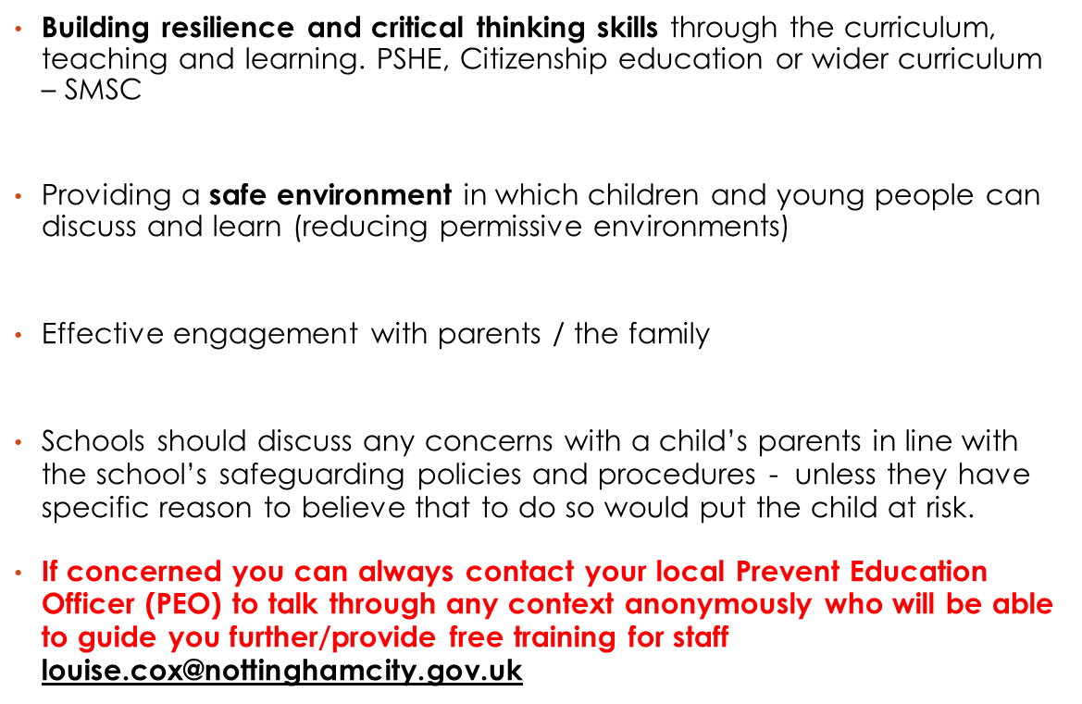
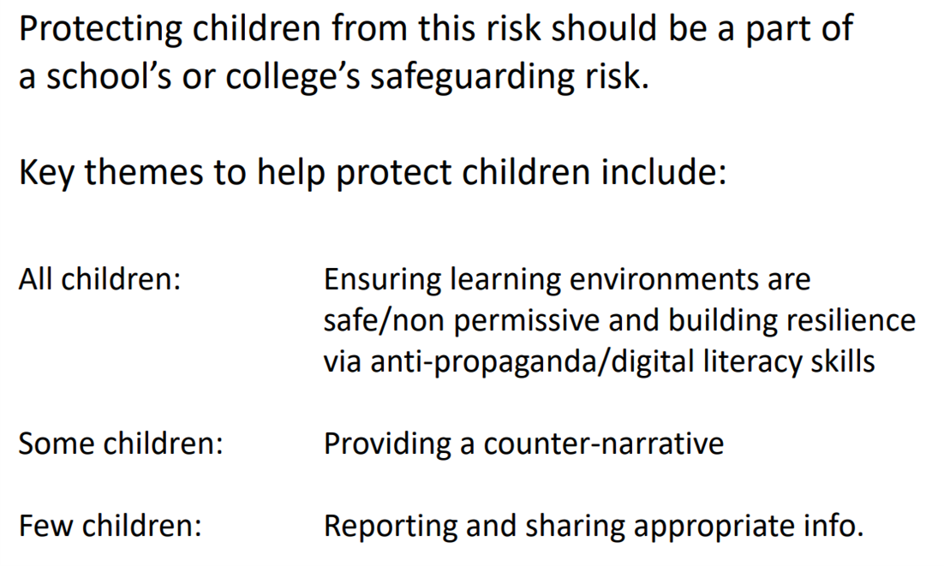
What does it look like in school?

Slide 37

TO SUMMARISE
Notice, Check, Share
Follow local Safeguarding procedure- ‘Notice, Check, Share’
Speak with DSL and share information, checking school systems for previous incidents of note
Look at the situation in context and at the whole picture
A holistic overview of the young person’s behaviour, attendance, performance and past incidents should all be considered
Speak to child and Speak to the parents (unless risk of harm)
Would you refer? If unsure consider conversation with PEO or Police- ultimately though, the decision to refer is made by the DSL

Slide 38
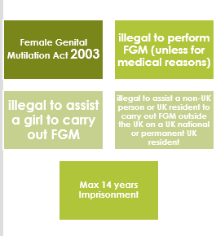
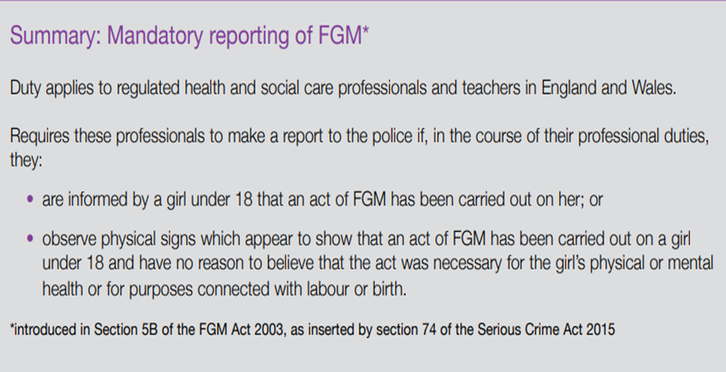
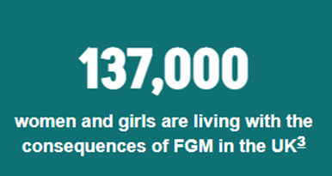
FGM
Female genital mutilation (FGM), also known as female genital cutting and female circumcision, is the partial or full cutting of a girl’s clitoris and labia, for non-medical reasons.
FGM is most often practiced on girls (between infancy and 15 years of age) but can occur across the life course of girls and women – some girls being cut when they are born and some women experiencing it after marriage.
The procedure has severe physical, psychological, and social consequences for the rest of the girls' lives – and can cause complications and pain during pregnancy and childbirth; pain during sex; difficulties urinating or menstruating; incontinence; psychological problems and trauma.
FGM is often performed as a rite of passage for girls (marking the transition into becoming a woman), and after it has taken place, many girls are forced to marry and taken out of school.
Notes:
KCSIE paragraph 44

Slide 39

Mental Health
Warning signs staff are well placed to notice
(School staff cannot make a diagnosis)
Significant changes in behaviour
Ongoing difficulty sleeping
Withdrawal from social situations
Loss of interest in activities they usually enjoy
Notes:
Remind colleagues that it is about looking at the behaviours for CYP.
Reporting appropriately.
Support networks available for CYP to talk or get advice – internal or signposting
KCSIE 2026 – paragraph 45 - 48

Slide 40
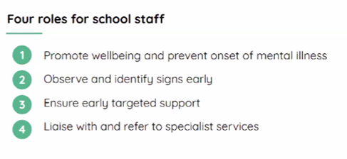
If a child is in danger: call 999 or take them to A&E. If urgent but not an emergency: contact NHS 111 and select the mental health option.

Slide 41
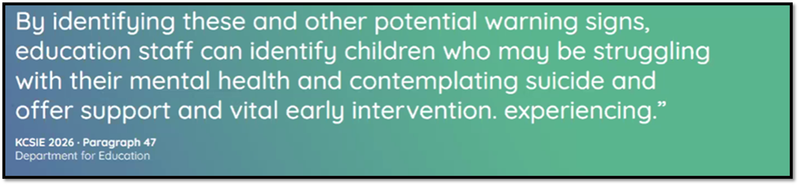

Slide 42
Dealing with disclosures

Slide 43
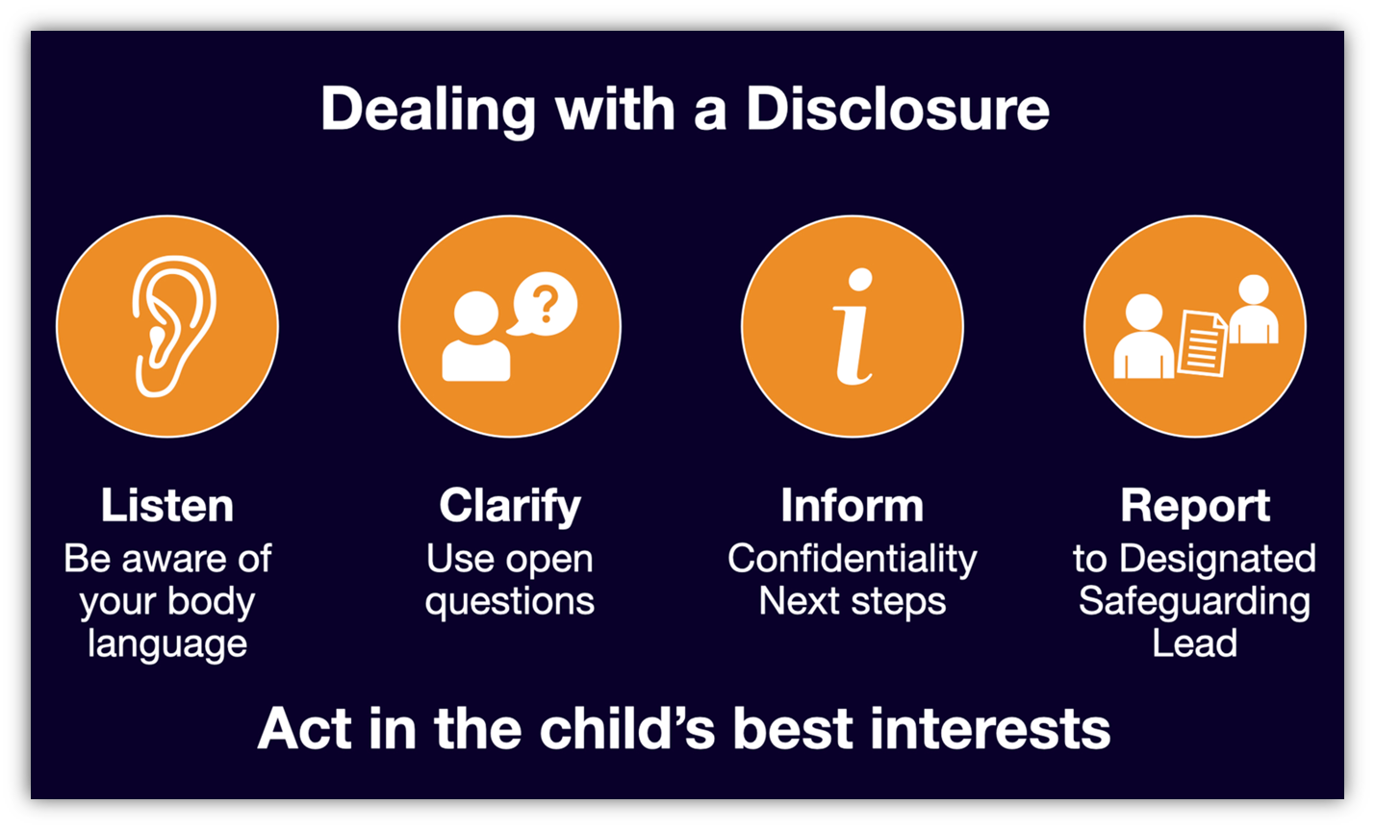
Notes:
What staff should do
Listen carefully and allow the child to speak freely without interruption.
Stay calm and patient — avoid showing shock, disbelief, or judgement.
Reassure the child that they have done the right thing by telling you.
Acknowledge their feelings and validate their experience.
Use open, non‑leading questions only if clarification is essential (e.g., “Tell me what happened”).
Take the child seriously — never dismiss or minimise what they share.
Explain next steps in a simple, age‑appropriate way (e.g., “I need to share this with someone who can help keep you safe”).
Record the disclosure accurately using the child’s own words.
Report immediately to the DSL or deputy DSL, following school procedures.

Slide 44
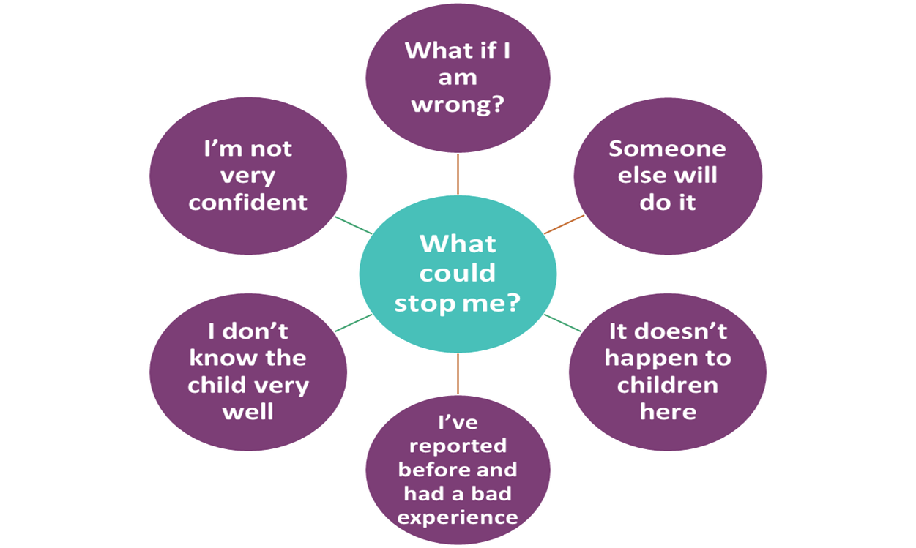
What might stop professionals from reporting abuse ?
Notes:
Repeat message of 'It Could Happen Here' and therefore ALL staff need to understand what signs of different abuse look like and how to ensure a safe and open environment through thier interactions with children and 'approachability'.
Ask delegates what they think might stop/prevent them from reporting a disclosure or concern that may not be included above?

Slide 45

Why should I pass it on? – Culture of vigilance
This child needs help
At this school we take safeguarding seriously
I know our school procedure
I know who to pass it to
I know what is expected of me
It is my responsibility
This is serious and important
Children spend more time in school than any other place
After parents, school staff are often the adults a child trusts most
The indicators of abuse are present
Abuse investigations often highlight a failure to act

Slide 46
Acting on Disclosures
Disclosures should be recorded and discussed with the DSL immediately
The record should be signed and dated and include:
Child’s full name, where and when the disclosure took place.
Was anyone else with you at the time of disclosure?
What did the child say? – their words and descriptions
What did you do or say?
Did they show you an injury, if so where is it, colour, size what does it look like (draw on body map if provided)
What else do you know about the child?
Apart from the DSL, you should NOT discuss the disclosure with anyone else.
Notes:
What staff must NOT do
Do not promise confidentiality — you must explain that you will need to share the information.
Do not ask leading questions or press for more detail than the child freely offers.
Do not investigate or attempt to resolve the situation yourself.
Do not make assumptions about what happened or who is responsible.
Do not discuss the disclosure with other staff unless they are part of the safeguarding team.

Slide 47
Recording and reporting systems
All settings will have a reporting procedure for staff to follow when a disclosure is made.
Concerns will be reported via the school's reporting system in a timely way (aligned to the individual settings procedures).
All information helps build a detailed picture of the child’s experiences
All information received will always be treated as highly confidential.
NEVER discuss the information with anyone other than a DSL/DDSL- this includes being mindful of any staffroom/ public space conversations.

Slide 48
Information Sharing
No barriers to sharing
Early information sharing is vital — whether concerns are just emerging or the child is already known to children’s social care.
Do not assume that a colleague or another professional will take action.
Data protection laws do not prevent sharing information when it is necessary to keep a child safe.
If in doubt, always speak to the Designated Safeguarding Lead (DSL).
Fears about sharing information must never stand in the way of protecting a child’s safety.
Notes:
Remind colleagues that information sharing is the most important part of safeguarding.
Recall Victoria Climbe and/or many other SCRs where the lack of shared information has resulted in the death of a child.
Don’t assume someone already knows / if they do know their perception may be different.
Reiterate that Data Protection Laws do not prevent the sharing of information to keep a child safe.

Slide 49
Local Context:
Nottingham City Council and beyond

Slide 50


Slide 51


Volume of Emails into the MASH
Average for this time of year - 4,300 a month
Roughly 1,100 a week, 200+ a day
1595 contacts
721 Yellow
810 Amber
64 Red
Breakdown
229 were from Settings within Education
453 were from Health services
585 were from Police
189 Individual/self/family
139 other
Notes:
Gill Till - MASH updates
---
Section start – 09:40
Section end – 09:50

Slide 52
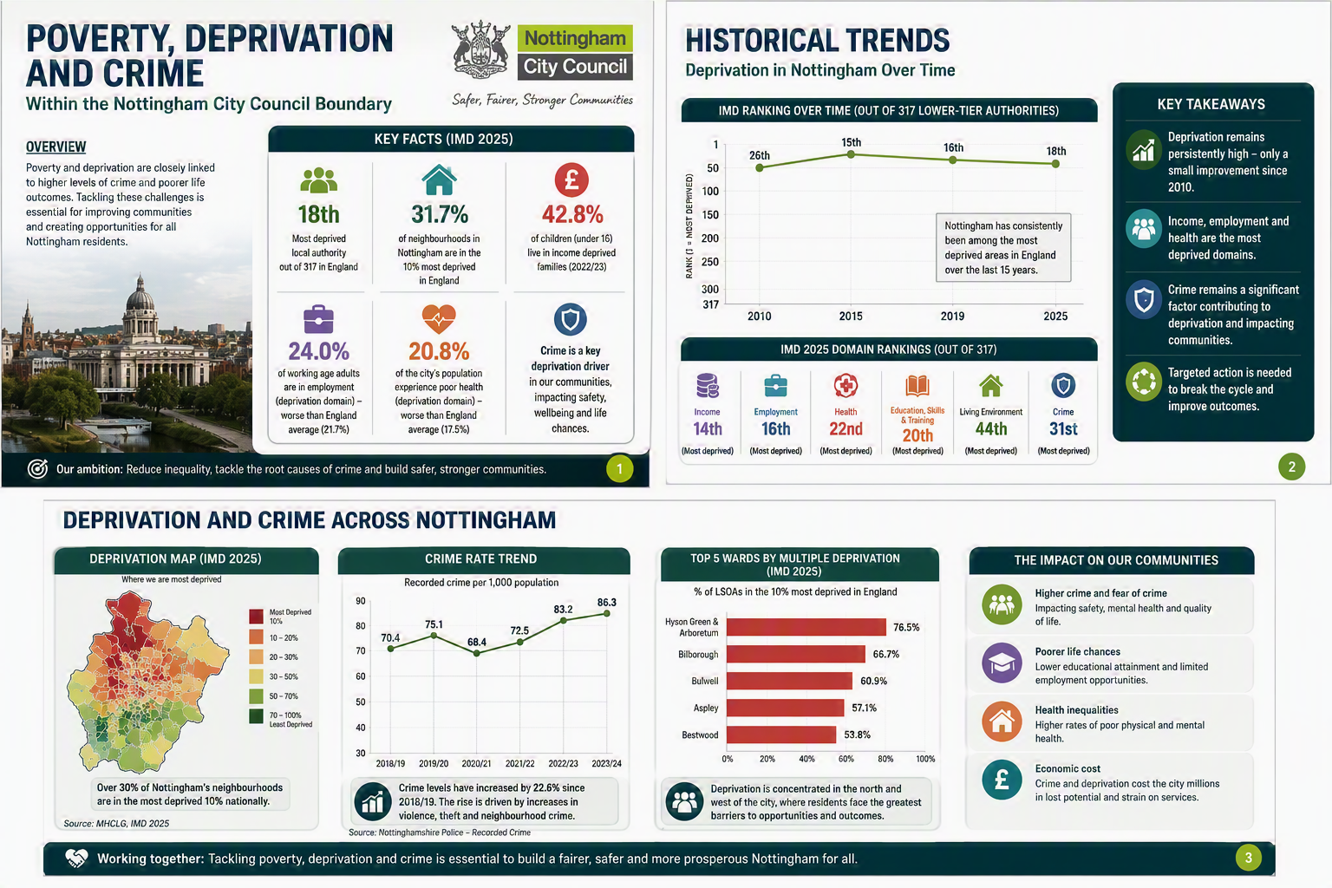

Slide 53
Understanding and Responding to Local Context
Know Your Local Area Build an understanding of local group/ gang names, influential community members, group dynamics, signs, colours, and recent activity. 2.Work With Local Partners Engage regularly with agencies such as PCSOs, SEIOs, the VRP, and the YJS to share insight and strengthen joint responses. 3.Map School/Academy Links Identify any group affiliations connected to your setting using social media intelligence, incident reports, and student disclosures/ intel. 4.Strengthen Communication Ensure whole‑school training includes this topic. Make sure key staff understand how to spot, disrupt, and monitor activity, and know how to share intelligence (e.g., via 101 or your local sergeant). 5.Know Your Students Well Be familiar enough to notice changes in behaviour, language, clothing, valuable items, music preferences, peer groups, arrival times, or attendance patterns.
Notes:
Claire Maclean – DSL Experience

Slide 54
Nottingham City Attendance Data 25/26

Slide 55
Website reminders
There are several main websites held by the Local Authority that will be key to supporting the role of the DSL-
Nottingham City Safeguarding Children Partnership
Safeguarding section of Nottingham Schools Website
Early Years at Nottingham City Council
Achieve Well Team
Notes:
Claire Maclean – Local Updates
---
Section start – 10:15
Section end – 10:30
---
The NCSCP website will provide lots of vital information for the DSL on partnership policy and procedures documents including escalation process, threshold of need document, LADO threshold and City MASH e-form.
The Nottingham Schools website is where you can find key resources including the Nottingham City template Safeguarding and Child Protection Policy, training programme, DBS letter for all Nottingham City employees to allow access to your setting as well as the DSL Network booking page.

Slide 56
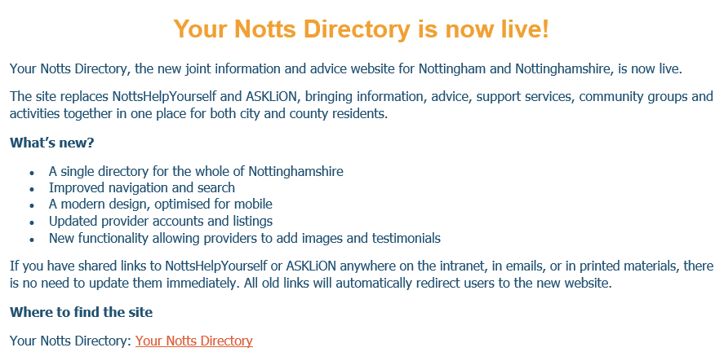
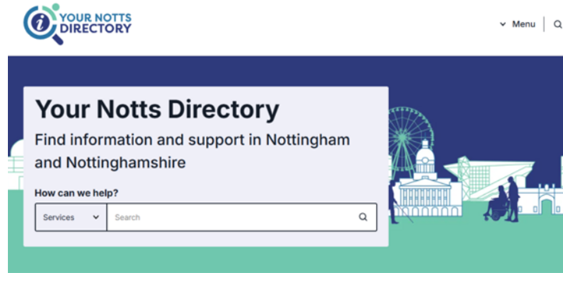
Notes:
Claire Maclean – Local Updates
---
Section start – 10:15
Section end – 10:30

Slide 57
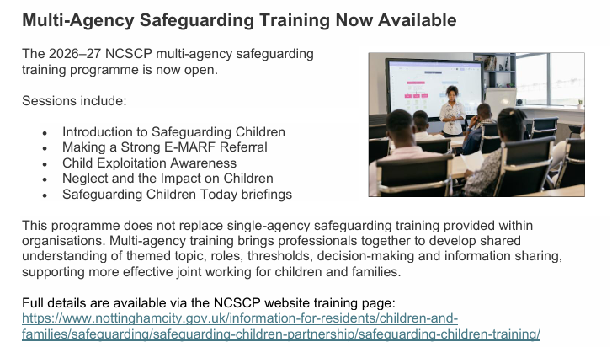
https://www.nottinghamcity.gov.uk/information-for-residents/children-and-families/safeguarding/safeguarding-children-partnership/safeguarding-children-training/
Notes:
Claire Maclean – Local Updates
---
Section start – 10:15
Section end – 10:30
---
https://www.nottinghamcity.gov.uk/information-for-residents/children-and-families/safeguarding/safeguarding-children-partnership/safeguarding-children-training/

Slide 58
Allegations of adults in positions of trust including Low Level Concerns

Slide 59
Allegations & Low-Level Concerns
Allegations:
Follow statutory procedures.
Report immediately to the headteacher or chair of governors.
Engage LADO where appropriate.
Low-level concerns:
Record, review, and respond proportionately.
Aim to maintain a safe and professional culture.
Patterns must be monitored

Slide 60
Allegations Against Staff
Trainee teachers now included
Trainee teachers are now explicitly included alongside supply staff, volunteers, and contractors.
The same reporting process applies: concerns must be referred to the headteacher or principal, who will consider whether to make a referral to the Local Authority Designated Officer (LADO).
Notes:
This slight change to the wording/language ensure that no one is missed. It ensure that settings understand that it is not the responsibility of the university or college to deal with concerns.

Slide 61
Volunteer Supervision
From the Crime and Policing Act 2026
Effective from 1 September 2026
Removes the previous exemption allowing supervised volunteers to work without an enhanced DBS and children’s barred list check.
Enhanced DBS with barred list check now becomes mandatory for schools.
Two distinct checks:
  Enhanced check – criminal record held by the police and justice system.
  Barred list check – confirms whether an individual is barred from working with children, including for disciplinary reasons not resulting in conviction.
Threshold: more than 3 days in any 30‑day period, or any overnight stay.
Counts cumulatively across all settings a volunteer works in — not just your school.
Notes:
Explain that it is essential to have both checks as they contain different information, this therefore provides a stronger check.
Visitor DBS checks It is now clearer that visitors should be asked for the DBS checks only where it is proportionate to contact with children, not a blanket requirement:

Slide 62

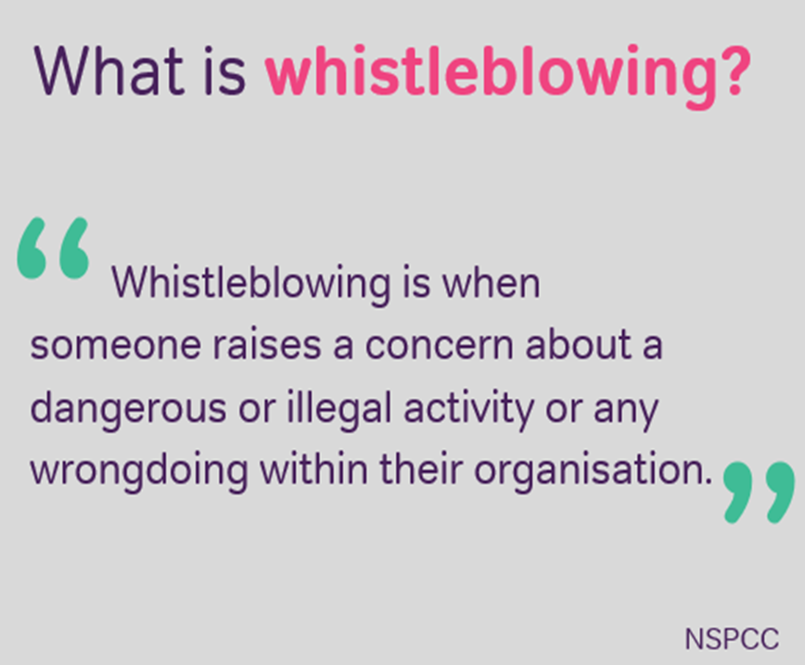
Notes:
Ensure that there are effective arrangements in place so employees feel safe to speak up and will be guided through the process where wrongdoing highlighted for example.
Appropriate whistleblowing procedures should be in place in all education settings for concerns to be raised with senior leaders, but there is also the option of whistleblowing to the NSPCC or DfE.
Things you may whistleblow on- criminal offence, someone's health and safety in danger, setting breaking the law, someone covering up wrongdoing

Slide 63
Contetual Safeguarding slides here
Insert settings contextual info here to ensure training offers bespoke content- it is suggested that you consider adding:
DSL photos
Safeguarding structure- how many DDSL's, safeguarding governor
Reporting and recording systems
Contextual safeguarding information relevant to your setting eg domestic violence statistics, child on child abuse processes
Update on key policies/practices including filtering and monitoring

Slide 64
Thank you

