Slide 1


DSL Network
Tuesday 10th February 2026
09:30 – 12:00
Notes:
Welcome - Alys Finch and Claire Maclean

Slide 2




Notes:
Welcome - Alys Finch and Claire Maclean

Slide 3


DSL Network Aims and Purpose
To promote connectivity with the Nottingham City Safeguarding Children Partnership, other key local authority departments and Designated Safeguarding Leads across the city
Act as a conduit for policy updates
A network which demonstrates professional behaviours and mutual support
Sharing of pertinent local and national updates focusing on safeguarding priorities and emerging trends across the city of Nottingham
Today’s objective:
To enhance the knowledge and confidence of Designated Safeguarding Leads (DSLs) and school governors in understanding and fulfilling their statutory safeguarding responsibilities.
2. To provide clear guidance on the referral pathways for exploitation concerns into the local authority and to refresh DSL’s knowledge on best practice for managing cases and supporting affected children and families.
Notes:
Welcome - Alys Finch and Claire Maclean

Slide 4

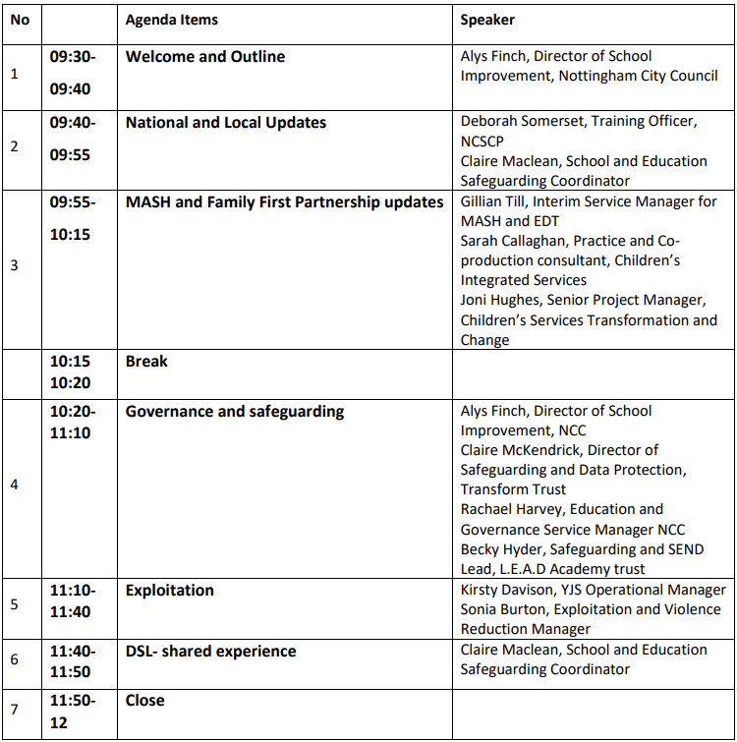

DSL Network Agenda
Notes:
Welcome - Alys Finch and Claire Maclean
Introduce Deborah Somerset on next slide

Slide 5

NCSCP Safeguarding Updates
Deborah Somerset
Training Officer
NCSCP/SAB
Nottingham City Safeguarding Children Partnership - YouTube
Notes:
National Updates – Deborah Somerset
JM

Slide 6
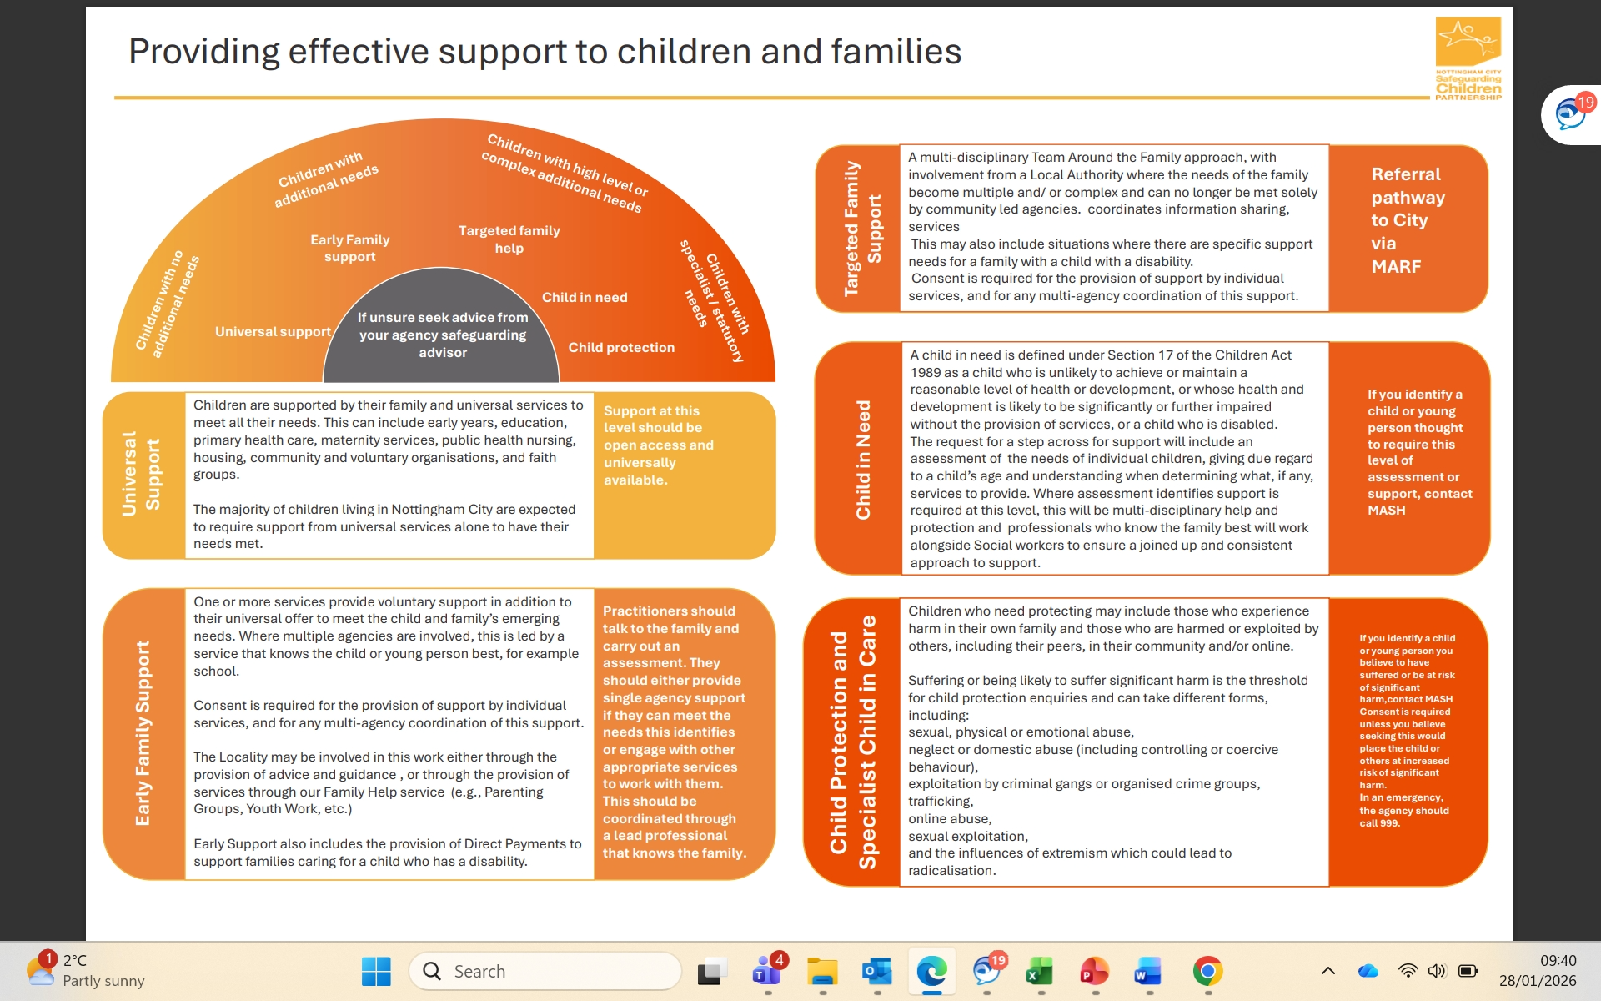

NCSCP Updates
Notes:
The Continuum of Need is an interim model until end of March 2026. These next few slides are only a snapshot. More information can be found here
file:///C:/Users/desome/OneDrive%20-%20Nottingham%20City%20Council/Documents/Personal/Continuum%20of%20Need/interim-continuum-of-need-ncscp%20(4).pdf
National Updates – Deborah Somerset

Slide 7
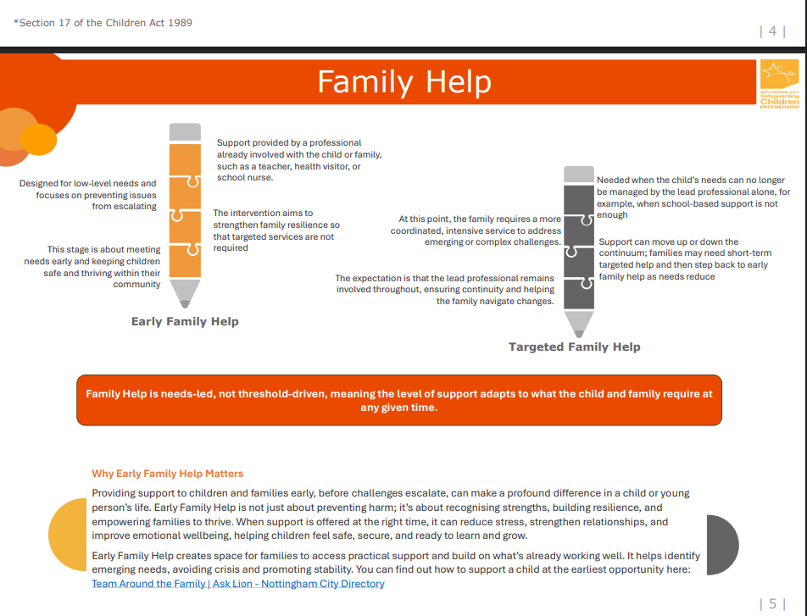
NCSCP Updates
Notes:
National Updates – Deborah Somerset

Slide 8
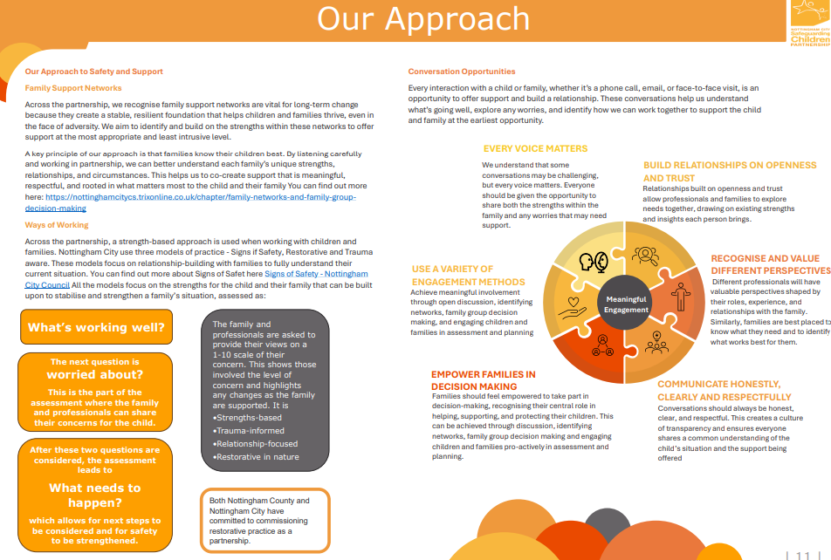
NCSCP Updates
Notes:
National Updates – Deborah Somerset

Slide 9
NCSCP Updates
Child Safeguarding Practice Review Panel’s annual report 2023/24 –
330 rapid reviews were submitted to the Panel between April 2023 and March 2024.
Of the 330 reviews, 49% were deaths, 48% were serious harm incidents and 3% were ‘other’
53% of parents had mental health conditions, 43% had substance use problems, and 25% had a reported disability.
The age distribution within the rapid reviews showed that under 1s were the largest age group represented (36%), followed by 16-to-17-year-olds (22%).
Sudden unexpected death in infants (SUDI) and suicide were the most common likely cause of deaths. Nonfatal intrafamilial assaults were the most common likely cause of harm
3 themes - Theme 1 – Children with Mental Health Needs; Theme 2 - Safeguarding Pre-School Children with Parents with Mental Health Needs & Theme 3 - Extrafamilial Harm
Podcast: The work of the Child Safeguarding Practice Review Panel | NSPCC Learning
Notes:
These are the latest figures
National Updates – Deborah Somerset

Slide 10
NCSCP Updates
Educational Neglect Policy
This is a relatively new policy from last year, relatively short at 12 pages
Interesting conversations around at the moment, as we look to the summer break, regarding the impact of taking children out of school for family holidays
Regarding home education, how do we check this is being done in a way that fulfills the child`s needs?
It’s Silent”: Race, Racism and Safeguarding Children –
Examines the impact of race, ethnicity and culture on:
Multi-agency practice where children have suffered serious harm or died
It includes findings from 40 rapid reviews and 14 LCSPRs involving children from Black(15 reviews), Asian (14 reviews) and Mixed Heritage (25 reviews) backgrounds
This report suggests a need for a sea change in how we address issues about race, culture and ethnicity in safeguarding practice.
This is a vital pre-requisite of better protecting and helping Black, Asian and Mixed Heritage children from harm both within their families and in the extrafamilial environment (outside the home).
Notes:
Leaders and practitioners need to develop their capacity to understand and use intersectional approaches to better address the safeguarding needs of Black, Asian and Mixed Heritage children
The Educational Neglect policy is obviously one for DSL`s to be familiar with. See the policy here….. Educational Neglect Policy FINAL.docx
National Updates – Deborah Somerset

Slide 11
NCSCP Updates
The Crime and Policing Bill
This was introduced into the House of Commons in February 2025. Depending on where you are in the UK, different parts of the Bill will apply.
The wide-ranging purposes of the Bill include:
To counter serious violence
Counter violence against women and girls.
Counter exploitation of children and adults.
Combatting anti-social behaviour, knife crime and terrorism
A number of fact sheets have been introduced to assist with the understanding and further information around the Bill. To read the Crime and Policing Bill (2025), click here Crime and Policing Bill: overarching factsheet - GOV.UK
NSPCC Let's Talk
Let's Talk has launched in Nottingham this month and will be rolled out in Nottinghamshire shortly afterwards. The Service will initially be delivered directly for 2 years. After this, the NSPCC are exploring opportunities for other local providers to take on delivery, enabling the NSPCC team to extend support. The Service will support children and young people under 18 for up to 12 tailored sessions, addressing their Problematic Sexual Behaviour. In addition, parents and carers will be offered up to 6 sessions to reinforce the work being done with their child or young people.
More details to follow through the Partnership.
Notes:
More information regarding both of these items can be found in our December 2025 NCSCP Partnership Newsletter here…….. https://sway.cloud.microsoft/rDrjNAXErv9pUT7K?ref=Link
National Updates – Deborah Somerset

Slide 12
NCSCP Updates
Multi-Agency Working and Information Sharing - NSPCC (January 2025)
These resources explore how safeguarding professionals can successfully work together and share valuable information both within and between agencies. Included in the resources is:
An evidence snapshot, which summarises findings from research published between 2014 and 2023, regarding multi-agency working and information sharing in children’s Social Work
Practice points designed to assist Social Workers to focus on actions that support positive multi-agency working and information sharing
Three expert insight films
The resources highlight how important multi-agency work and information sharing is, to achieve the best outcomes for children and their families.
For further information, click on the link below:
Multi-agency working and information sharing: learning from case reviews | NSPCC Learning
Evidence Snapshot
Practice Points
Expert Insights (3 films)
Notes:
More information regarding this can be found in our December 2025 NCSCP Partnership Newsletter here…….. https://sway.cloud.microsoft/rDrjNAXErv9pUT7K?ref=Link
National Updates – Deborah Somerset

Slide 13
NCSCP Updates
DfE Mobile Phone Guidance from April 2026.
Strongly encourages schools to operate as mobile phone free environments during the school day
Ofsted has said it will reflect this guidance in its inspections from April 2026
Focus will be on impact of behaviour, learning and pupil wellbeing, rather than on a single model being adopted.
Clear policies, consistency and attention to safeguarding will remain key.
Responses to breaches of the mobile phone policy should be clear, proportionate and consistently applied, in line with the behaviour policy and safeguarding procedures
Some actions to consider
Review current behaviour policy to check how clearly mobile phone expectations are set out and if they reflect updated guidance
Agree consistent approach to managing mobile phones during school day, including how exceptions (e.g., medical needs) are handled
Brief staff and governors so expectations are well understood
Notes:
Here is a link to the guidance……Mobile phones in schools - GOV.UK
National Updates – Deborah Somerset

Slide 14
NCSCP Updates
Communicate early with parents and carers explaining the schools plans and how further information will be shared
Check safeguarding and inclusion arrangements including reasonable adjustments, medical needs and routes for pupils to raise concerns are in place
You can find the DfE guidance here: https://www.gov.uk/government/publications/mobile-phones-in-schools
Ofsted expectations can be found here: https://educationinspection.blog.gov.uk/2026/01/23/what-the-governments-updated-guidance-on-mobile-phones-means-for-school-inspections/
Notes:
National Updates – Deborah Somerset

Slide 15
NCSCP Updates
Useful Resources from the South Western Grid for Learning (SWGfL)
Integrating AI in Schools: Policy Template
SWGfL’s school AI policy template helps schools balance opportunity and risk by promoting responsible, ethical, and effective use across teaching, learning, and administration.
Find the template here: https://swgfl.org.uk/magazine/integrating-ai-in-schools-new-policy-template-available
Test whether your school internet blocks harmful online content
TestFiltering.com allows schools to check that their internet filtering is working effectively without exposing staff or pupils to harmful content, supporting compliance with UK statutory safeguarding guidance.
Find the tool here: https://testfiltering.com/
Notes:
Find more information re SWGfL here……Safety and Security Online | SWGfL.
National Updates – Deborah Somerset

Slide 16
NCSCP Updates
Child Protection Authority
The creation of a Child Protection Authority (CPA) was one of the lead recommendations from the final report from IIHCSA
In April 2025, the Government committed to consulting on a road map to establishing a CPA as a national body to improve child protection by the end of 2025. The consultation is now open and close 5th March 2026
The overall aim is to make the multi-agency child protection system cleaner and more unified. Also to ensure ongoing improvements through effective evidence-based support
The purpose of the consultation is to consider the fact that the current child protection system faces 3 persistent challenges:
The system is fragmented and lacks strong leadership/co-ordination at national level. Also, data is not being used effectively
Good practice across the country is nor consistently shared/embedded
Learning is not consistently translated into improvements and the same weaknesses recur
Notes:
More information can be found here……Establishing the Child Protection Authority in England - GOV.UK.
National Updates – Deborah Somerset

Slide 17
Breakdown: of SIN's, RR's, LCSPR's and Learning Reviews
Serious Incident Notifications (SINs) made by Local Authorities to the Child Safeguarding Practice Review Panel, Department for Education and Ofsted when a child has died or is seriously harmed, and abuse or neglect is known or suspected. Local Authorities also required to submit a SIN where a LAC has died, whether or not abuse or neglect is known or suspected.
Rapid Reviews conducted for each notification. These reviews are undertaken by local safeguarding partners, with the written report to be submitted to the CSPR Panel within 15 working days of the incident notification. The purpose of the Rapid Review is for partners to identify, collate and reflect on the facts of the case as quickly as possible to establish whether any immediate action is needed to ensure a child’s safety and to identify potential practice learning. This includes deciding whether to undertake a LCSPR
Local Child Safeguarding Practice Reviews (LCSPRs) are undertaken to provide learning to improve safeguarding practice at both local and national levels and to prevent similar incidents from occurring in the future. When safeguarding Partnerships decide to proceed with a Local Review, there is an expectation that these reviews are completed, submitted and published within six months of the Rapid Review.
Learning Reviews are undertaken when a case is presented to the CSPR strategic partners as a discussion around SIN criteria. If a case does not meet threshold for a Rapid Review, but there is an opportunity for learning, then the NCSCP will undertake a Learning Review. This form of review will take a similar approach to a Rapid Review, but will not be time dependent. Identified themes and learning and development will be disseminated through the Partnership in the same manner as a Rapid Review.
Notes:
Useful to give context
National Updates – Deborah Somerset

Slide 18
Recent Learning Review Case Study
Circumstances leading to Learning Review:
Child EGP, aged 17. Between December 2024 and June 2025 there was a high number of missing episodes, some for as long as 16 days. These periods coincided with the expiry of a Deprivation of Liberty Safeguards (DoLS). EGP is pregnant with baby expected Feb 2026. EGP has been exploring her sexuality and also converted to Islam, but has on occasions, lapsed. She entered care in 2012 because of significant harm, including DA. At high risk of exploitation, access to substances and having contact with risky adults.
Areas of improvement in practice for
Children`s Social Care – high turnover of SW`s
Frequent placement changes
Disclosures not acted on
Education – poor transitions
Placement instability
PEP meetings not happened
Notes:
Learning Reviews offer an opportunity to further explore cases that might identify practice and procedural issues across more than one agency that do not meet the threshold for a serious incident notification and Rapid Review.
National Updates – Deborah Somerset

Slide 19
Recent Rapid Review Case Study
Circumstances leading to Rapid Review:
Child ZSM , aged 4 months at the time of the incident, in 2025. We cannot detail anything further as the recommendations made by the NCSCP have not yet been signed off by the national CSPR Panel
Notes:
Rapid Reviews offer an opportunity to further explore cases that might identify practice and procedural issues across more than one agency that do not meet the threshold for a serious incident notification and Rapid Review.
National Updates – Deborah Somerset

Slide 20
Recent Learning Review Case Study
Circumstances leading to Learning Review:
Child AH. Subject to a Rapid Review in July 2025. He was almost a year old. Learning Review took place in July 2025. During routine home visit, concerns raised re child`s presentation and the need for further assessment. It had been noticed that the child`s head circumference had increased significantly in size. He was already on a CPP for emotional abuse. An MRI was carried out and showed bleeding around the brain, most likely caused by Abusive Head Trauma
Areas of improvement in practice for
Children`s Social Care
Health
Police
Housing
EMAS
Notes:
Learning Reviews offer an opportunity to further explore cases that might identify practice and procedural issues across more than one agency that do not meet the threshold for a serious incident notification and Rapid Review.
National Updates – Deborah Somerset

Slide 21
Publications & Support Information
Transitional Safeguarding
How to conduct a safeguarding audit in schools
What you need to know about child sexual abuse | CSA Centre
Raised by relatives: Experiences of Black and Asian kinship carers
Signs That a Child Is Suffering From Mental Health Issues | NSPCC
Recognising Abuse and Neglect
Parents with Mental Health Problems
Signs of Safety - Nottingham City Council
Health For Teens | Everything you wanted to know about health
Health For Kids
Mental Health Support | NottAlone - Services For Teachers
Victims in their own right? Babies, children and young people’s experiences of domestic abuse
Notes:
Further resources for people to explore should they wish
National Updates – Deborah Somerset

Slide 22
NCSCP Learning and Development Opportunities
The learning and development programme begins in April 2026 and runs until March 2027
It is split into 4 terms
Colleagues can find out about the training by accessing Learning Zone, clicking on NCSCP and reading about the appropriate courses. They can also book themselves onto their chosen course (s)
Colleagues who are external to NCC can still read up on courses they are interested in, but would have to contact us at the Partnership, so a Learning account could be created. Contact details on the last slide
This is the link to the Learning Zone and our courses….. Home: NCSCP - Nottingham City Safeguarding Children Partnership
Notes:
The training offer has been influenced by Rapid Reviews, Learning Reviews, LCSPR`s and requests from colleagues
Internal colleagues can use their learning account to book on. External colleagues to contact us
National Updates – Deborah Somerset

Slide 23

Website Update
There are two main websites held by the Local Authority that will be key to supporting the role of the DSL-
1- Nottingham City Safeguarding Children Partnership- www.nottinghamcity.gov.uk/ncscp
2- Early Years - Nottingham City Council
Notes:
The NCSCP website will provide lots of vital information for the DSL on partnership policy and procedures documents including escalation process, threshold of need document, LADO threshold and City MASH e-form.
National Updates – Deborah Somerset

Slide 24

Nottingham City Safeguarding Children Partnership (NCSCP) Cross Authority Child Exploitation training – Learning Objectives Deborah Somerset Training Officer NCSCP/SAB

Slide 25
Course Part 1 - Learning Objectives
During this session, attendees will……
Discuss the definitions of Child Exploitation (CE) and harms outside the home.
Explore the prevalence of CE in Nottingham City
Identify different models of grooming
Outline the importance of consent
State the impact of CE on children
Identify indicators and vulnerabilities of CE
Describe Contextual Safeguarding and places of risk
List effective ways of working with families experiencing CE
Demonstrate professional responses and use of appropriate language to CE
The report sets out how group-based CSE is defined in relation to child sexual exploitation and child sexual abuse, highlighting that:
child sexual abuse (CSA) is an umbrella term that includes different types of abuse, including intrafamilial CSA, online CSA and child sexual exploitation
child sexual exploitation (CSE) is a subset of child sexual abuse involving a power imbalance and the coercion or manipulation of a child into sexual activity in exchange for something the child needs or wants
group-based child sexual exploitation (group-based CSE) is a subset of child sexual exploitation where two or more perpetrators are involved.
the ‘grooming gangs’ model of abuse is well documented and remains largely consistent, with the main difference in recent years being the growing role of online platforms and social media.
all children are vulnerable because of their age, so they may not necessarily exhibit known risk factors and vulnerabilities
Notes:
The timeline begins in 2009, when the government first provided a definition of CSE. The timeline highlights three recurring themes that have not been properly addressed since 2009: • the need to improve system processes around data gathering, information sharing and staff training • the ability to identify risk factors and recognise signs of grooming and exploitation • the need to collect data and information on perpetrators, including on ethnicity and culture. Report makes 12 recommendations.

Slide 26
Course Part 2 - Learning Objectives
During this session, attendees will……
Explore the strategy of Protect, with reference to children and young people, by building the highest level of defence
Discuss the strategy of Pursue, by relentless disruption and targeted action
Training is open to anyone from the Partnership and beyond. Those employed by NCC should have a learning account. Anyone else can contact the Training Team and we can set up a learning account for you. We are in the process of updating the training section of the Partnership website, which will be helpful for people to book directly onto our courses. We will also be disseminating training information via e-mail, to Heads of Service and also in, for example, NCSCP Newsletters.
The NCSCP e-mail address is Safeguarding.Partnerships@nottinghamcity.gov.uk
Our contact telephone number is 0115 876 4762
Our website can be found at Safeguarding Training - Nottingham City Council
Notes:
The timeline begins in 2009, when the government first provided a definition of CSE. The timeline highlights three recurring themes that have not been properly addressed since 2009: • the need to improve system processes around data gathering, information sharing and staff training • the ability to identify risk factors and recognise signs of grooming and exploitation • the need to collect data and information on perpetrators, including on ethnicity and culture. Report makes 12 recommendations.

Slide 27
Contact us
Email
safeguarding.partnerships@nottinghamcity.gov.uk
Telephone
0115 876 4762
Notes:
Contact us to discuss all things training
National Updates – Deborah Somerset
Introduce Claire Maclean on next slide

Slide 28

Local Updates
Key websites
Local Safeguarding Partnership Audit
Changes to Restrictive Interventions
Community safety
Out of hours contact/ safeguarding inbox addresses
CGL vaping service to launch
Disclosure and Barring Service workshops
Notes:
Local Updates – Claire Maclean

Slide 29
Website links
Below are the main websites held by the local authority that will be key to supporting the role of the DSL-
Nottingham Schools: www.nottinghamschools.org.uk
Achieve Well Team: Achieve Well – About
- Nottingham City Safeguarding Children Partnership: www.nottinghamcity.gov.uk/ncscp
Notes:
The Nottingham Schools website is where you can find key resources including the Nottingham City template Safeguarding and Child Protection Policy, training programme, DBS letter for all Nottingham City employees to allow access to your setting as well as the DSL Network booking page.
The NCSCP website will provide lots of vital information for the DSL on partnership policy and procedures documents including escalation process, threshold of need document, LADO threshold and City MASH e-form.
Local Updates – Claire Maclean

Slide 30
Local Safeguarding Partnership Audit (LSPA)
This academic year's online audit will open at the start of the summer term.
An email will be sent to all Headteachers and the DSL along with a ‘support and guidance’ document that should answer any questions to help with completion of the audit and understanding the wider process.
The annual audit will open online on Monday 13th April 2026
The deadline for completion is Monday 13th July 2026
We have attempted to ensure that the audit is as accessible as possible to reduce the time and resources required to complete your submission, this is through feedback from professionals completing it last year, updates to KCSIE 2025 and a working group of educational representatives from the Education Subgroup.
We recommend that Keeping Children Safe in Education 2025 (KCSIE 2025) is at hand whilst completing the audit.
Notes:
Local Updates – Claire Maclean

Slide 31
Restrictive Intervention update
The revised DfE guidance, Restrictive interventions, including the use of reasonable force, in schools, becomes effective on 1 April 2026, replacing previous guidance. Key updates include mandatory recording and reporting of all significant incidents and seclusion to parents, improved, clearer terminology, and stronger focus on de-escalation and SEND support.
Key Changes and Updates (Effective 1 April 2026)
Mandatory Recording & Reporting: Schools are legally required to record and report any use of reasonable force and, for the first time, instances of seclusion to parents.
Focus on Prevention: The guidance emphasizes reducing the need for restrictive interventions through proactive, school-wide strategies.
Terminology and Definitions: The revised guidance provides clearer, updated definitions on what constitutes reasonable force and when it is considered a last resort, as noted in this PDF from GOV.UK.
SEND Support: Specific guidance is included to ensure staff better support pupils with Special Educational Needs and Disabilities (SEND).
Seclusion Guidance: The update explicitly provides advice on the use of seclusion.
Notes:
Local Updates – Claire Maclean

Slide 32
Restrictive Intervention update (cont)
Actionable Steps for Schools
Review Policies: Update existing behaviour and physical intervention policies to align with the new guidance before 1 April 2026, as discussed in this article from Adoption UK Charity.
Staff Training: Ensure staff receive training on the new requirements regarding recording, reporting, and, as highlighted in this, the, SSS, Learning, article.
Record Keeping Systems: Implement robust systems to ensure all incidents are properly documented and reported to parents.
The previous, interim, and current guidance remains in effect until 31 March 2026, as explained in this, document, on, GOV.UK.
Notes:
Local Updates – Claire Maclean

Slide 33
Community Protection
We occasionally see and hear of safeguarding and road safety incidents near some of our schools. More specifically incidents where strange vans hover and unknown adults behave badly including what appears to be trying to tempt children into cars etc. These are clearly a significant concern to your school especially if they are arising on the way to and from school. In terms of sharing information, we would hope you can follow these steps in the rare event this happens.
Please try and get as much information about the incident and report directly to the police. Please do not rely on any rumours, we have seen sometimes parents posting something on Facebook which becomes embellished and has little or no evidence. However please let the police know of your concerns. (Call 999 or 101 or call your community officer)
Please also let NCC know about the incident, email into CP.BDU@nottinghamcity.gov.uk and copy in Claire Maclean, School and Education Safeguarding Coordinator
NCC will ensure that Community Protection, Education and Children’s services are aware of the incident and they will discuss your case with the police to get best advice and actions in place. That discussion will look at how to improve protection and manage the situation, maybe increase patrols etc. They may contact you directly. Education will then let you know anything further that you might need to know or actions for your school to take. They will also send out any wider information to help inform heads in nearby local schools and what needs to be communicated to the parents and carers. This might be for example
A letter to send out to families in all schools in the City from the Police
A letter to send out to families in the local area via schools ( from the police or NCC)
Information about incidents for Senior staff to know about but suggesting no further dissemination
Simply no further action
It is often difficult to balance reassurances and the necessary alarm, but this way we hope to tread that path sensibly and give you confidence in the action and information you pass on to families and ensure proper protection of children, young people and their families in the City.
Notes:
Local Updates – Claire Maclean

Slide 34
Out of hours contact/ safeguarding inbox addresses
Schools Safeguarding Inbox - Operation Encompass and General Best Practice
We are encouraging schools to set up a generic safeguarding email inbox. It's crucial that professionals and partners can confidently share information without the need to second guess contact details of colleagues in schools. We are hopeful that you will be able to speak to your IT administrators and request a shared inbox be created for the right members of staff to access.
For example - safeguarding@schoolname.sch.uk
By doing this you can help ensure:
Continuity - There is no need for schools to update contact lists with the local authority, police or other partners.
Security - Access can be managed and monitored internally via permissions.
Assurances - Schools can be large settings, and a shared inbox ensures that no notification or email is missed.
Coverage - Most settings have more than one member of staff dealing with safeguarding related notifications and emails. A shared inbox would allow all relevant staff to see the same message without forwarding emails.
Although this is not mandatory, we are encouraging schools to adopt this way of working. It is a practical step that has proven to be helpful across the many settings that already have this in place. If your school already has a safeguarding inbox, no action is required. If not, we highly recommend schools to do so as part of your safeguarding reviews.
Notes:
Local Updates – Claire Maclean

Slide 35
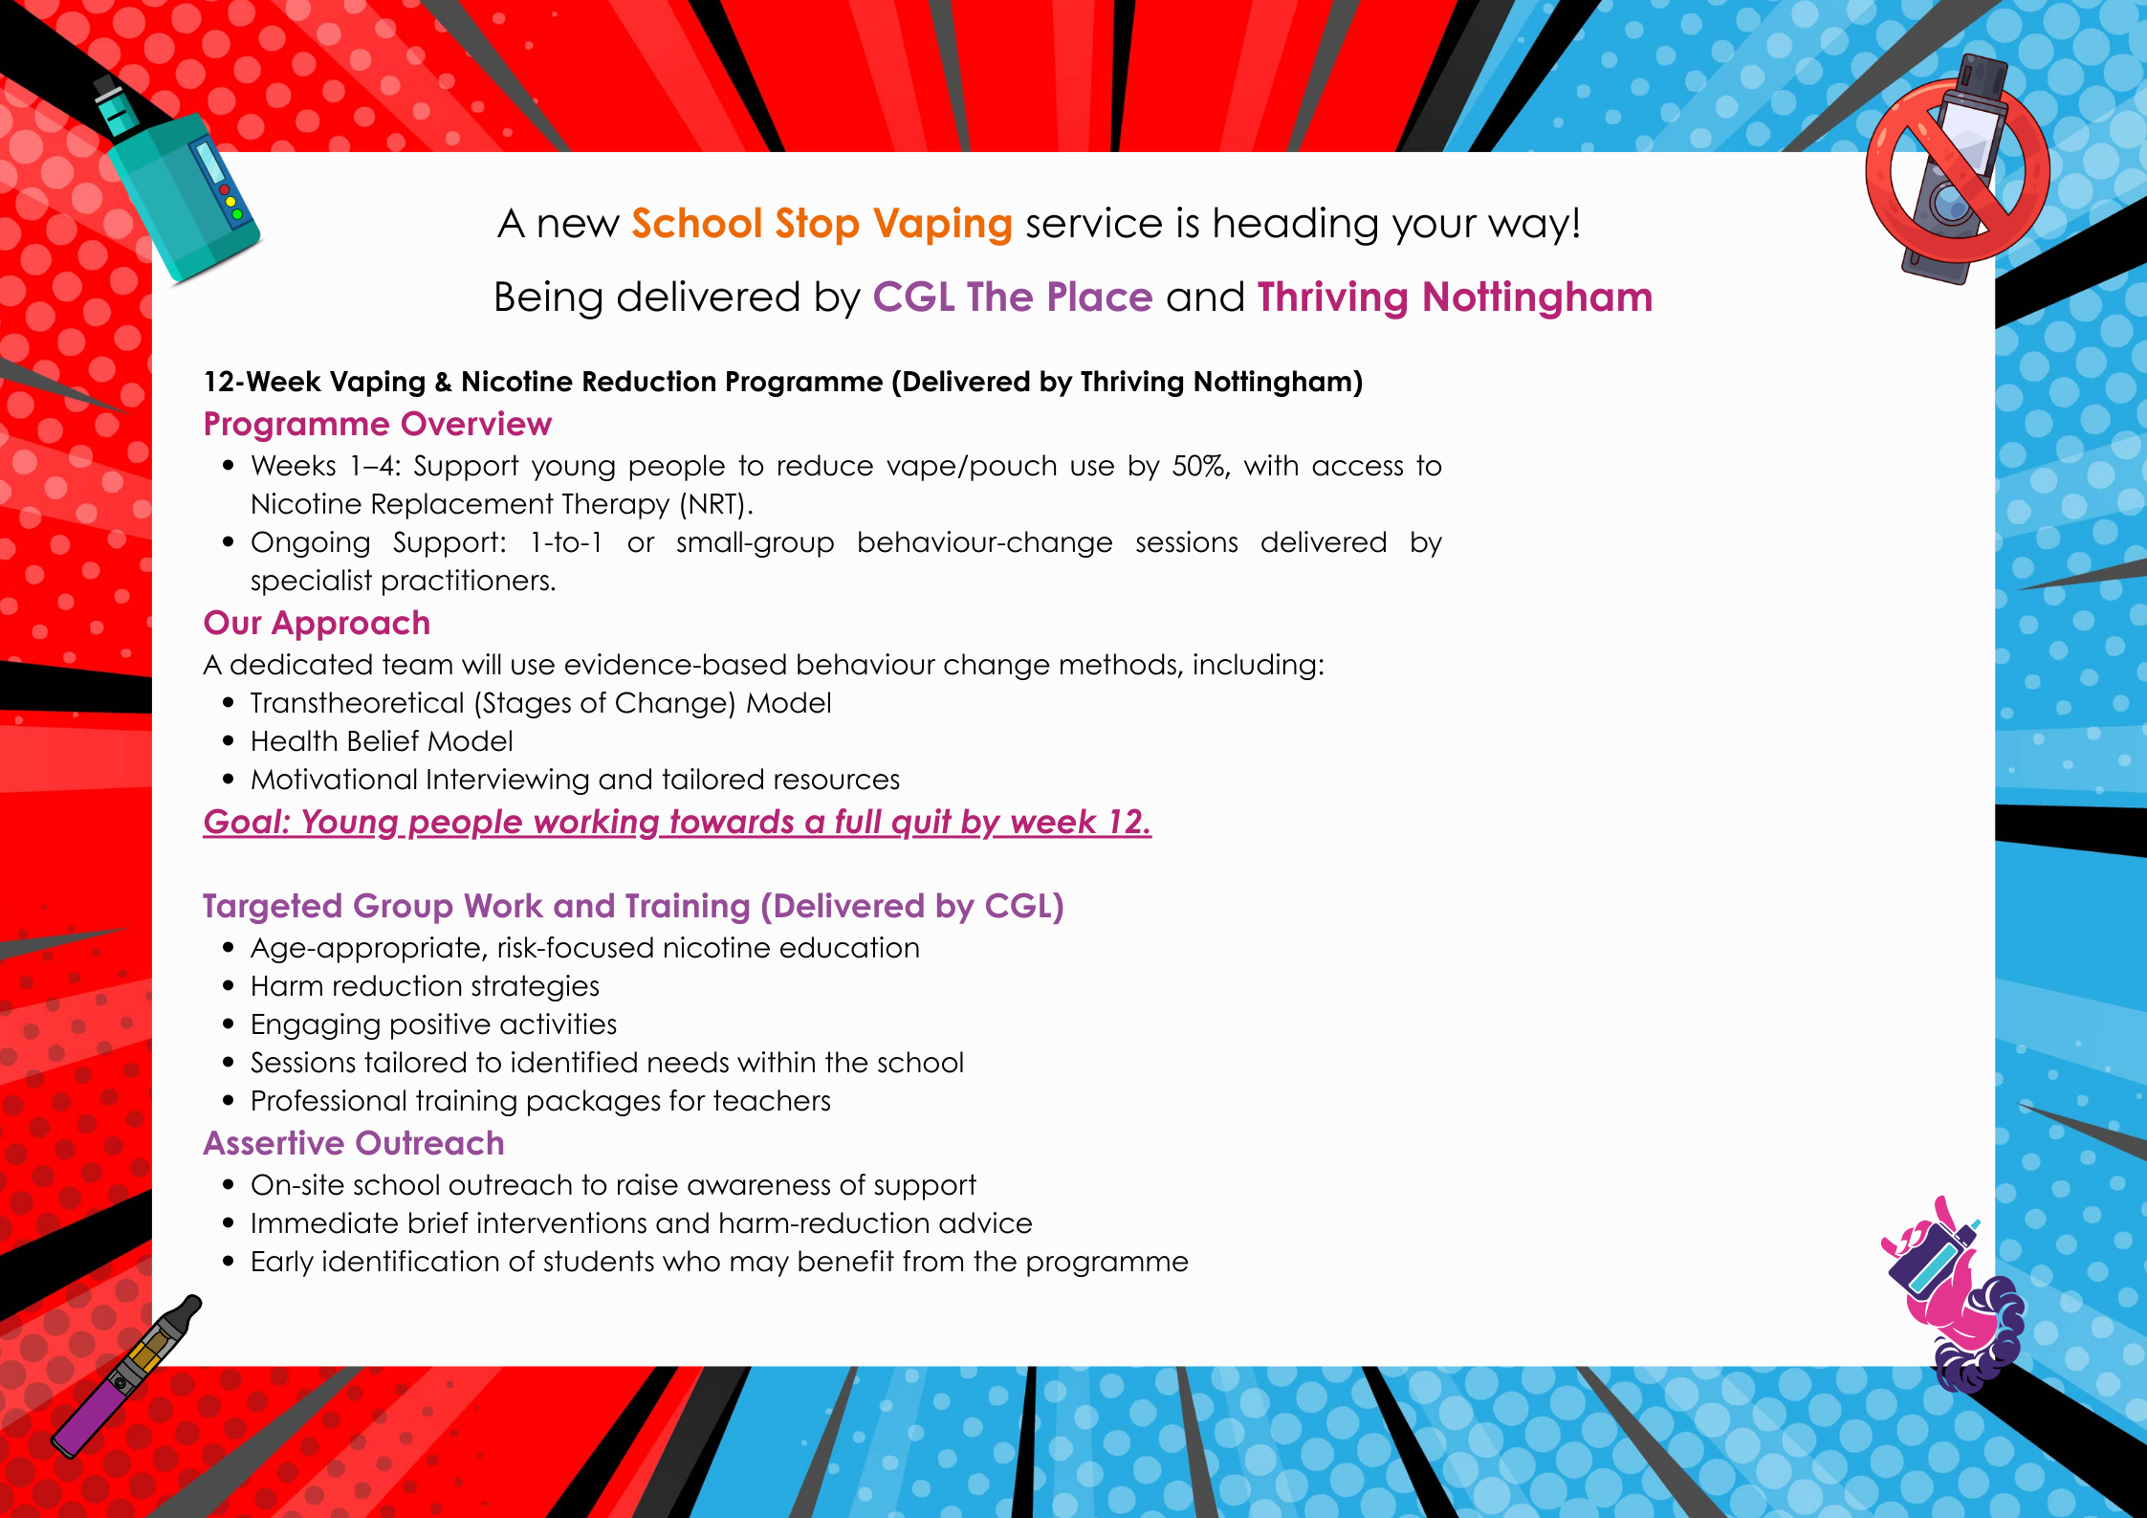
CGL- vaping service launch
Notes:
Local Updates – Claire Maclean

Slide 36

Vaping Name – Fill in form
Notes:
Vaping Name – Fill in form
https://forms.office.com/pages/responsepage.aspx?id=3LyvUBZJWkS7wVBP0GO2cWTVBSE9KFtNi8OK9Bw1UIlUNjRGSElVSk9WVDI4RVFPTzM4VURSVU1LUC4u&route=shorturl
Children to complete this before end of day 13th feb
Local Updates – Claire Maclean

Slide 37

DBS workshops
The DBS offer free monthly workshops for organisations to learn more about DBS processes and legislation.
You can find out more or sign up here:
DBS Disclosure and Eligibility Workshop,
DBS Barring and Legal Duty to Refer Workshop
DBS Enhanced Application Process Workshop
DBS Harmful Behaviour Outside of the Workplace
Notes:
Local Updates – Claire Maclean
Introduce Sarah Callaghan and Joni Hughes on next slide

Slide 38
Families First Partnership, Young Futures Hub and Family Hubs Programme January 2026
Nottingham City Council
Notes:
Sarah Callaghan and Joni Hughes - Family First Partnership updates

Slide 39
Families First Partnership Programme – Highlights Report
Project Manager: | Joni Hughes
Date: | January 2026
RAG Status:
Critical Milestones This Period / Next Period (Families First)
Progress to date
DFE Submission Complete
Comms Officer Recruited
Education Roles Drafted
Project Support Officer Roles advertised, one recruited starting on the 18th January
Meeting with Mutal Ventures for extra government support
Interim Continuum of need documents launched with partners
Family Help Mapping Complete
Draft Family Help Strategy in circulation
Progress next reporting month (January)
Quarter 4 data submission for the DFE
Recruitment of the 2nd project support officer, Missing and Exploitation Lead and the FFp Education roles (5)
Updating of the overarching programme plan with HOS
Service mapping of the Front Door
Workshops for the joint continuum of need documentation with County
Workshop for further shaping of the Family Help Strategy
Children and Families Assessment Launch
Develop a communications plan for sign off
Notes:
Sarah Callaghan and Joni Hughes - Family First Partnership updates

Slide 40
Families First Partnership Programme – Highlights Report
Project Manager: | Joni Hughes
Date: | January 2026
RAG Status:
Critical Milestones This Period (Young Futures Hub)
Progress to date
Attended several government planning sessions
Completed a YFH site appraisal with corporate landlord
Held first multi agency project board
DLT paper for sign off on the recommended venue
Completed extensive co-production with children and young people
Completed multi agency and VCS engagement sessions
Circulated draft action plan taken from the government recommendations
Progress next reporting month (January)
Submit final implementation plan to DCMS
2nd project board to agree on sub workstream plan to deliver on the action plan
Executive Board Paper to receive the grant and agree the venue
Further partnership engagement sessions
Setting up of a youth council to attend a year long schedule of events
Initiate a capital project with property services
Attend a government panel meeting to discuss the bid submission
Notes:
Sarah Callaghan and Joni Hughes - Family First Partnership updates

Slide 41
Families First Partnership Programme – Highlights Report
Project Manager: | Joni Hughes
Date: | January 2026
RAG Status:
Critical Milestones This Period (Family Hubs)
Progress to date
Agreement that Family Hubs joins the FFP
Progress next reporting month (January)
Scoping
Project Plan
Risk Log
Investment action plan for remaining family hub monies
Map service offer
Notes:
Sarah Callaghan and Joni Hughes - Family First Partnership updates

Slide 42
Summary of activity so far
Young Futures Hub – Youth Engagement Update
We’ve made fantastic progress in engaging young people across Nottingham for the Young Futures Hub and Youth Space. Here’s what’s been achieved so far: 510 responses to the survey.
Survey Reach & Responses
Distributed to all LA secondary schools, academies, and alternative provisions and shared with some faith-based schools
Circulated to voluntary sector youth providers, some of whom will host face-to-face sessions in coming months.
Contact made with the Multi-Faith Council.
Duplicate survey going out to children in foster care, residential settings (including out-of-area), and care leavers.
HAF Teams contacted and survey shared
Notes:
Sarah Callaghan and Joni Hughes - Family First Partnership updates

Slide 43
Other important information
Common Themes:
Many respondents emphasised that the hub would help young people who feel unsure about their future or need guidance after school.
The hub is seen as a place where young people should feel secure and be themselves.
Young people highlighted the importance of having easy access to advice, support, and opportunities.
Young people have said that the hub should assist those who are most vulnerable or struggling.
Young people said that the hub should focus on fostering kindness, inclusion, and a sense of belonging.
Young people want the hub to be accessible – what does this mean?
Most of all, YP tell us they want the hub to be safe.
Notes:
Sarah Callaghan and Joni Hughes - Family First Partnership updates
Back to Claire Maclean for the break

Slide 44


Break Time
See you in 5
Notes:
Claire Maclean – Break
Introduce Alys Finch on next slide

Slide 45
Safeguarding in our schools and our city: ensuring effectiveness and cultivating culture through great governance
Notes:
Alys Finch – Governance and safeguarding

Slide 46
Session aims
In this part of the session, we’ll explore:
The meaning and role of governance in enabling and ensuring effective safeguarding
Our roles as governors, school leaders, DSLs, and NCC colleagues in effective safeguarding governance
Key things to do, know, understand, and lead in our roles
Where effectiveness meets culture
Key questions to take back into your setting and your next steps as a leader of safeguarding
Notes:
Alys Finch – Governance and safeguarding

Slide 47
The meaning and role of governance in enabling and ensuring effective safeguarding
Governance IS…
Governance ISN’T…
Fundamentally: safeguarding is everyone’s responsibility – this includes creating, growing and maintaining a culture of safeguarding.
This is about what we do, how we do it, why we do it, and all of us owning safeguarding at every level.
….and cultivating culture!
Notes:
Alys Finch – Governance and safeguarding

Slide 48
Our specific roles in effective safeguarding governance
Notes:
Alys Finch – Governance and safeguarding

Slide 49
Governors – the strategic eye
Key things to know:
Governors are the strategic leaders, responsible for safeguarding arrangements ensuring compliance in your school.
Governors are a critical friend and play a key role in the internal audit of safeguarding.
Key things to do:
Ensure appropriate policies, procedures and systems are effective, compliant and reviewed annually or when changes arise.
Ensure staff and governor training is completed at induction and training is updated regularly. Also, children are taught how to keep themselves and their peers safe, including online.
Ensure the school contributes to multi agency working (ref: Working together to safeguard children)
Be aware of your obligations under the Human Rights Act 1998 , the Equality Act 2010, (including the Public Sector Equality Duty), and their local multi-agency safeguarding arrangements KCSiE part 2, pages 26 - 27).
Ensure a whole school approach to safeguarding, everyone is responsible. All systems, processes and policies should operate with the best interests of the child at their heart.
Appoint a designated LAC teacher and ensure that staff have the skills, knowledge and understanding to keep looked after children and previously looked after children safe. Also appoint a LAC governor (this may be included in the safeguarding governor role).
Appoint a safeguarding governor who will undertake monitoring visits, report to governors, review policies and procedures and support the DSL in completion of the safeguarding audit.
Notes:
Alys Finch – Governance and safeguarding

Slide 50
Governors – the strategic eye
Key things to lead
Responsible for safeguarding arrangements, for example review and approval of policies, ensuring robust systems and procedures are embedded and monitoring of those policies, systems and procedures.
Managing allegations in respect of the Head.
What does ‘effective and compliant’ look like in this role?
Monitoring of trends, themes and patterns, follow up and action, impact and outcomes.
Children’s voices being heard and views acted upon.
Training and expectations for staff and governors.
Support for the DSL.
Engagement with partners and other professionals.
Consistency and continuity in record keeping, effective use of CPOMs /My Concern etc and reporting.
Clear, impactful internal communication/ external communication.
Full engagement of and with the SLT and governors.
Notes:
Alys Finch – Governance and safeguarding

Slide 51
Governors – the strategic eye
Be willing to think the unthinkable that it could happen at your school.
On going culture of vigilance by all in the school.
Keep the child’s best interests at the centre.
Take responsibility.
What might ‘culture’ look like in this role ?
We’ll come to this when we come to the roles as parts of the same governance piece!
Notes:
Alys Finch – Governance and safeguarding

Slide 52
DSLs (and Heads!) - Effective safeguarding governance = Leadership + Culture + Systems + Accountability.
1. Strong, Visible Leadership
2. Clear Policies, Procedures & Frameworks
3. A Safe Organisational Culture
4. Effective Training & Competence
5. Robust Safe Recruitment Practices
6. Data, Insight & Effective Record-Keeping
7. Partnership Working
8. Accountability, Assurance & Oversight
9. Listening to Children, Adults & others
10. Continuous improvement
Notes:
Alys Finch – Governance and safeguarding

Slide 53
What does ‘Effective’ look like?
Strong, Visible Leadership
All leaders (staff, SLT, DSLs, Governors, Trustees) understand the risks, allocate resources, and model expected behaviours.
2. Clear Policies, Procedures & Frameworks
Staff know exactly what to do if they are worried about someone.
3. A Safe Organisational Culture
People feel safe speaking up—and are taken seriously when they do.
4. Effective Training & Competence
Everyone—from reception to senior leaders—understands signs of harm and how to respond.
5. Robust Safe Recruitment Practices
Only suitable and safe individuals gain access to children or vulnerable adults.
Notes:
Alys Finch – Governance and safeguarding

Slide 54
What does ‘Effective’ look like?
6. Data, Insight & Effective Record-Keeping
Leaders can spot risk early and make informed decisions.
7. Partnership Working
No organisation tries to “manage risk alone”; collaboration protects people better.
8. Accountability, Assurance & Oversight
Safeguarding is part of governance—not just operational practice.
9. Listening to Children, Adults & others
The voices of those at risk directly influence policy and practice.
10. Continuous Improvement
The organisation becomes safer every year because learning is embedded.
Notes:
Alys Finch – Governance and safeguarding

Slide 55
Where Governance meets Culture
what an effective safeguarding culture in schools looks like:
Safeguarding is understood as everyone’s responsibility, not just the DSL’s and senior leaders.
Children feel safe, listened to, respected, and know who to talk to if they’re worried.
Staff are trained, vigilant, and confident in recognising and reporting concerns.
Leadership sets the tone with strong oversight, accountability, and visible support for safeguarding.
Communication is open and transparent, with no fear around raising concerns.
Record keeping is accurate, timely, thorough, and secure.
The curriculum teaches pupils about safety, relationships, and how to seek help.
Safe recruitment practices ensure adults working in school are safe and suitable.
The school environment is inclusive, supportive, and promotes pupils’ wellbeing.
The school works effectively with families and external agencies for early help and protection.
.
Notes:
Alys Finch – Governance and safeguarding

Slide 56
And… Ofsted!
Notes:
Alys Finch – Governance and safeguarding

Slide 57
Key questions to take back into your setting
To what extent do we have a ‘culture’ of safeguarding, not just effective, compliant safeguarding?
What do we need to continue/start/stop as school leaders and governors to grow our culture of safeguarding in our school?
What do our staff/governors/children/families need for them to ‘own’ their part in our culture of safeguarding? How will we enable this?
What does/will a culture of safeguarding look, feel, and behave like in our setting when it’s embedded?
What is ‘a safeguarding culture’ in your setting?! Does everyone share the same answer and understanding?
Notes:
Alys Finch – Governance and safeguarding

Slide 58
Your next steps as a leader of safeguarding
Commit to:
One takeaway from this session
One thing you’ll do by half-term based on this session
One connection/idea you’ll follow up from this session in the next 6 weeks.
Notes:
Alys Finch – Governance and safeguarding
Introduce Sonia Burton and Kirsty Davison on next slide

Slide 59


Adolescence family help Service to include Exploitation case study
Notes:
Sonia Burton and Kirsty Davison – Exploitation

Slide 60
National Reform
A national focus on prevention and early intervention.
The new national framework, Families First Partnership Programme and Children’s Social Care reforms
https://www.gov.uk/government/publications/families-first-partnership-programme
The aim of the Families First Partnership (FFP) programme is to transform the whole system of help, support and protection, to ensure that every family can access the right help and support when they need it, with a strong emphasis on early intervention to prevent crisis.
This support will be delivered by skilled, multi-disciplinary professionals from a range of backgrounds who will help families to navigate support by building strong and trusting relationships with them.
Notes:
Sonia Burton and Kirsty Davison – Exploitation

Slide 61
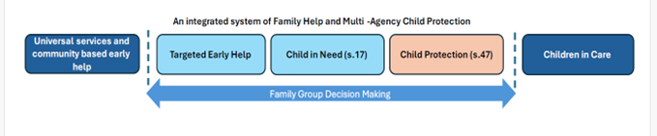
Family Help
Nottingham City Council Transformation based on national reforms and peer reviews and Ofsted recommendations
Family Help is for all children, young people and families whose needs are multiple and/or complex, meaning that a family’s needs are above the level of universal and community based early help
Notes:
Sonia Burton and Kirsty Davison – Exploitation

Slide 62
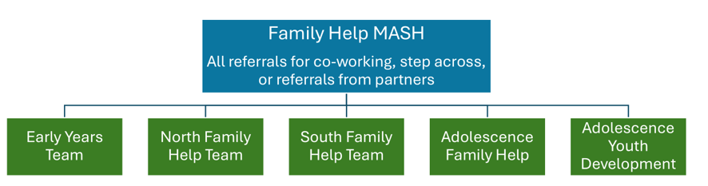
Family/adolescence early help
Network meetings and missing returns
Co-working with social care
Notes:
Sonia Burton and Kirsty Davison – Exploitation

Slide 63
Utilising Family Strengths and Networks
Families will be assigned a Family Help Worker as a lead professional who will assess the needs of the family, coordinate the family plan and draw upon a wider group of professionals to form a multi-disciplinary Team Around the Family (TAF).
The family plan should have actions for the network alongside professionals to bring about long-term sustainable change
Family Network Meetings will form part of all Family Help assessments and will:
Include wider family, beyond immediate parents and carers, in the development of plans which is critical to supporting sustainable improved outcomes.
Utilise genograms and eco-maps during the assessment period to build a picture of the family network.
Support the family to help identify solutions and continue to keep children safe, happy and healthy.
Notes:
Sonia Burton and Kirsty Davison – Exploitation

Slide 64
Adolescence Family Help
An integrated model with children at the heart of it
Missing, exploitation, diversion and youth justice delivered via an integrated service delivery model
A focus on earlier prevention and diversion away from the justice system
Retains a youth justice identity for statutory work
Use of the YJB Child First approach and values
Trauma aware relationship-based practice, utilising systemic therapy approaches
Informed by a profile of need which will highlight which child the new team will focus on
Community is key to prevention with visible youth staff who know the community and children
Utilises the skills and knowledge of partners
Notes:
Sonia Burton and Kirsty Davison – Exploitation

Slide 65
Jimmy Case Study
Jimmy is 13 years old and 9 months. He lives at home with his mum and dad, who both work full –time. He has two younger sisters, one is 11 and one is 10 years of age.​
Jimmy has had a number of fixed term exclusions due to what is described as ‘challenging behaviour.’​
He is now starting to be loud and disruptive in class and his time keeping is poor, he regularly arrives late to school and lessons, he as had a number of playground fights with peers.​
Notes:
Sonia Burton and Kirsty Davison – Exploitation

Slide 66
Jimmy
Jimmy is now 14 he still lives at home with both parents, who still both, work full-time.
He was reported missing and found in the early hours of the morning in possession small of a small amount of cannabis.​
He was detained and returned home to his parents.​
​
Notes:
Sonia Burton and Kirsty Davison – Exploitation

Slide 67
Jimmy
Jimmy is now 15 he still lives at home with both parents, who still both work full-time. There has been more missing episodes and he was found to be in possession of a knife in his school bag.​
The knife was not brought out of the bag by Jimmy. Jimmy had shared with some of his peers that he had the knife and was overheard by a member of staff.​
The police were called who arranged for Jimmy to be voluntary interviewed at the local police station.​
Notes:
Sonia Burton and Kirsty Davison – Exploitation

Slide 68
Jimmy
Jimmy's school attendance has dropped, he is now showing 52% attendance, some of this is lateness.​
​
Jimmy has had a number of fixed term exclusion due to continued decline in his behaviour. He had a fight with another child and a member of staff was hurt during this altercation. ​
Jimmy is permanently excluded.​
Notes:
Sonia Burton and Kirsty Davison – Exploitation

Slide 69
Jimmy
Jimmy is placed in alternative provision. There have been concerns of him smelling of cannabis.​
He has been seen with two phones and other children have shared a picture from his social media of him with a large knife, with two other bigger young people. They are all wearing face covering. ​
Notes:
Sonia Burton and Kirsty Davison – Exploitation

Slide 70
Jimmy
Jimmy has been reported missing and was missing for 3 days.
He was found in Newark in the home of a vulnerable adult.​
There was a large amount, of drugs and money in the house.​
​
Notes:
Sonia Burton and Kirsty Davison – Exploitation

Slide 71
Jimmy
The police completed a National Referral Mechanism and a
public protection notice was sent to Nottingham Social Care
(City MASH)​
Jimmy was bailed back to Nottingham and a social care
assessment was undertaken.​
​
Notes:
Sonia Burton and Kirsty Davison – Exploitation

Slide 72
Team Around the Family and TAF Workers
Many agencies already provide support to children, young people and their family when they experience increasing needs. The TAF model will acknowledge this work, increase consistency across the partnership and reduce duplication, ensuring families receive the right support from the right service at the right time.
All families should be offered an Early Help Assessment (EHA) by a professional they have an existing relationship with, such as a teacher or health visitor. This person will become the Lead Professional, if the family wish them to do so, creating a Team Around Family network and multi agency plan
TAF Workers, a new role within Family Help, are practitioners who support external agencies who complete EHAs, plans and lead TAF meetings. They offer TAF development support, Quality Assurance support and ‘case conversations’ (supervision) for external Lead Professionals. They lead workshops, forums and bespoke support to all external agencies.
Notes:
Sonia Burton and Kirsty Davison – Exploitation

Slide 73
Exploitation
Current:
Completion of Exploitation tool kit
Attendance at Exploitation Risk Management Meeting
Actions recorded on liquid logic with review date by Chair of ERMM
Exploitation tool kit to be reviewed prior to review meeting
Future:
A joined-up approach between City and County
A review and updating of the toolkits and meetings which take place
A bigger focus on disruption of the perpetrators
Notes:
Sonia Burton and Kirsty Davison – Exploitation

Slide 74
Interventions
Adolescent Workers provide 1:1 direct face to face work with child.
Safety planning with family, and agencies.
NRM – National Referral Mechanism. Identifies child as the victim. https://www.gov.uk/government/publications/human-trafficking-victims-referral-and-assessment-forms/guidance-on-the-national-referral-mechanism-for-potential-adult-victims-of-modern-slavery-england-and-wales
Philomela protocol – missing children
Disruption work by police. https://www.gov.uk/government/publications/child-exploitation-disruption-toolkit/child-exploitation-disruption-toolkit-accessible#reactive-action
Child in need plans for those children who are high risk.
Early help for those children at moderate risk.
Partner agencies to continue to support for children with emerging concerns.
Notes:
Sonia Burton and Kirsty Davison – Exploitation

Slide 75
Children who are missing
Current:
Return interviews need to be completed within 72 hour of child returning notification being received.
If a child has 3 missing episodes in 90 days or missing for over 72 hours, multi-agency meeting to be arranged by lead practitioner
Future:
Return interviews will be completed by the child’s worker if open to services
If the child isn’t open, we will allocate to Family Help workers in either adolescence or family help team
A wider focus on contextual safeguarding
Notes:
Sonia Burton and Kirsty Davison – Exploitation

Slide 76
Referrals for Adolescence Family Help
Partners can continue to request support from Family Help and Adolescent Family Help via the Multi Agency Safeguarding Hub (MASH) at Nottingham City Council
The Multi Agency Referral Form (MARF) will continue to be used for both safeguarding and Family Help requests
We are aiming to have new partner assessment that will replace the MARF for Family Help requests by January 2026
The new partner assessment has been developed in collaboration with partners from education, health and wider partnership. This will be piloted from September 2025.
Notes:
Sonia Burton and Kirsty Davison – Exploitation
Introduce Claire Maclean on next slide

Slide 77
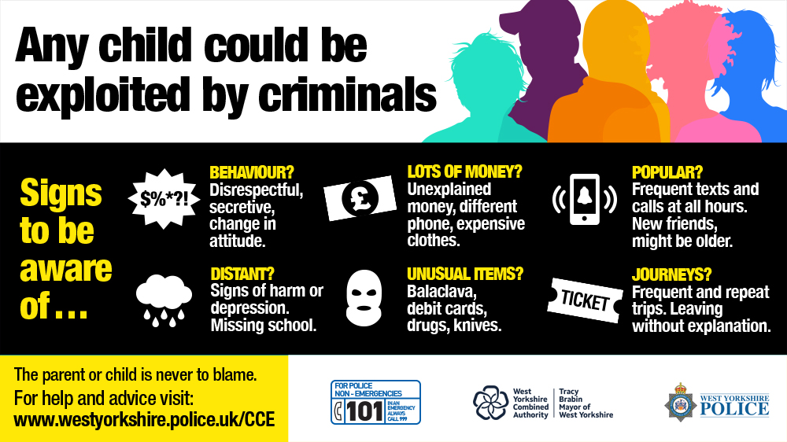
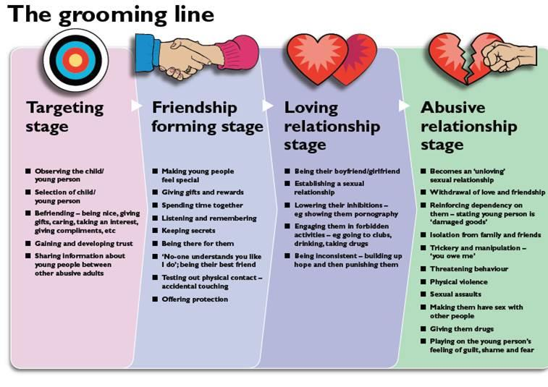
DSL – experience
Leicestershire Police: Are You listening?
Notes:
Claire Maclean – DSL Experience

Slide 78
DSL – experience
Key Actions for Understanding and Responding to Local Context Know Your Local Area Build an understanding of local group/ gang names, influential community members, group dynamics, signs, colours, and recent activity. 2.Work With Local Partners Engage regularly with agencies such as PCSOs, SEIOs, the VRP, and the YJS to share insight and strengthen joint responses. 3.Map School/Academy Links Identify any group affiliations connected to your setting using social media intelligence, incident reports, and student disclosures/ intel. 4.Strengthen Communication Ensure whole‑school training includes this topic. Make sure key staff understand how to spot, disrupt, and monitor activity, and know how to share intelligence (e.g., via 101 or your local sergeant). 5.Know Your Students Well Be familiar enough to notice changes in behaviour, language, clothing, valuable items, music preferences, peer groups, arrival times, or attendance patterns.
Notes:
Claire Maclean – DSL Experience

Slide 79
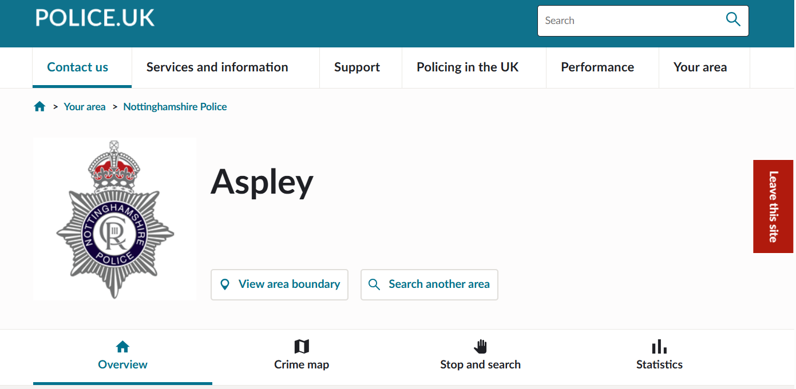
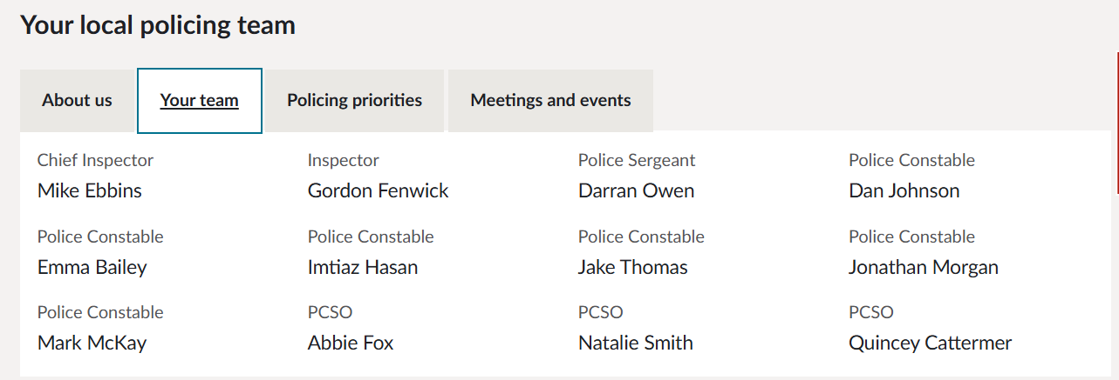
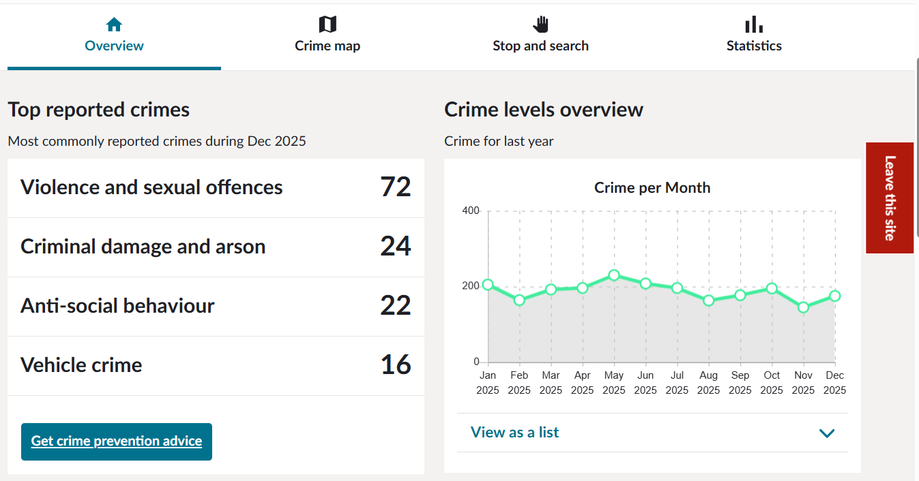
https://www.police.uk
https://www.nottinghampost.com/all-about/crime
Notes:
Claire Maclean – DSL Experience

Slide 80
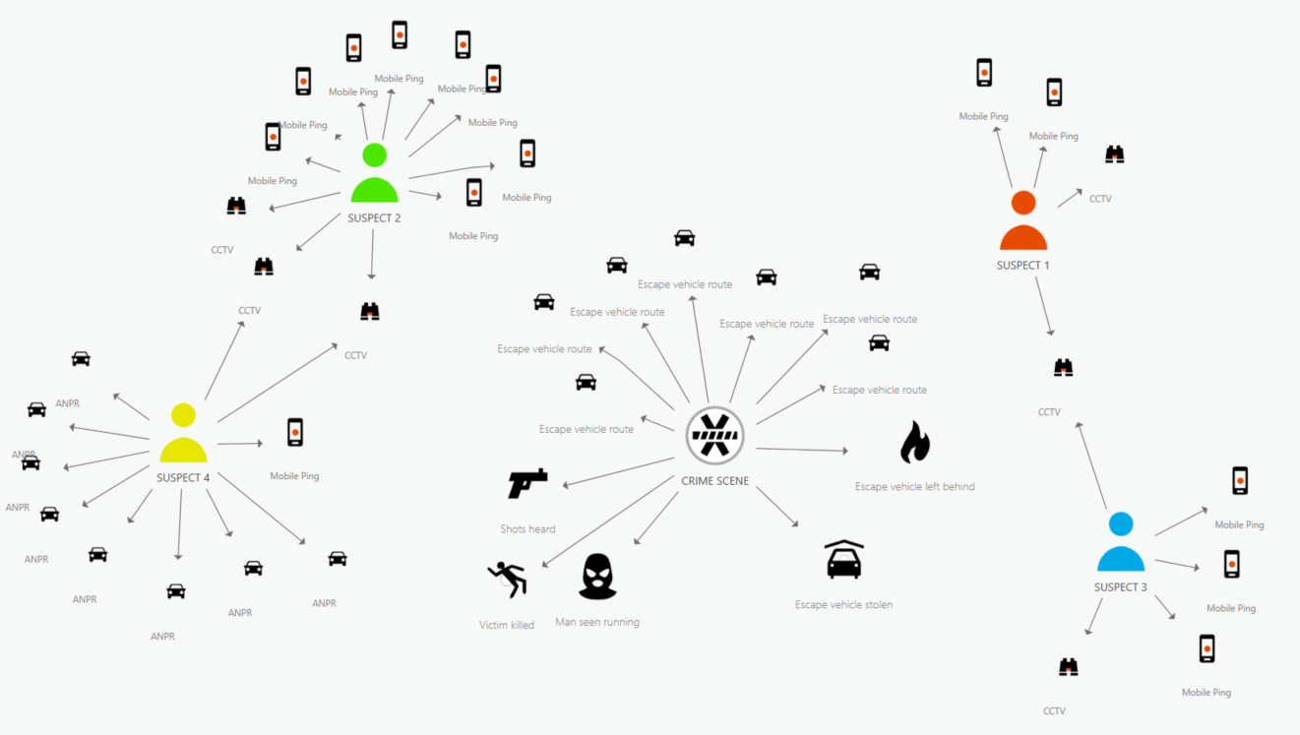

DSL exploitation tools
DSL 1:1
Safeguard training children and staff
Parent contact and meeting
Educate parents
Anonymous reporting
Inform police and MASH
Visibility outside school
Create safe spaces- build trust
Referrals and external support

Slide 81
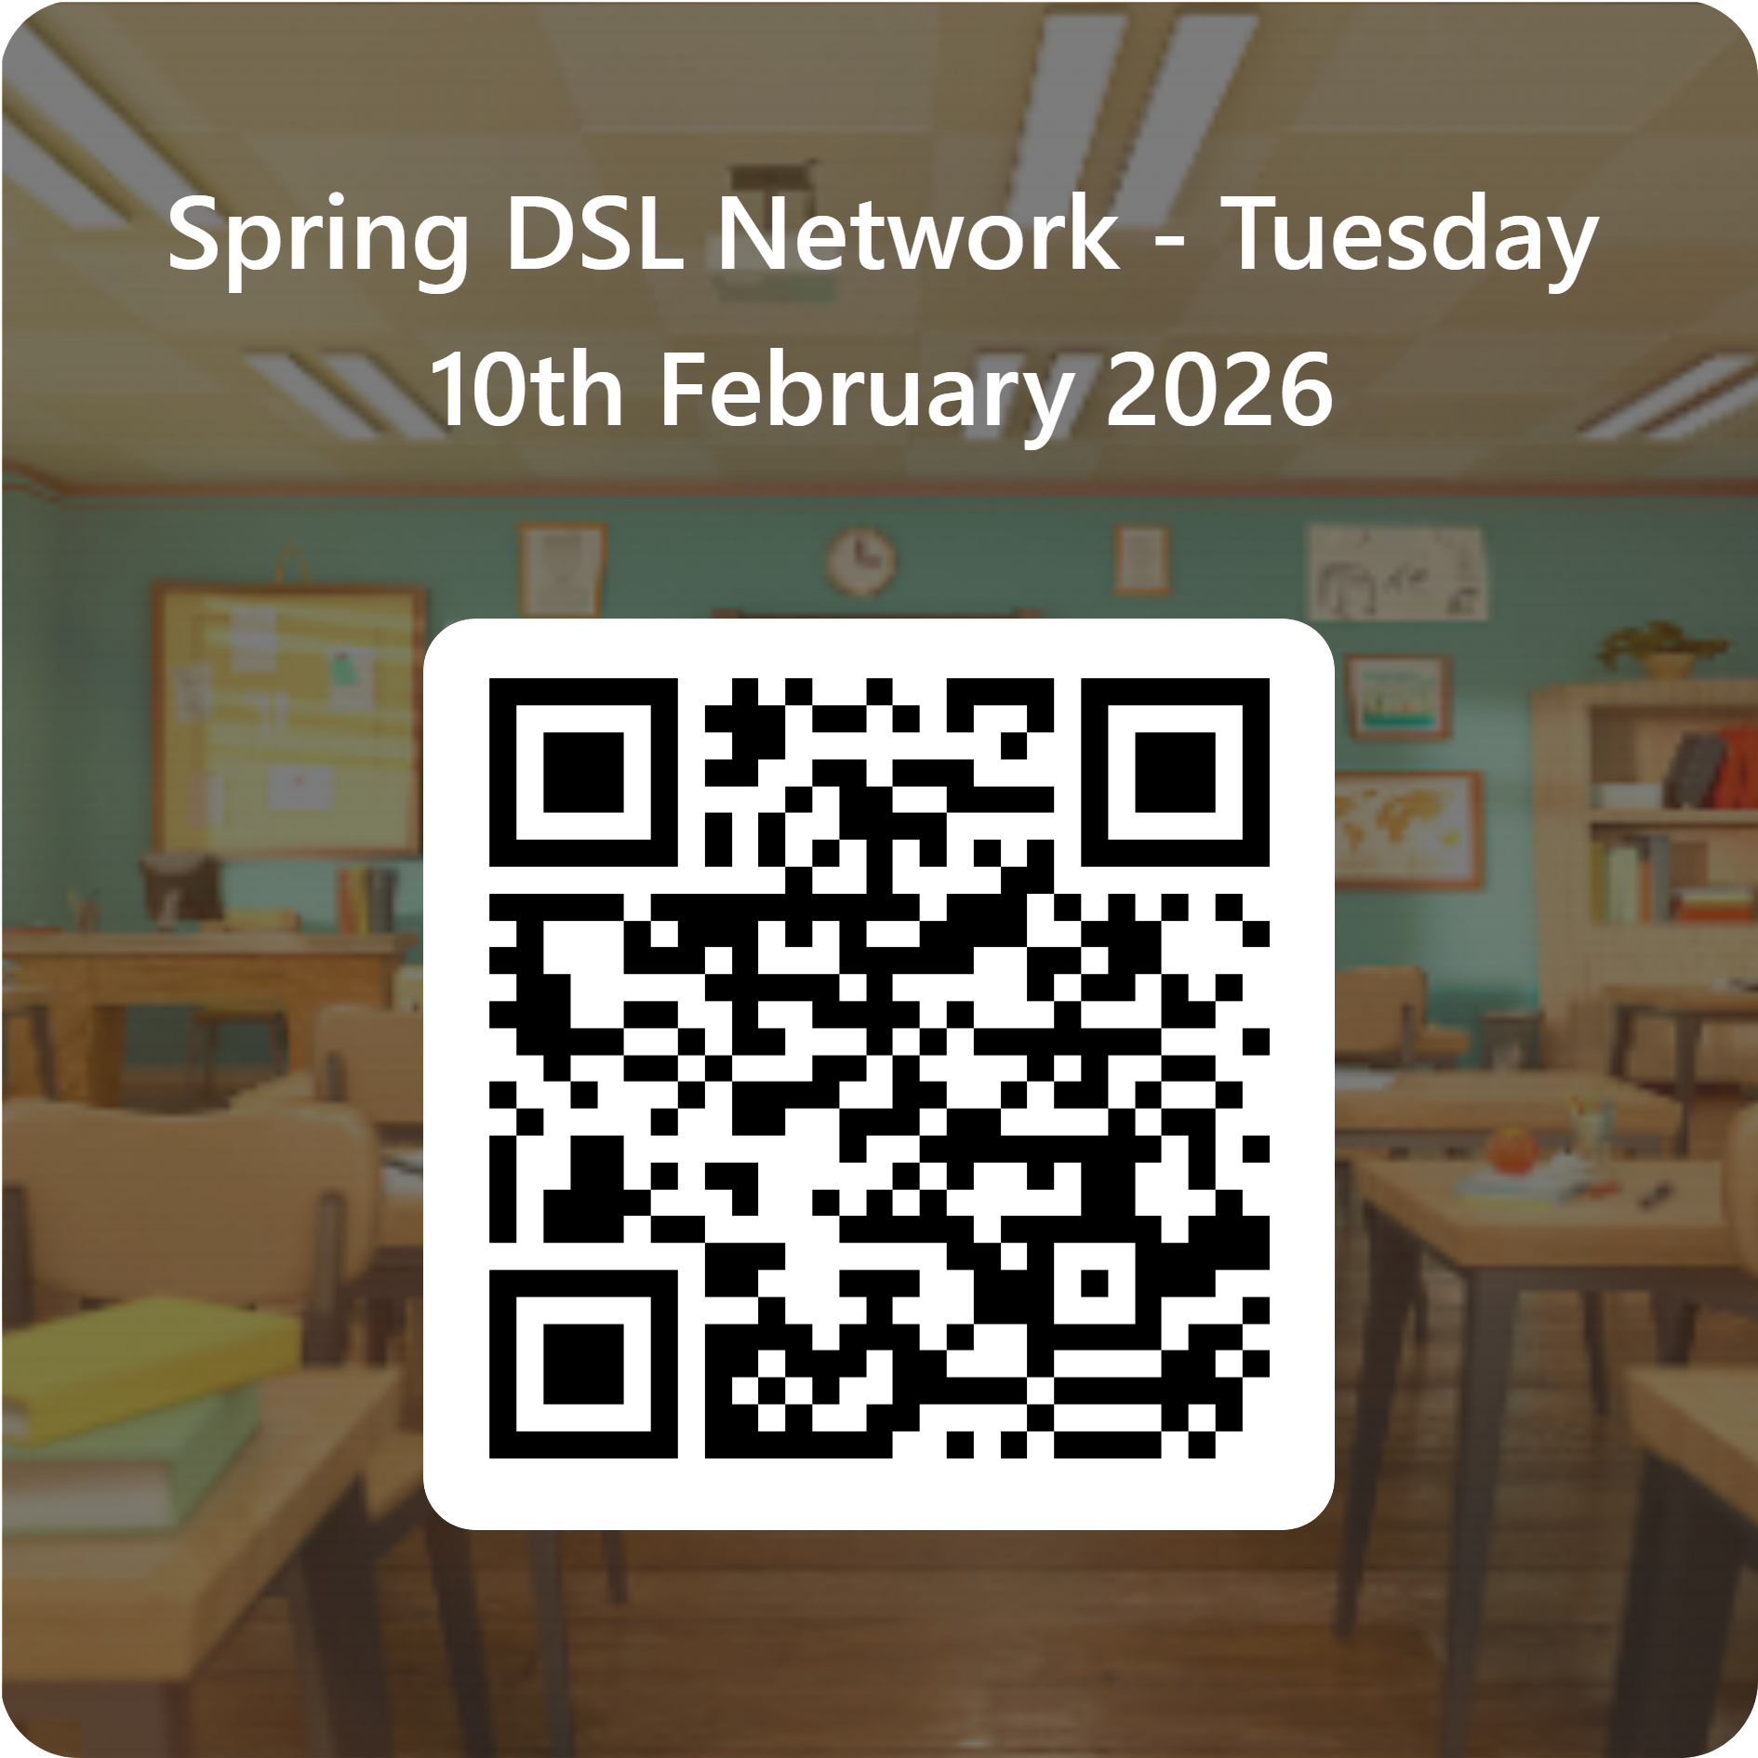



Feedback
We’d really appreciate your feedback from today in response to the content covered alongside any other thoughts on topics you may like to see included at future network events- thank you!
Notes:
Claire Maclean – Feedback

