Slide 1
Year 6
Knife Crime Lesson
Slides designed in collaboration with students at West Notts College

Slide 2
What do you know at the start of the lesson?

Slide 3
Before we begin…
Knife crime and carrying a knife are both very serious. It may have affected you or people you know.
If you (or someone you know) feel worried or anxious during or after the session or at any time, please let someone know.

Slide 4
What are we learning?
By the end of the lesson, you will:
Understand the laws and charges for carrying a knife
Understand how social media can influence a decision around carrying a knife
Know how carrying a knife impacts the lives of others
Know what to do if someone is carrying a knife

Slide 5
Group agreement
Share your ideas thoughtfully
Listen carefully to adults and classmates
Ask questions but not personal ones
Be kind and respectful to each other
Keep yourself and others safe

Slide 6
Three, Three, Three
At your tables you have 3 pieces of paper. There are 3 different questions, one on each paper.
You have 3 minutes on each paper.
The first minute you will need to talk in your group about your answers.
The second minute you will need to write down your answers.
The third minute you will need to read your answers over and be ready to share something with the class.
Notes:
Teacher to take photos of pupils mind maps to evidence knowledge and/or misconceptions

Slide 7
Three, Three, Three
What are the reasons for carrying a knife?
What laws and rules are in place around buying and carrying knives?
What could happen if you were found carrying a knife?

Slide 8
True, false or don’t know?
Let’s get active! Stand up and tuck your chairs in ready for the next task.
You are going to be shown some statements about the laws of carrying a knife.
If you think that what the statement says is true stand on the true side of the room. If you think the statement says it is false, stand on the other side of the room.
If you don’t know, that’s ok! Stand in the middle of the room.

Slide 9
True, false or don’t know?
A person can carry a knife if they need it for their work
A person can carry a knife if it is part of their religious dress
If a friend hands you a knife, you should hold it as it’s your friend
A person can carry a knife as part of their fancy dress costume
Shops are not allowed to sell knives to young people under 18
A person can carry a knife if they feel like they are in danger
Children 10 and over can be charged with a crime
You are safer carrying a knife than not carrying one
Notes:
Teacher to take photos of young people for evidence and understanding.
Answers:
True – if it is your trade such as someone who works in construction or a chef
True – Sikhs carry a kirpan, a small, blunt blade that is a sacred religious symbol and one of the five articles of faith in Sikhism
False – You should not carry a knife regardless of who hands it to you
False – A fancy dress costume does not excuse you for carrying a knife
True – Shops can only sell knives to adults aged 18 and over. When they are sold it is highly likely that they are in very strong packaging that can only be taken off safely at home using strong scissors
False – If you are in danger, you cannot carry a knife. It is illegal to carry a knife in a public area unless under certain circumstances as per the first two statements
True – If the police and authorities believe it to be necessary, anyone aged 10 and over can be charged with a crime. It can impact future education and job choices
False – It might feel like if you have a knife you can defend yourself and be safe. When actually, carrying a knife will often result in you being wounded.

Slide 10
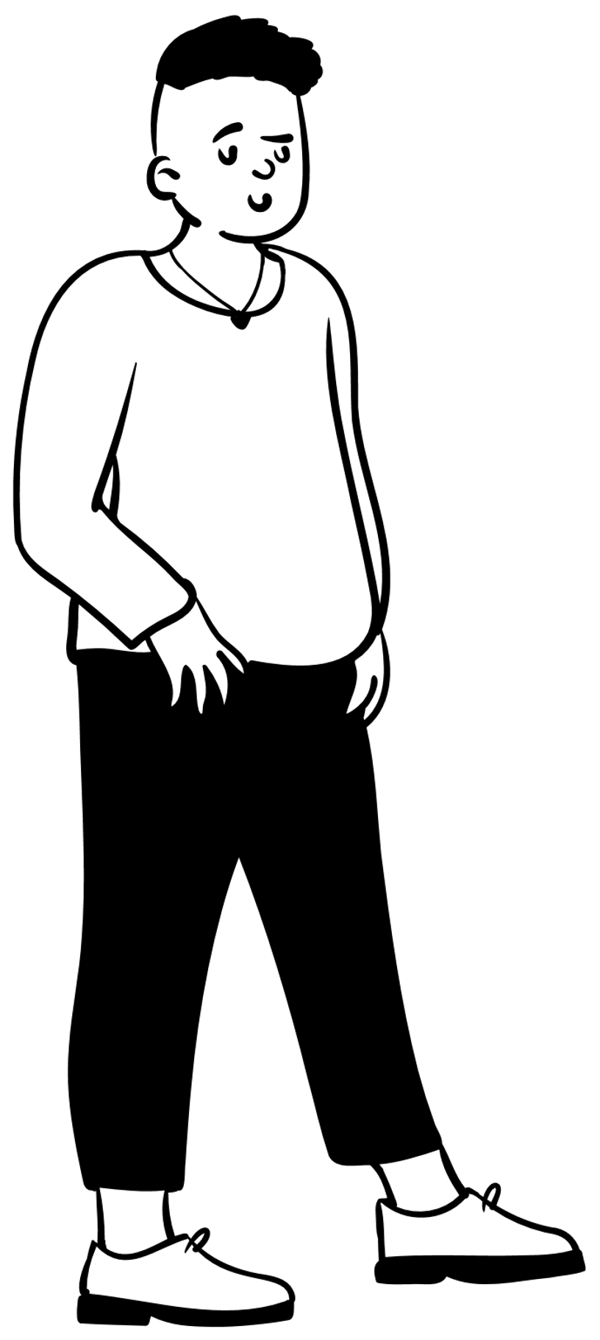
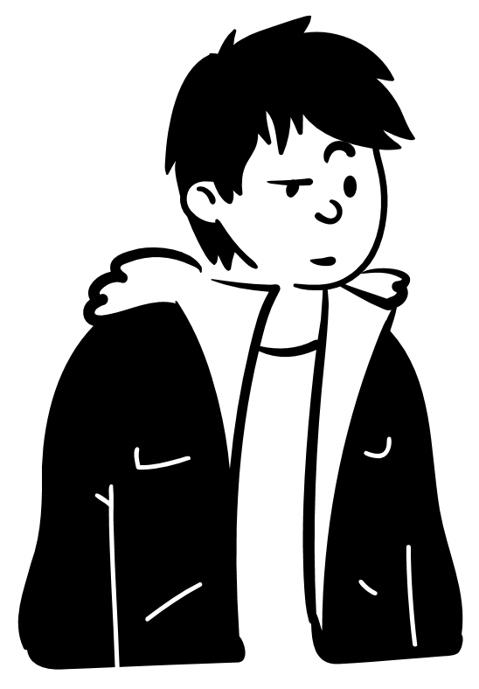
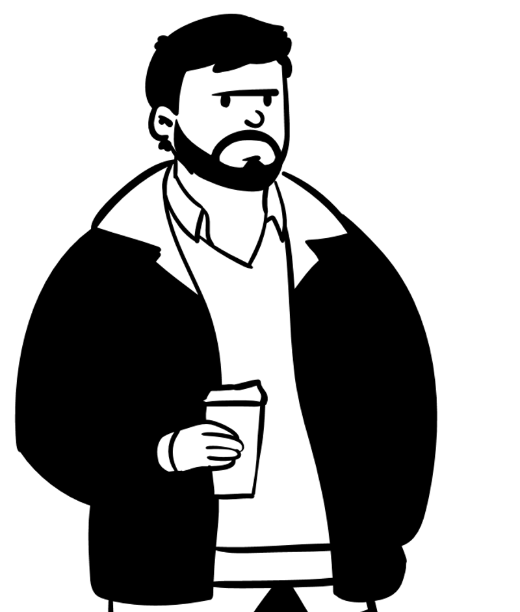
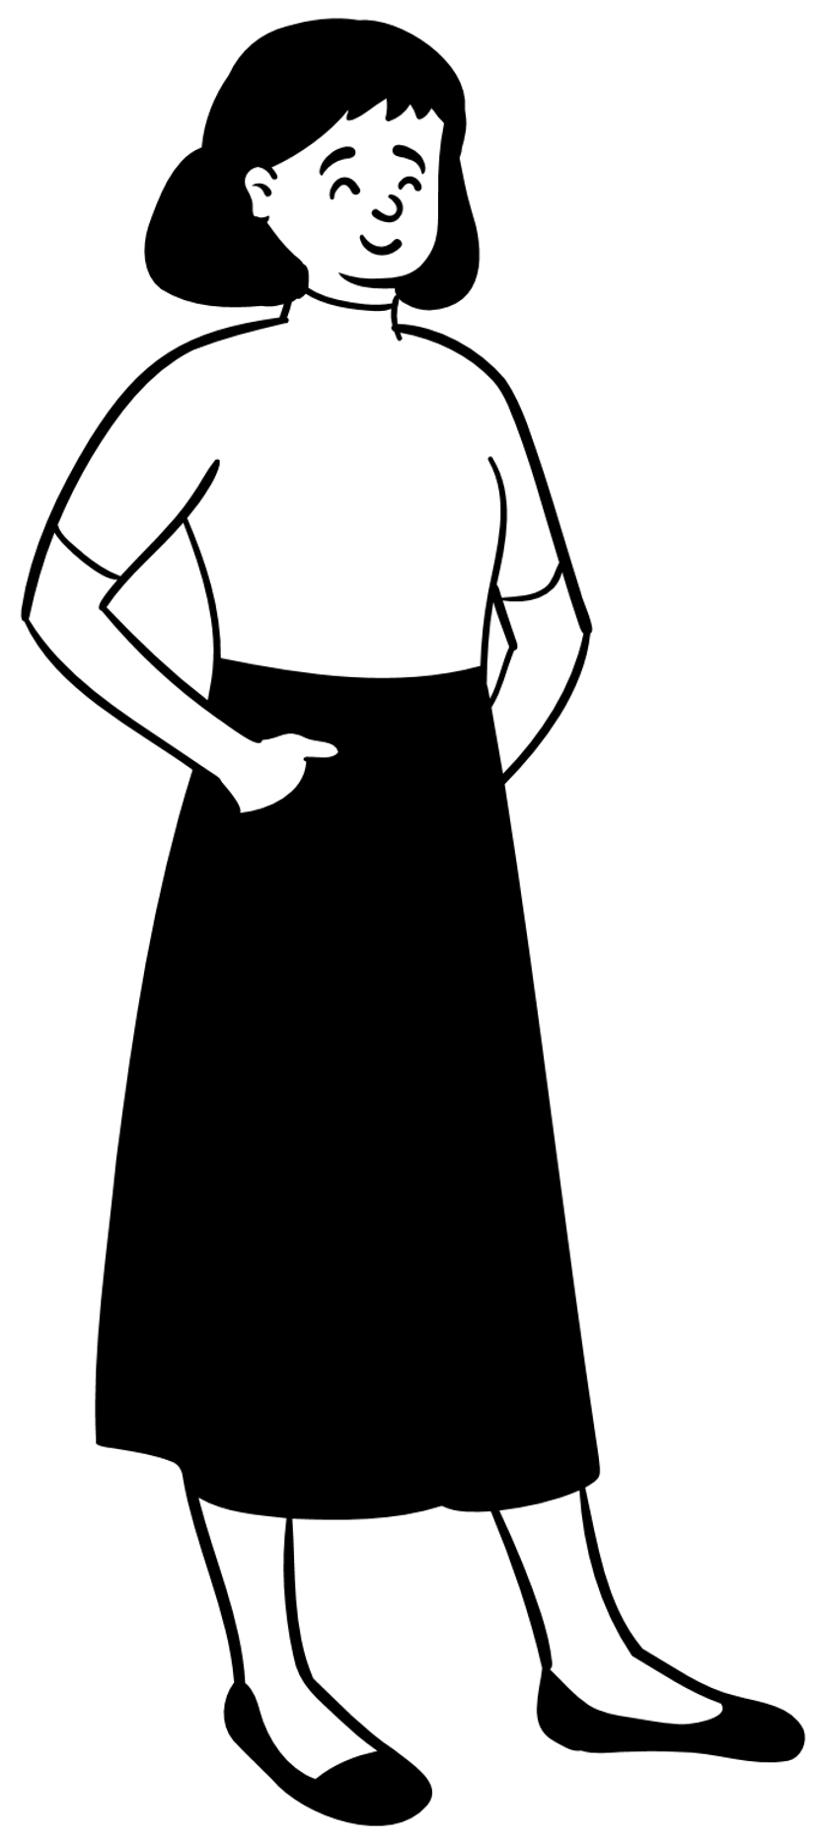
Meet the characters :
Older Kid (Marcus)
Kyle
Harry
The Strangers
(Luca and Aaron)
Jenny (Kyle’s Mum)
Officer Jones

Slide 11
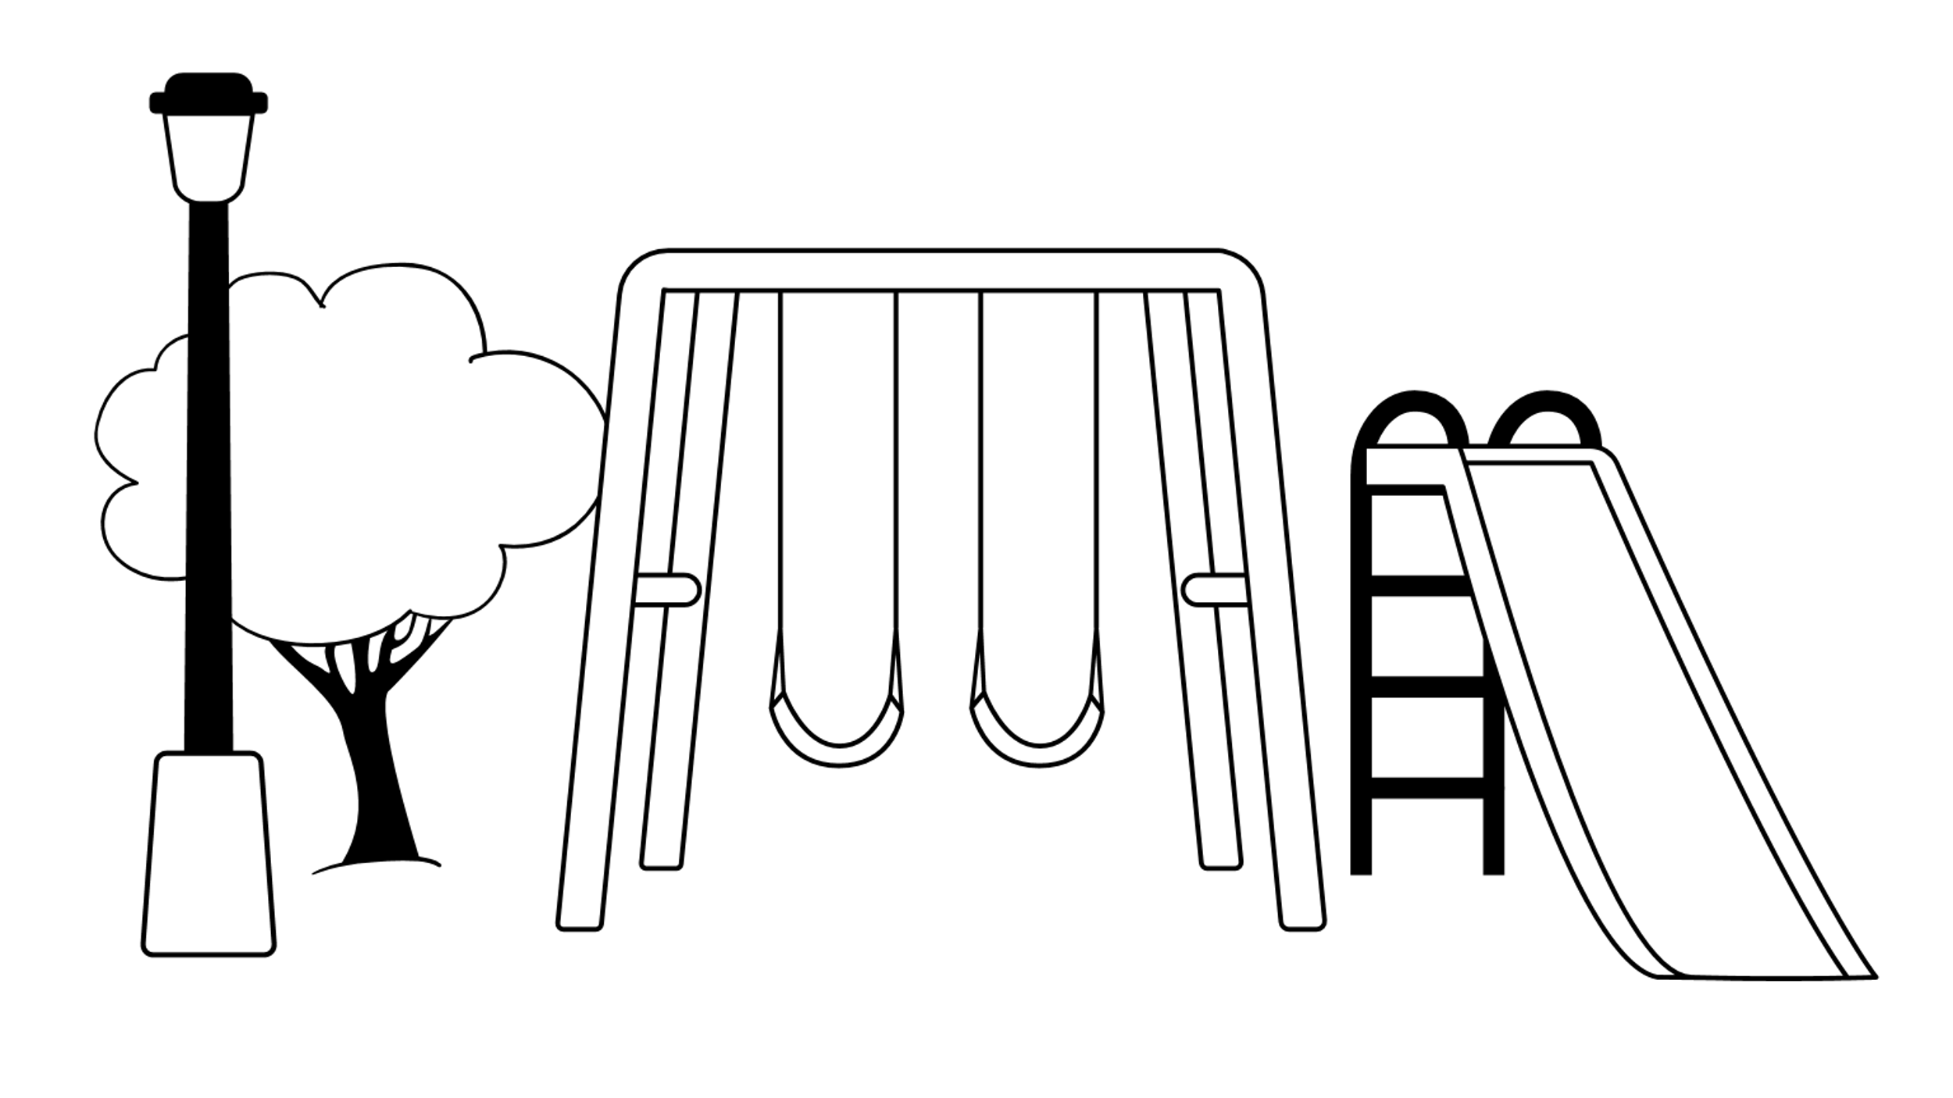
Kyle and Harry are the best of mates. They meet up at the local park quite often to ride their bikes and hang out. This time an older kid has turned up with a machete and is showing them. This isn’t the first time it’s happened.
Here, just hold it for a sec man! Why you being scared, you’d look sick with it.
Nah man, I don’t think I should…
You don’t get it. It makes you look dead hard, and people love that. I’m doing you a favour. All my mates at school think I’m the hardest.
I suppose if I look cool before secondary school, it might help making mates

Slide 12
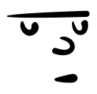
Kyle makes a decision. He decides to hold it for one photo that he might keep for later…
Yo you look cold! No one is gonna mess with you now, don’t worry about it.
I can’t wait to show this to people. I’m not going to have any problems in secondary.

Slide 13
Kyle attempts to give it back to the older kid, but he wants Kyle to keep it.
Nah man don’t worry I got another two at home! You hold on to that one.
I don’t think… Where should I put it?
Do I look like I care?
Just hide it and don’t tell anyone where you got it from.

Slide 14
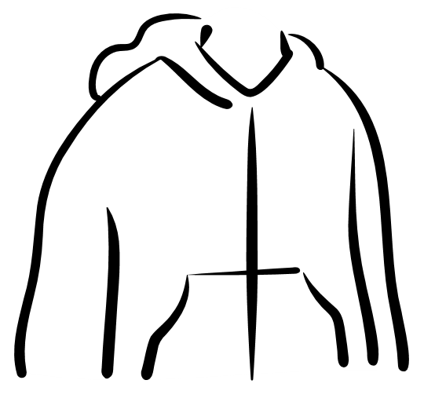
The next evening Kyle goes to the chicken shop down the road with Harry and the knife on him. He is approached by two strangers…
OI! YOU!
You’re that kid on Snap with the machete.
Wha… Nah it’s not like that, I’m not involved in anything
DON’T LIE.
GIMME THE KNIFE NOW!
Nah please, don’t hurt me just have it man

Slide 15
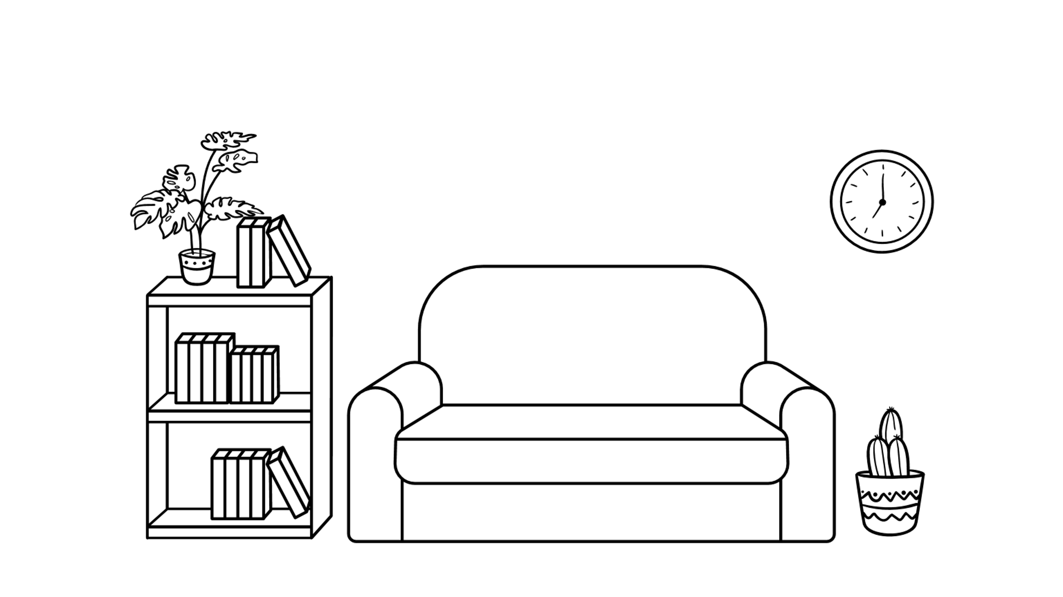
Kyle comes home and goes straight to his room. His mum calls after him but he refuses to talk to her and wants to be left alone…
Kyle!
What’s the matter? Did you meet Harry?
LEAVE ME ALONE!
Are you ok? What’s up? You’re worrying me…
No one else knows. It’s fine. Just go to sleep Kyle and it’ll be fine in the morning.

Slide 16
The next day he feels a bit better and goes to his football training. His mum spots that he’s left his phone at home and goes through his social media and photos to see if he’s ok. She’s worried he’s being bullied online.
This… this can’t be real.
HE POSTED THAT? WHERE DID HE GET THAT FROM?
Oh Kyle, you have no idea what you’ve done!

Slide 17
Out of fear for his, hers and their family's safety, his mum makes the decision to self report it to the police. Officer Jones comes over to the house to talk to Kyle. He admits everything…
I’m sorry officer… I… I thought if I had it then that way someone else doesn’t have it. Other people would be safe…
Young man, do you understand exactly what you have done.
Why would you take something as dangerous as that from someone, let alone a stranger?
So why did you take it back out with you the following day? Surely the public is safer if you left it at home…
I… I dunno… I promise I wasn’t trying to hurt anyone, and I’m not involved in any gangs or trouble!

Slide 18
He asks him about his social media post…
If that’s the case, why did you not dispose of it or alert the police?
Kyle you’ve chosen to share images of you showing off the knife across social media.
I’m sorry…
I don’t know what I was thinking… It was stupid of me. I’m sorry…
Am I gonna be in serious trouble?
You do know that anyone over the age of 10 can be charged with a criminal offence…
You understand that right?

Slide 19
Let’s think back…
On your worksheets answer the questions about Kyle and the case study.
Notes:
Print worksheet for pupils

Slide 20
Where do you think Kyle went wrong?
How do you think social media influenced Kyle to pose with the knife?
What could have happened at the chicken shop?
Why do you think his mum reported him to the police? How have his actions impacted her?
What do you think should happen next with Kyle?

Slide 21
Let’s remind ourselves about our True and False questions at the start of the lessons.
What are the laws around carrying a knife?

Slide 22
What could you do if you think, or know, that someone is carrying a knife?

Slide 23
What can you do if you think, or know, that someone is carrying a knife?
If you can, avoid the person and don’t go near them.
If you can’t avoid them, stay calm and do not argue with them.
Try to remove yourself from the situation.
In no circumstances should take or carry the knife.
Report it to a trusted adult as soon as possible so they can report it to the police.

Slide 24
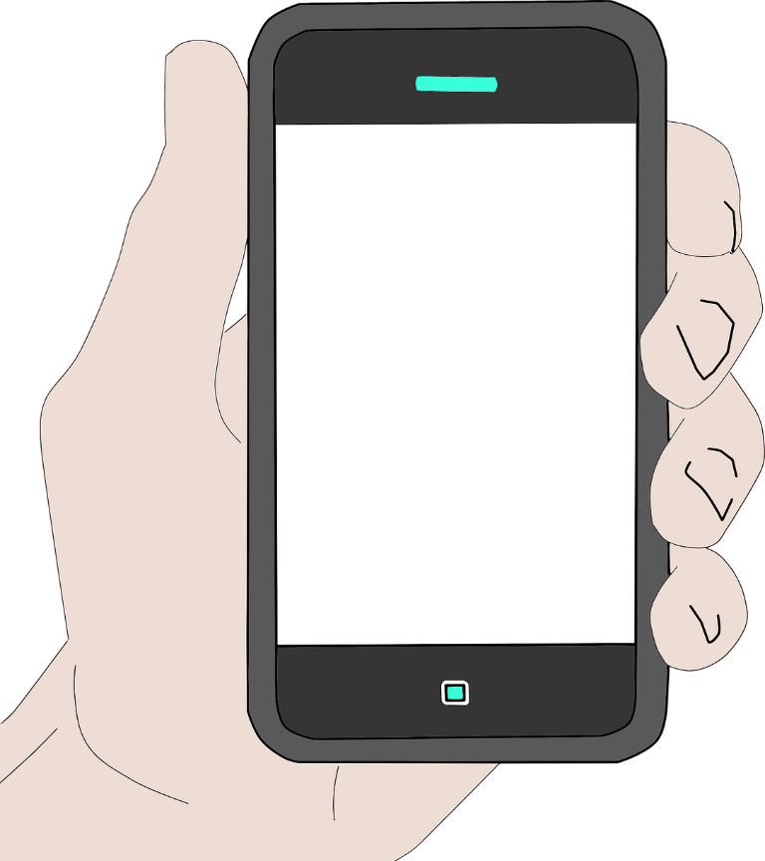
Who can you
talk to?
Police Officer
Police Community Support Officer
Teachers and adults at school
Parents and carers
Family members
Youth workers
Any trusted adult
In an emergency 999
In a non-emergency 101

Slide 25
To stop knife crime, I pledge to…
#NottsAgainstKnives

Slide 26
A reminder..
In today’s lesson we talked about the consequences of carrying a knife and the pressures of social media. We thought about how social media and the desire to be liked by others can sometimes make us make rash and irresponsible decisions.
If you feel worried or anxious about anything we have talked about today, please let someone in school or home know.

Slide 27
What do you know at the end of the lesson?

